Slide 1
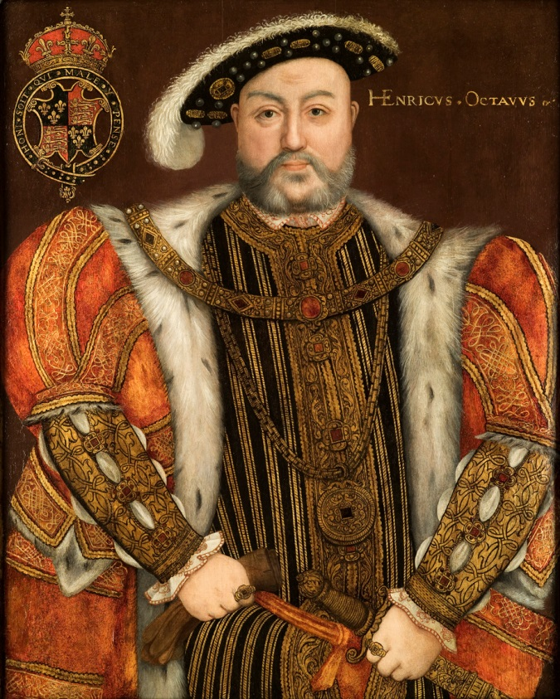
Protestant Ideas Spread to England
Ms. Ha
Reformation Day #3

Slide 2
CONTENT OBJECTIVES: (do not copy)
1. SWBAT: explain how the Reformation influenced
King Henry VIII.
2. SWBAT: explain why King Henry VIII started the
Anglican Church
3. SWBAT: explain why the King beheaded so many
of his wives.

Slide 3
LANGUAGE OBJECTIVES: (do not copy)
1. “I CAN” explain how the Reformation influenced
King VIII of England.
2. “I CAN” explain why the King started the Anglican
Church.
3. “I CAN” identify the reasons why the King beheaded so
many of his wives.
I will be able to do this through discussion, note-taking,
foldable and primary resource readings.

Slide 4
KING HENRY VIII

Slide 5
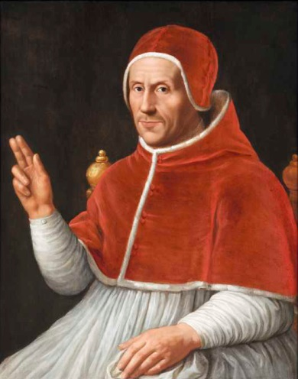
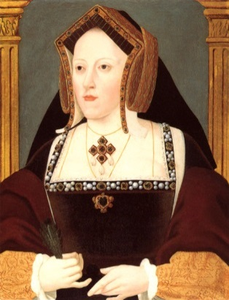
I. King Henry VIII Clement VII
A. Breaks with the Church
1. 1509: Married Catherine of Aragon
a) Spanish Princess
b) Had a daughter / “Mary” / no male heirs
c) Pope Clement VII would not issue
annulment-Catholics said “no” to divorce
d) Catherine asked nephew, Holy Roman
Emperor to stop Henry.

Slide 6
2. Henry had already secretly married Anne Boleyn
a) How to divorce Catherine?
b) Henry VIII appointed a new archbishop of
Canterbury
c) Archbishop: top religious
leader in a Church province
d) New Archbishop: marriage to
Catherine “not legal”

Slide 7
3. In 1534, Parliament (England’s government)
made king head of Church of England
a) New Church: Anglican Church
b) Established by Henry VIII
c) Henry and Anne had a daughter named Elizabeth
d) Henry had Anne beheaded- no boy- now remarry
e) Married Jane Seymour: boy “Edward”
f) Edward would only rule six years: died
g) Mary (daughter of Catherine) : Queen / returns
Church of England to Catholicism.

Slide 8
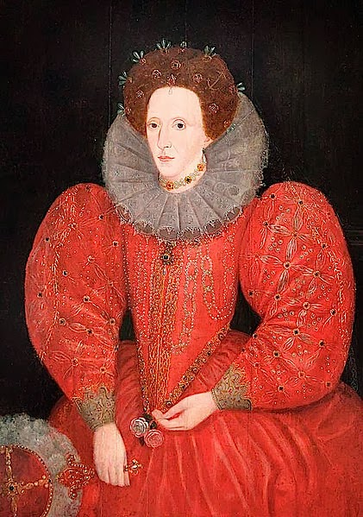
Queen Elizabeth I

Slide 9
4. To strengthen her position, married the Catholic
King of Spain, Philip II.
a) English Protestants hated Elizabeth
b) Queen Mary died in 1558.
c) Half-sister, Elizabeth I would become Queen
d) Try to join Catholics and Anglican Church
e) King/Queen would head Anglican Church
f) Anglican bishops run day-to-day church business

Slide 10
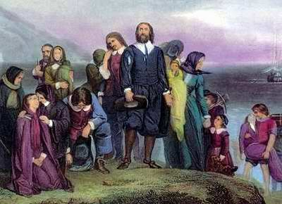
5. Not all Protestants “happy”
a) PURITANS: an English Protestant who wanted to purify
the Anglican Church
b) In the 1600s, some Puritans left England and settled in North
America

