Slide 1
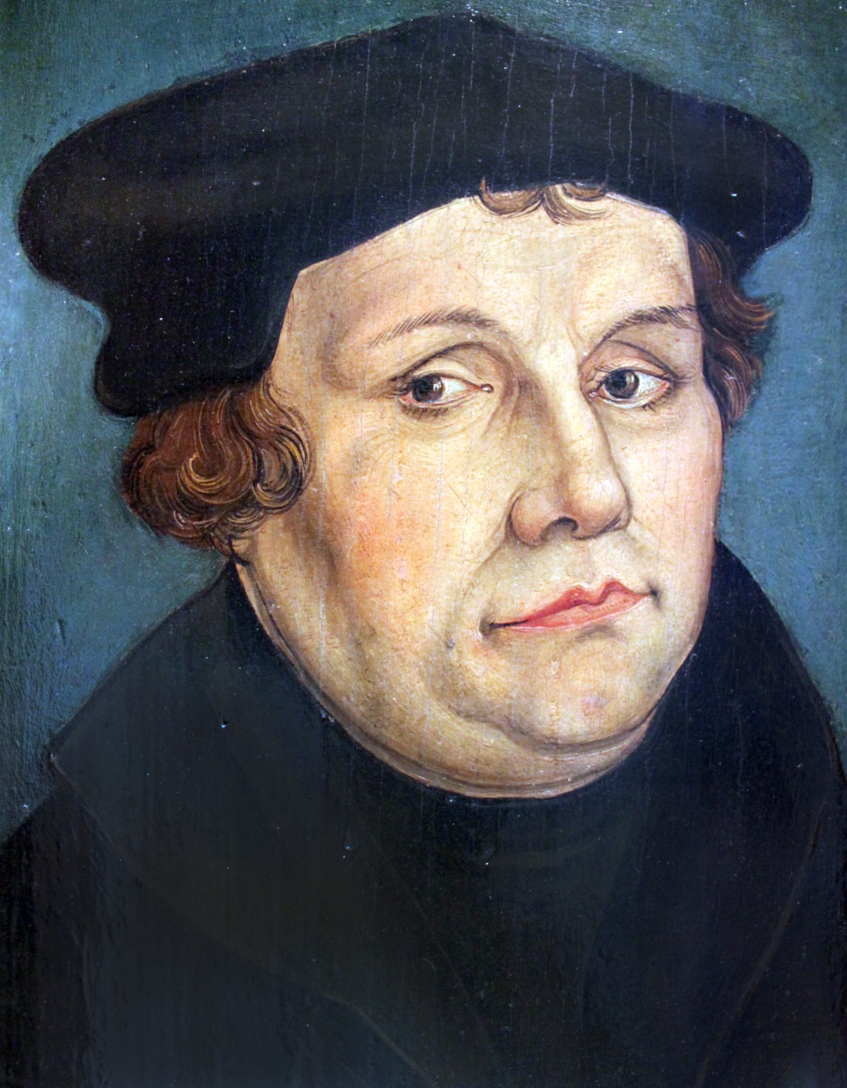
Martin Luther
Ms. Ha

Slide 2
CONTENT OBJECTIVES:
1. SWBAT: explain why Martin Luther
started the Reformation
2. SWBAT: explain the purpose of the
Church in selling indulgences
3. SWBAT: explain why Martin Luther
disagreed with this practice
and how he went about
changing it

Slide 3
LANGUAGE OBJECTIVES
“I CAN” explain why Martin Luther started
the Reformation
“I CAN” explain why the Catholic Church
sold indulgences
“I CAN” explain why Martin Luther tried to
change this policy of selling indulgences.
This will be accomplished through note taking, discussion, reading and a foldable.

Slide 4
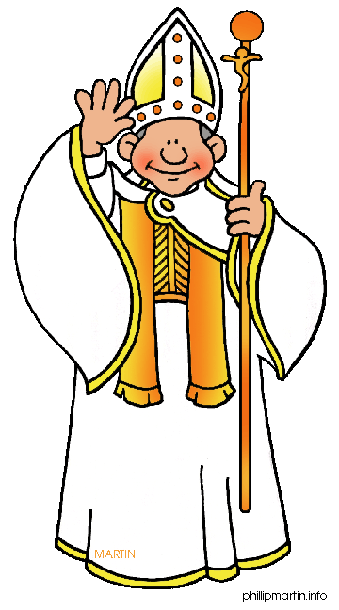
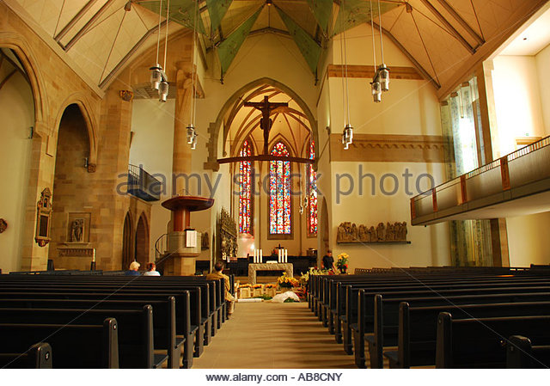
I. Martin Luther
A. He started the REFORMATION:
1. A mass movement that challenged and
changed the Catholic religion in Europe
2. Changed the Church / split

Slide 5
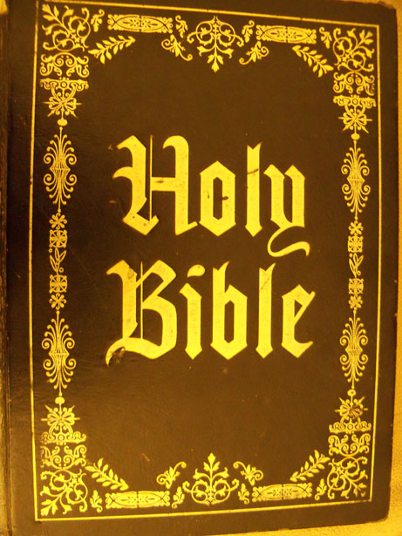
B. What bothered Luther?
1. Salvation: eternal happiness for
one’s soul
2. How did a person achieve this?
3. He found the answer
4. The Bible

Slide 6
C. Luther: win salvation by faith alone
1) Fasting
2) Prayer
3) Religious ceremonies
4) No “guarantee” or promise of salvation

Slide 7
D. Catholic Church stance:
1. People needed to do “good works”
2. They would save their soul
3. Luther’s discovery was his “rebirth”

Slide 8
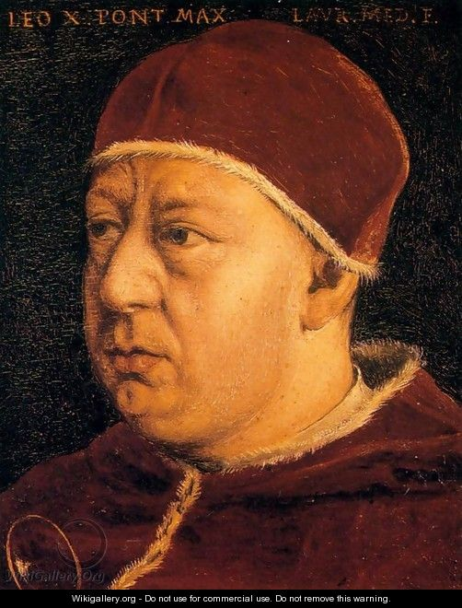
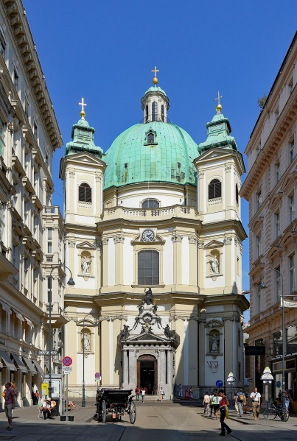
II. Selling Indulgences
A. Pope Leo X (1517) started selling them
1. Papers church gives out
2. “People not punished for sins.”
3. Church: buy indulgences a “good deed”
4. Needed money to build St. Peter’s
Church

Slide 9
B. John Tetzel
1. Monk
2. Buy indulgence, free a friend’s soul
from purgatory
3. PURGATORY: a place of suffering after
death, not in heaven or hell (in between)
4. Tetzel raised lots of $, sent it back to
Church

Slide 10
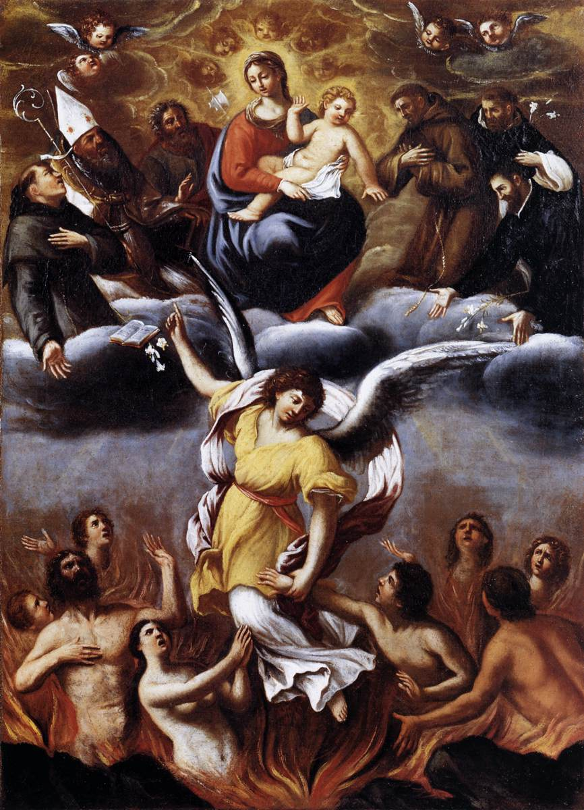
PURGATORY

Slide 11
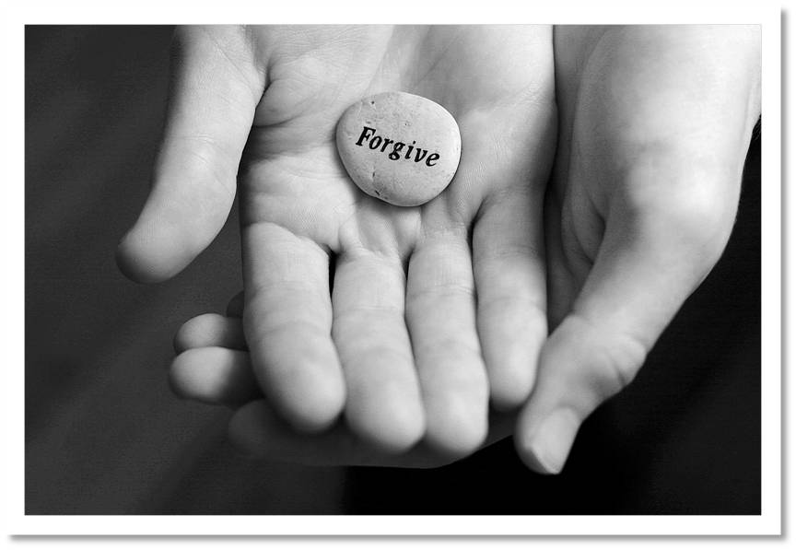
C. Luther disagreed
1. Wrong: could not buy forgiveness for
sins
2. Wrote 95 Theses
3. Thesis: statement or an idea that people
argue about to try to prove

Slide 12
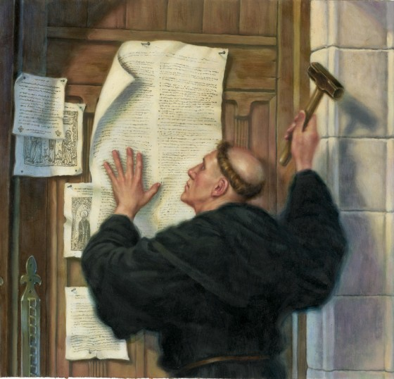
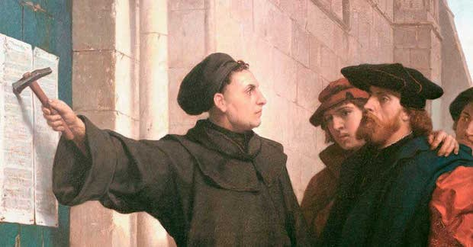
D. October 31, 1517
1. He let others read his ideas
2. Nailed 95 thesis on Wittenberg Church door

Slide 13
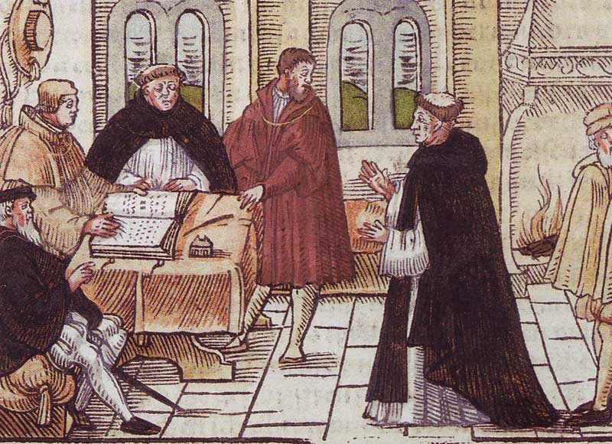
3. Sale of indulgences went down
4. Church lost money and excommunicated
Martin Luther from the Catholic Church

