Slide 1
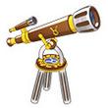
Astronomers & Mathematicians
Ms. Ha

Slide 2
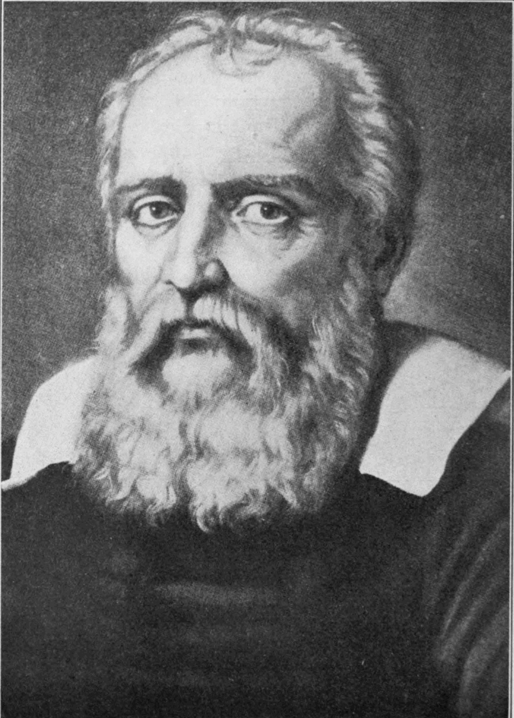
I. Astronomers
A. Galileo Galilei
  1. Born in Italy: 1564
  2. Taught math at University
  3. New lens maker: telescope
  4. Galileo: 1609 built his own

Slide 3
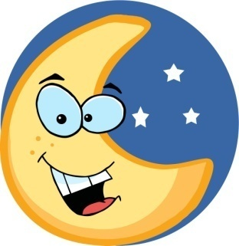

B. What did he discover?
  1. Moon was rough, not smooth
  2. Stared at sun (later lost vision bc of it)
  3. Saw sun, moon and planets were imperfect
  4. (Aristotle said they were perfect, wrong)
  5. Discovered, Jupiter had four moons
  6. Copernicus right, earth NOT center of universe
  (geocentricism)

Slide 4
C. Sun was center of universe (heliocentric)
  1. Problem: the Catholic Church
  2. 1616: Copernicus was wrong / censored work
  3. Challenged the Bible: Earth stays still
  4. Galileo: wrote a book
  5. Church put Galileo on trial for HERESY
  6. Galileo said he was wrong, supposedly said
  after “And yet it (Earth) does move.”

Slide 5
D. Galileo
  1. Gravity makes objects fall at same rate
  2. Aristotle (wrong again)
  3. Galileo: “father of experimental science”
  a. Use careful experiments
  b. Use measurements

Slide 6
II. Isaac Newton
A. Born in England in 1642
    Same year Galileo died
    Two important discoveries by Newton
      White Sunlight is a mixture of colors
      Why objects certain color
      “red” object red because it reflects red light and absorbs all other colors
      Object absorbs colors, soaks them up, disappear from our sight
      PRISM: 3 sided object, used light to pass through

Slide 7
B. Other Newton discoveries
  1. Knew planets orbited the sun
  2. What held planets in their orbits?
  3. Gravity: force in the universe
  4. Earth attracts falling objects
  5. Gravity: force that attracts everything together
  6. Result: sun’s strong gravity kept planets orbiting
  traveling in their orbits.

Slide 8
C. Newton’s Universal Law of Gravitation
  1. Gravity caused different types of motion
  2. Prediction patterns in gravity
  3. SCIENTIFIC LAW: predictable pattern in science
  4. UNIVERSAL: apply to the whole universe
  5. Copernicus, Kepler, Galileo: planets orbit sun
  6. Newton: gravity kept them in their orbits
  7. Book: said universe was orderly and logical
  8. Newton: genius. Died in 1727 Age of 85

Slide 9
III. Other Scientists
A. Andreas Vesalius
  1. Belgian doctor
  2. Studied ANATOMY: structure, of the human body
  3. Secretly dissected dead bodies / church “no”
  4. 1543: published his findings
  5. Thousands of careful drawings
  6. Vesalius: found heart had NO bone

Slide 10
B. William Harvey (early 1600s)
  1. English doctor
  2. BLOOD VESSEL: tube in the body that blood passes
  3. Found: heart is a “pump” that circulates (moves) blood (Until then, doctors thought blood did not move)
  4. 1628: Harvey publishes his findings
  5. Amber: hard, yellowish liquid comes out of trees

Slide 11
C. Benjamin Franklin 1752
  1. Studied electricity
  2. Static electricity builds up in something
  3. Objects rub together, electricity escapes
  4. Proved theory: metal key tied to kite / lightening. Metal key sparked
  5. Later develop a lightening rod to protect buildings and trees

Slide 12
D. Mathematics
  1. Use of symbols to represent
    a. Addition +
    b. Subtraction –
    c. Mulitiplication x
    d. Division */*

Slide 13
E. Telescope
  1. Observe and measure the natural world
  2. 1590s, Dutch maker of eyeglasses made it
  3. 1674: Anton van Leeuwenhoek 270x magnification
  4. Leeuwenhoek: first person to see one-celled animals
  5. Christian Huygens: type of first clock
  6. Thermometer: Gabriel Fahrenheit and Anders Celsius

