Slide 1
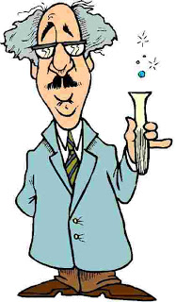
SCIENTIFIC REVOLUTION
Ms. Ha

Slide 2
CONTENT OBJECTIVES:
1. SWBAT: explain how scientists gathered their
information before the 1500s.
2. SWBAT: explain how the Scientific Method
revolutionized the scientific field.

Slide 3
LANGUAGE OBJECTIVES:
1. “I CAN” explain how scientists gathered
knowledge before the 1500s by taking
notes.
2. “I CAN” explain how the Scientific Method
revolutionized the scientific field by taking
notes, reading a primary resource and
examining a scientific experiment.

Slide 4
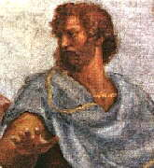
I. Development of modern science
A. Before 1500, how did scientists know what
was true or false?
1. Research the Bible
2. Read about Greek and Roman writers
3. Aristotle (philosopher) very well respected

Slide 5
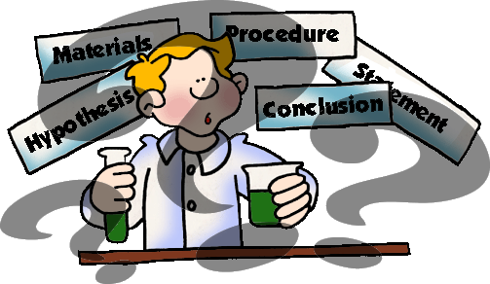
B. Word “science”
1. Latin word: “to know”
2. Science: way to find out the truth

Slide 6
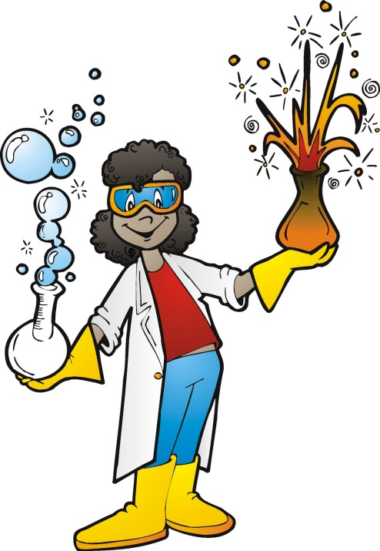
C. SCIENTIFIC METHOD
1. A set of steps to follow to reach a true end
a) METHOD: way of doing something
b) EXPERIMENT: heart of scientific method

Slide 7
2. The experiment, or test, gives an answer
3. Leonardo da Vinci: “born of experiment, the
mother of certainty.” 1500’s / new idea

Slide 8
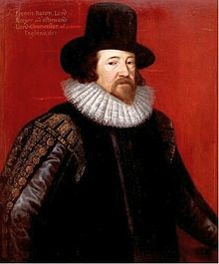
D. Five steps of the Scientific Method
1. Created by Francis Bacon
2. 1620s: Englishman

Slide 9
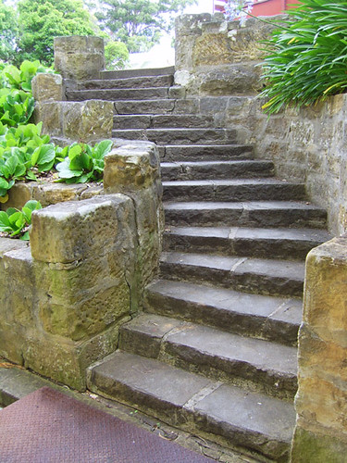
II. Scientific Method
A. Five Steps
1. Ask a question
2. Scientist makes a guess on what is already
known= hypothesis
3. Experiment is performed
4. Observation and notetaking
5. Scientist draws a conclusion=answer, from notes

Slide 10
Steps to the scientific method

