Slide 1
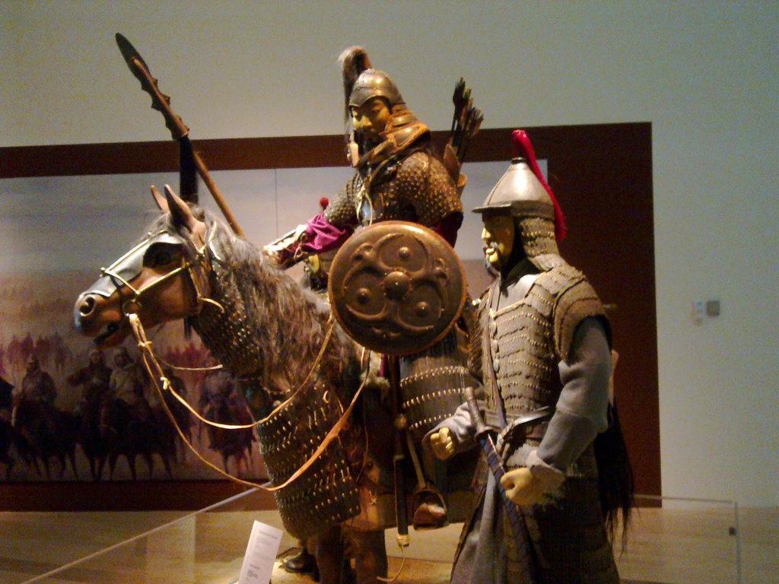
The Mongols
Ms. Ha
Chapter 12
Section 2

Slide 2
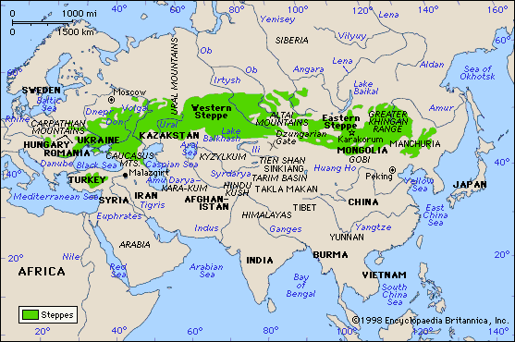
I. The Mongols
Nomadic tribe
1. Lived on the Asian Steppe
a. Vast (large) grassland
b. Varies in degrees from –57
degrees to +96 degrees

Slide 3
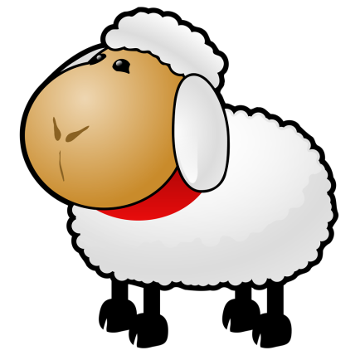
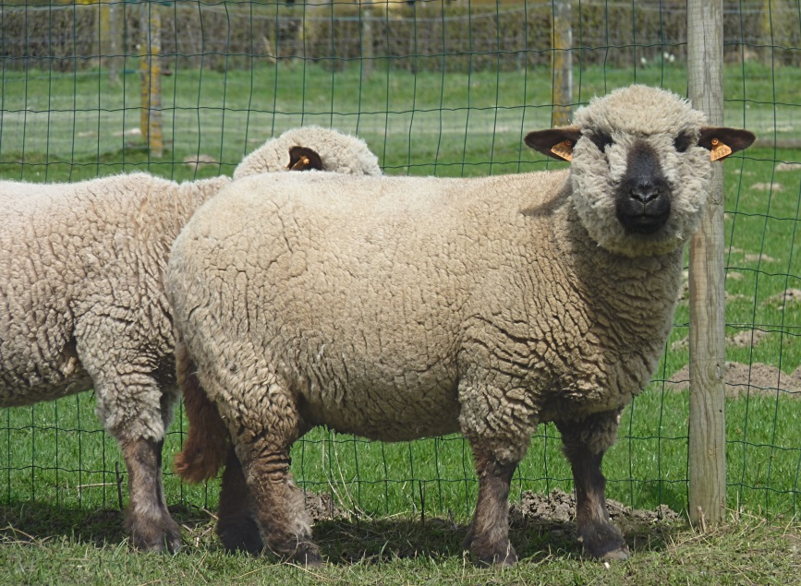
2. Nomads: travel, no permanent settlement
a) Pastoralists: herded domesticated animals
b) In search of good pastures
c) Sheep were most common
d) Used for wool and meat

Slide 4
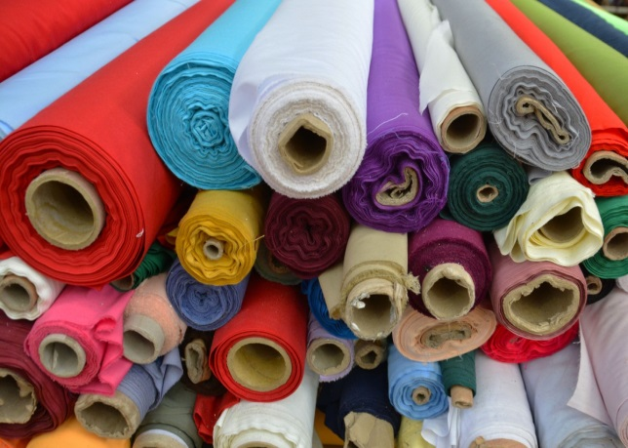
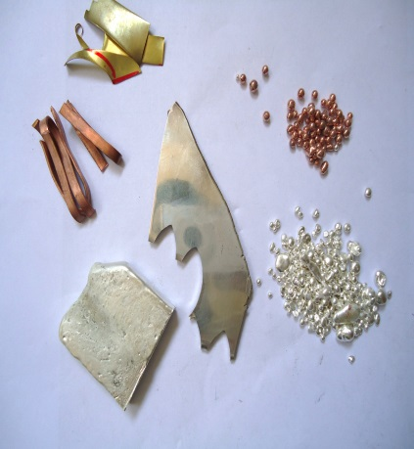
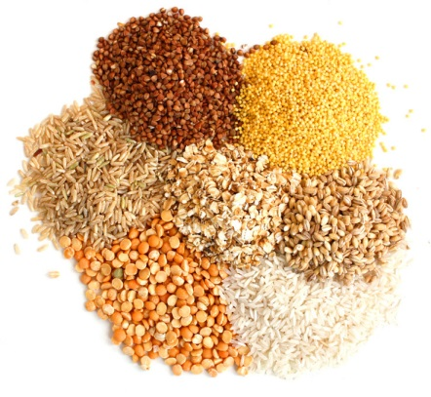
3. Nomads traded horses for:
a) Grain
b) Metal
c) Cloth
d) Tea

Slide 5
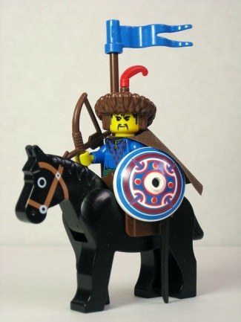
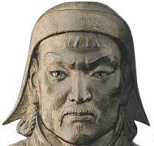
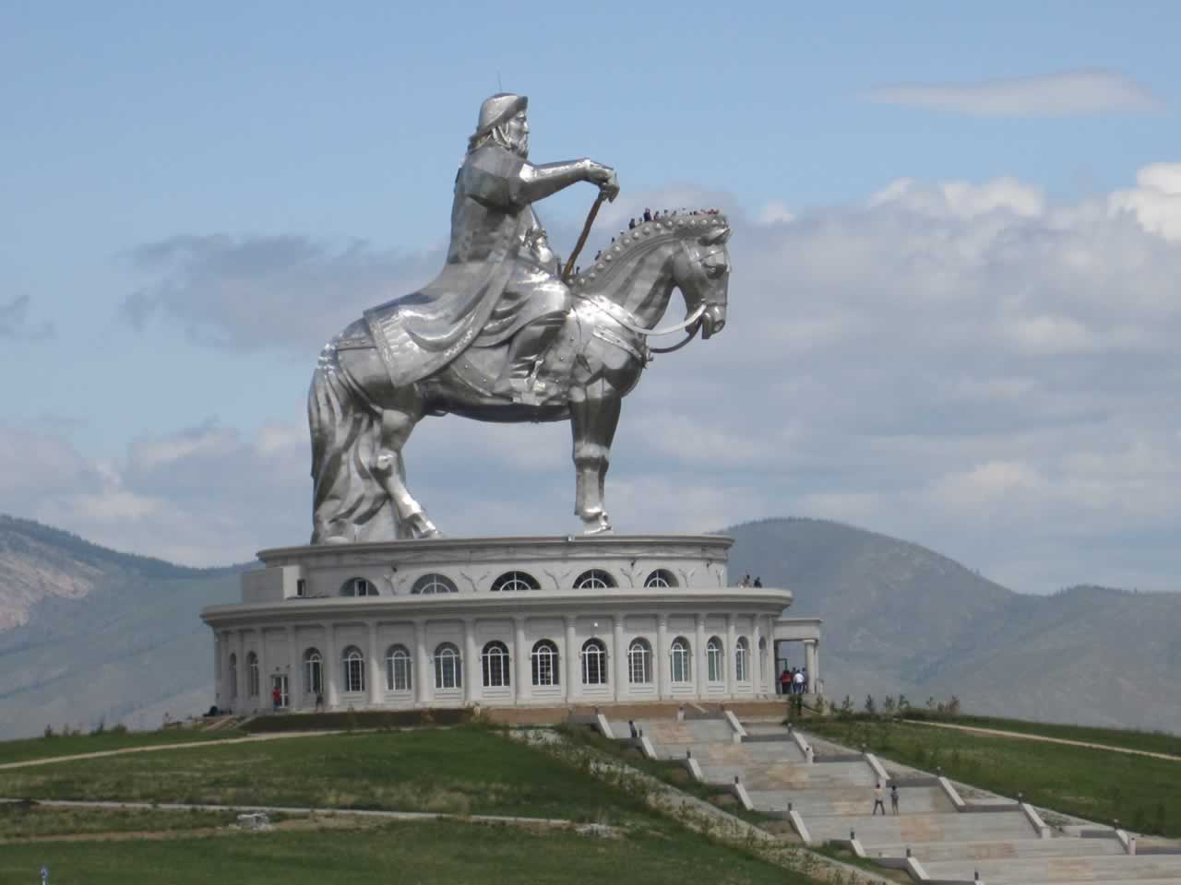
II. Genghis Khan “Universal ruler”
Mongol: Temujin “steel” (He was Genghis Khan)
1. Rise up from poverty / noble birth
2. Rule the Mongols until death of illness in 1227
3. Estimated 40 million killed / ruthless
4. Fair to those he conquered
a) No enforced beliefs on them
b) Mongols even adopted cultures of others

Slide 6
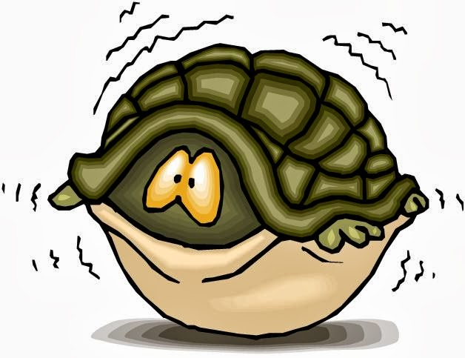
B. Genghis the Conqueror
1. Brilliant Organizer
2. Great Strategist: used tricks
3. Used cruelty as a weapon
a) Kill entire villages / No survivors
“In the countries that have not yet been overrun by them, everyone spends the night afraid that they may appear there too.” – Arab Historian

Slide 7
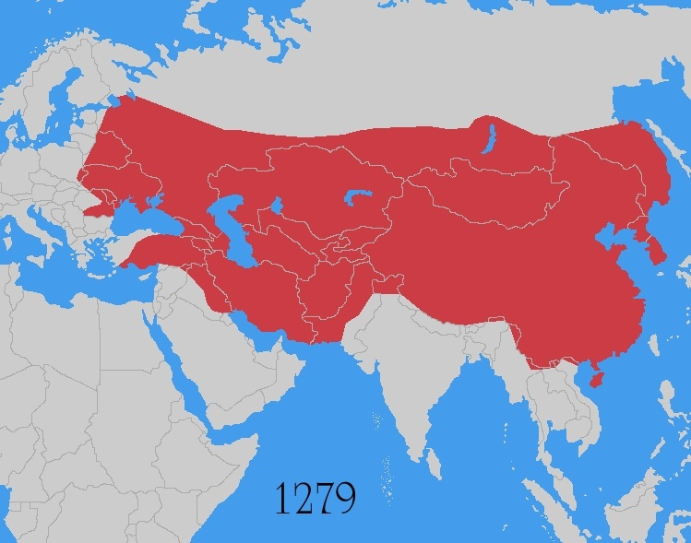
4. Under Genghis Khan, less than 50 years
a) Conquered land from China to Poland
b) His sons/grandsons took over after his death
c) Went as far as the Adriatic Sea (by Italy)
d) Split region into four regions, weakened
e) Split due to cultural differences

Slide 8
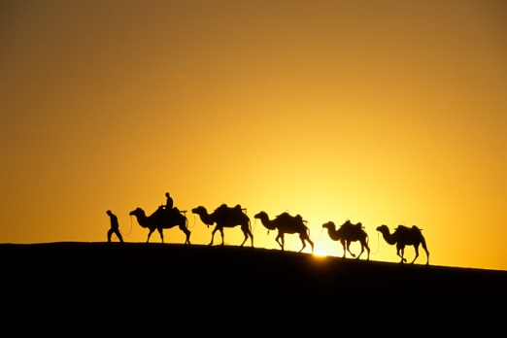
III. Impact of Genghis khan
Negative
1. Many areas never recovered
2. Irrigation systems in Mesopotamia ruined
Positive
1. Did not push beliefs on those conquered
2. Adopted some of the cultures of the conquered
C. Peace: Pax Mongolica
1. Mongols guaranteed safe passage
2. Trade caravans, travelers, missionaries

Slide 9
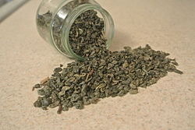
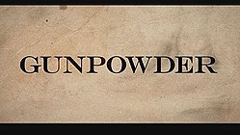
IV. Trade
Europe and Asia: very active in trade
1. Ideas and Inventions- abundant
2. Gunpowder reached Europe
3. Possible Bubonic Plague: spread along
trade routes
4. “Black Death”

