Slide 1
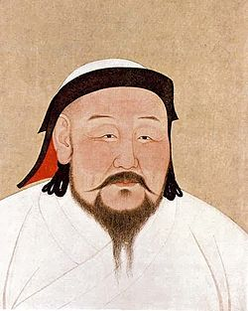
Mongol Empire
Ms. Ha
Chapter 12
Section 3

Slide 2
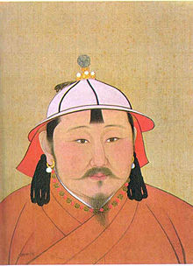
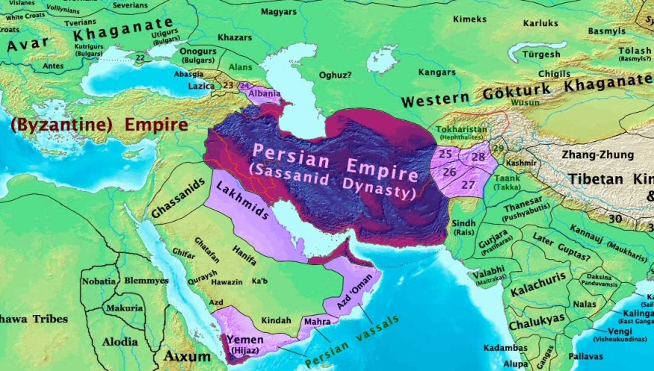
I. Kublai Khan
A. Grandson of Genghis Khan
1. In power in 1260
2. Empire split into four regions
or khanates
a) Central Asia
b) Persia
c) Russia

Slide 3
3. Kublai Khan: expand his khanate
a) Already had Mongolia, Korea, Tibet, and
northern China
b) GOAL: conquer all of CHINA (Genghis
Khan’s wish)

Slide 4
4. China fought hard
a) Never had a foreigner rule whole country
b) Kublai Khan won & did control it
c) Yuan (yoo.AHN) Dynasty was started

Slide 5
5. Success of the Yuan Dynasty
a) Kublai Khan united China- 1x =300 years
b) Mongol control left China open to
foreign contacts and trade
c) Mongols tolerated Chinese culture and
made few changes to government

Slide 6
II. Mongol Rule in China
A. Chinese/Mongols- little in common
1. Mongols kept separate identity
2. No Chinese allowed high in government
3. Felt no loyalty would be given
4. Mongols or foreigners took those jobs

Slide 7
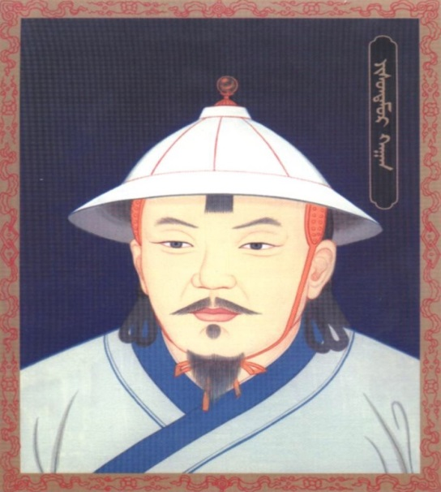
B. Kublai Khan
1. Able leader
2. Viewed as one of best from Chinese
3. Why? Unification of China
4. New capital at Beijing
5. Not from Mongolia / make mark as
emperor of China

Slide 8
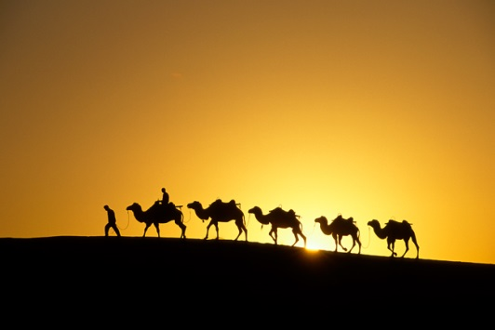
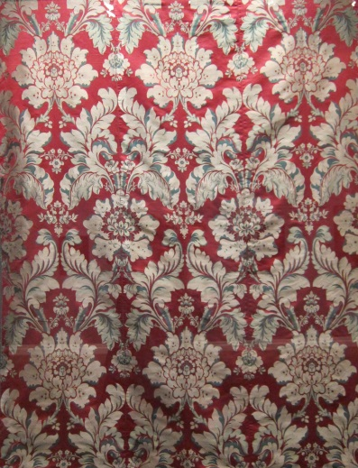
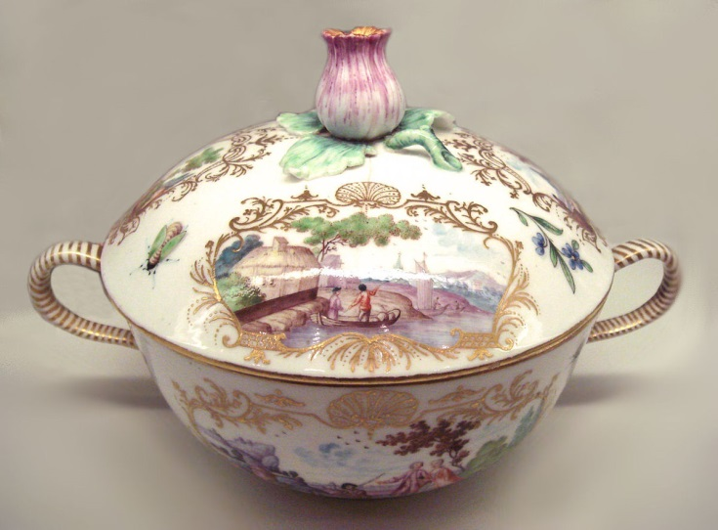
C. Foreign trade increased
1. Traders: transported Chinese silk &
porcelain
2. Valued in Europe and western Asia
3. Traveled over Silk Road

Slide 9
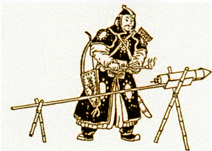
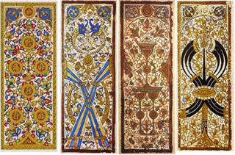
D. Traders carried Chinese inventions
1. Printing
2. Gun Powder
3. Compass
4. Paper Currency
5. Playing Cards

Slide 10
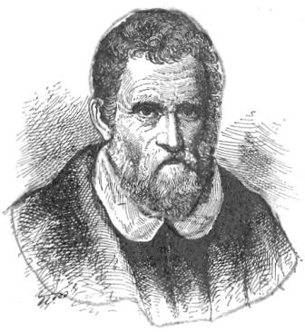
III. Marco Polo
A. Worked for Kublai Khan
1. Spoke several languages
2. Traveled silk road with father & uncle
3. 17 years he worked for him
4. Left China in 1292
5. Book written of his travels
6. Fascinating tails

Slide 11
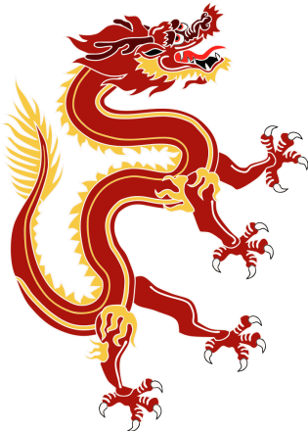
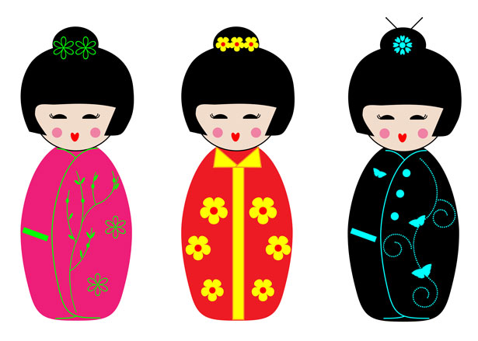
IV. Mongol Empire Declines
A. Kublai Khan died in 1294
1. Rulers after squabbled
2. Chinese rebellions broke out
3. Chinese wanted to get rid of Mongols
4. Mongol rule failed
5. Mongols had also failed to take over
Japan

