Slide 1
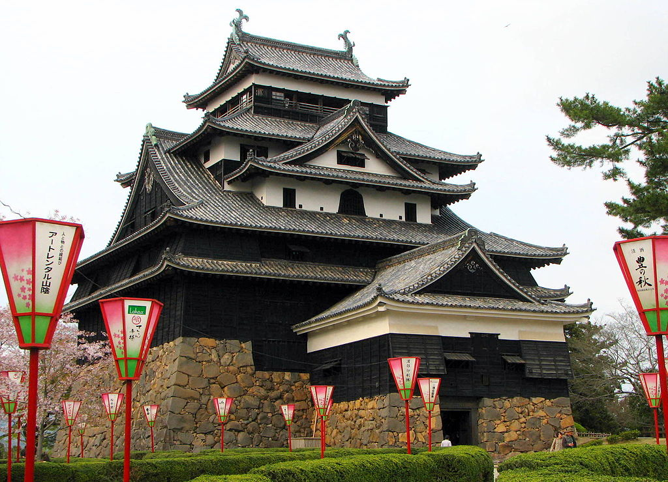
Feudal Power in Japan
Ms. Ha

Slide 2
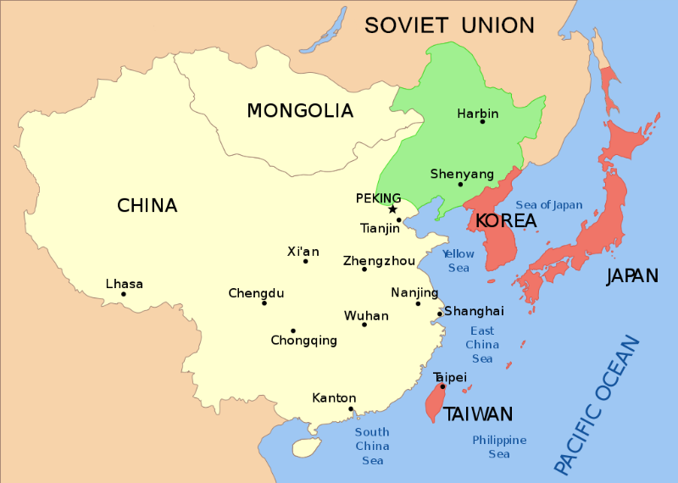
I. Japan
A. Geography
1. 150 miles from land
2. 500 miles East of China
3. Islands: 4,000
4. Four main islands

Slide 3
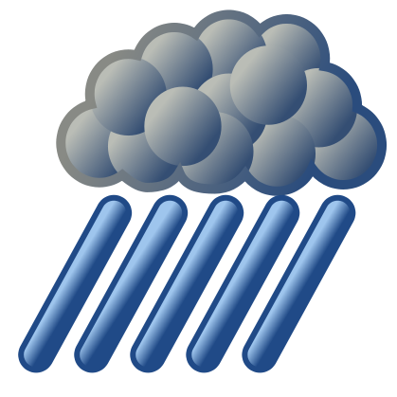
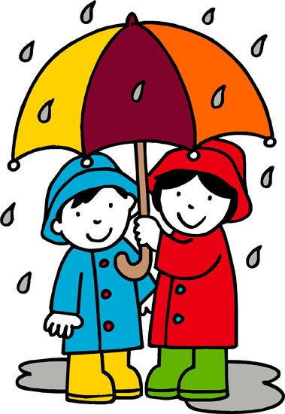
B. Area
1. Mild climate
2. Plenty of rainfall
3. Mountainous (12% used for farming)

Slide 4
II. Early History
A. Japan not unified
1. Hundreds of clans
2. Shinto: “way of Gods” / earliest religion
a) Respect forces of nature
b) Worship ancestors
c) Kami: divine spirits that were in nature

Slide 5
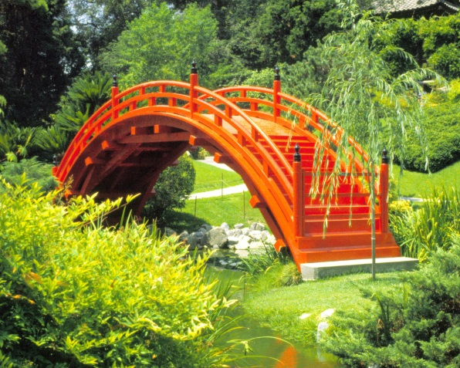
B. Influenced by Chinese ideas and customs
1. Adopted Buddhism
2. Adopted Chinese system of writing
3. Everyday life
a) Cooking
b) Gardening
c) Drinking Tea
d) Hair styles

Slide 6
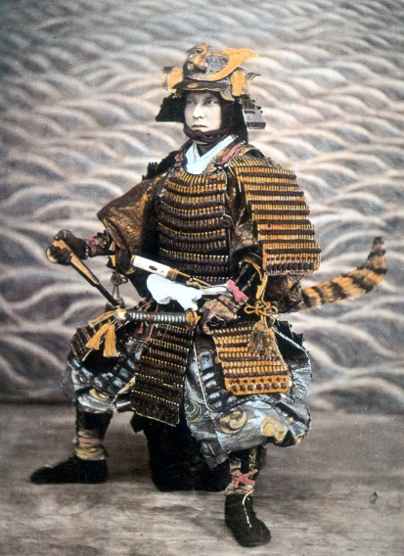
C. Mid- 11th Century
1. Large landowners set up private armies
2. Constant war of land control
3. Samuri Warriors
a) Bodyguard of loyal warriors to lords
b) Samurai means “one who serves”
c) Code of Behavior: Bushido (BUSH.ih.DOH)
d) Courage / reverence for gods / fair / generous / die with honor

Slide 7
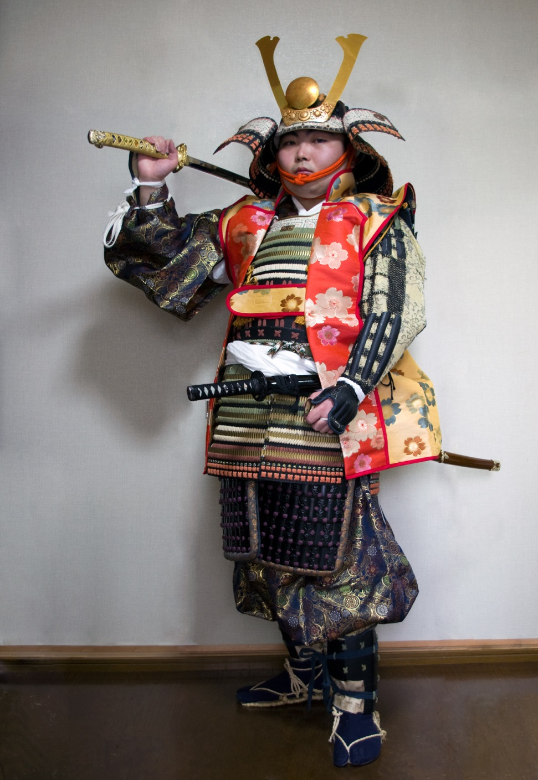
SAMURAI

Slide 8
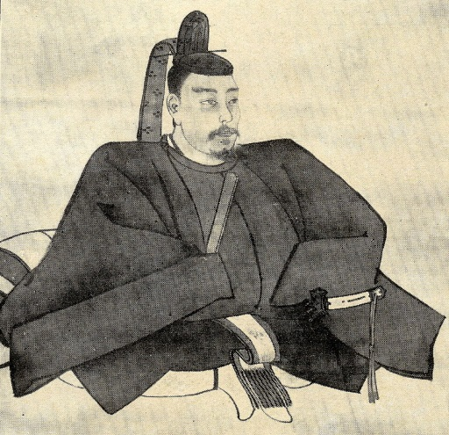
III. Kamakura Shogunate
A. Late 1100’s, two clans fought
1. Winner: Minamoto leader named Yoritomo
2. Title: SHOGUN “supreme general of the emperor's army”
3. “Military Dictator”
4. Japanese victory over Mongols under Kublai Khan
a) Fought them off in 1274 & 1281
b) Loyal samurai were not paid $, bitter
c) Samurai aligned with local lords
d) Local lords fought hard over land

