Slide 1
Chinese Innovations
Ms. Ha

Slide 2
Content Objective:
1. SWBAT: explain how inventions helped to
make China the most advanced
country.
2. Language Objective:
“I CAN” identify and explain the inventions
that helped to make China the most
advanced country of its time under the
Tang and Song Dynasties.

Slide 3
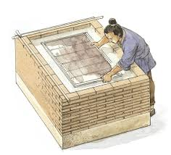
I. Chinese invent paper
A. Invented in AD 105.
1. Under the Han Dynasty
2. Hans ruled for 400 years
3. Books had been written on silk ($)
4. Get books easier in paper

Slide 4
B. Education
1. More books
2. People better educated
3. Government used paper
4. Maintain records easier

Slide 5
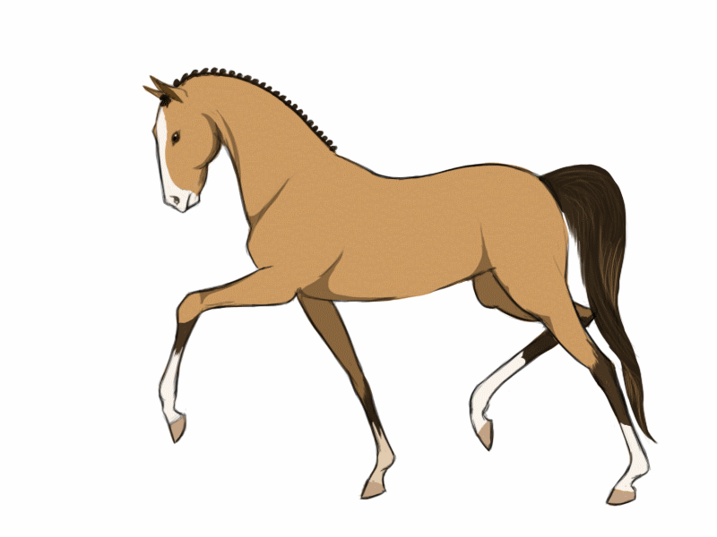
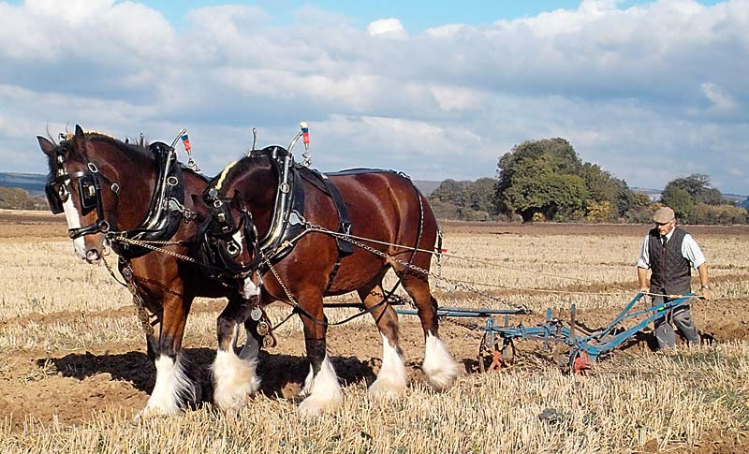
C. Another innovation
1. Collar harness for horses
a) Horses could pull heavier
loads
b) Better than one in Europe

Slide 6
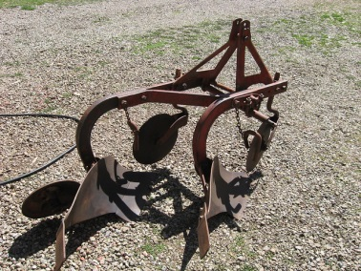
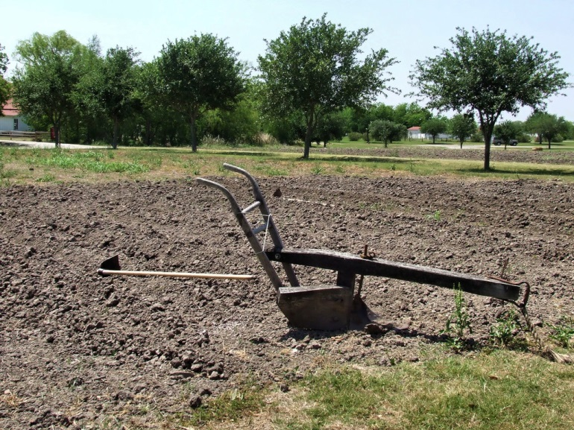
D. Two-bladed metal plow
1. More efficient: metal
blades
2. Two blades

Slide 7
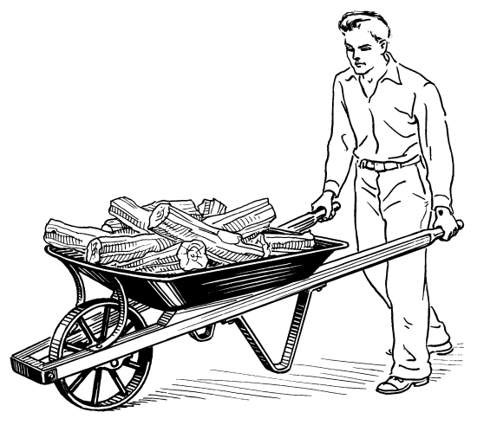
E. Invented the wheel barrow
1. Used in the creation of the
Great Wall
2. Bring supplies to work
sites (Great Wall)

Slide 8
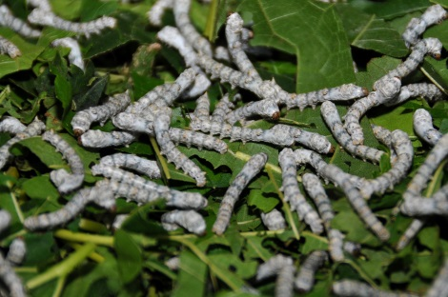
F. Silk production
1. Closely guarded secret
2. Worldwide demand for silk
3. Trade: The Silk Road to
Middle East/Europe

Slide 9
II. Han Dynasty Falls
A. Fell in AD 220
1. No one strong enough to rule for 30 years
2. Rose: Tang Dynasty & Song Dynasty
3. Tang will expand China
4. By AD 589, Emperor Wendi
5. Starts a Golden Age of China
6. Richest and most powerful & advanced
country in the world

