Slide 1
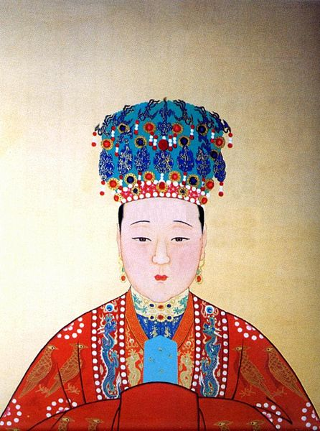
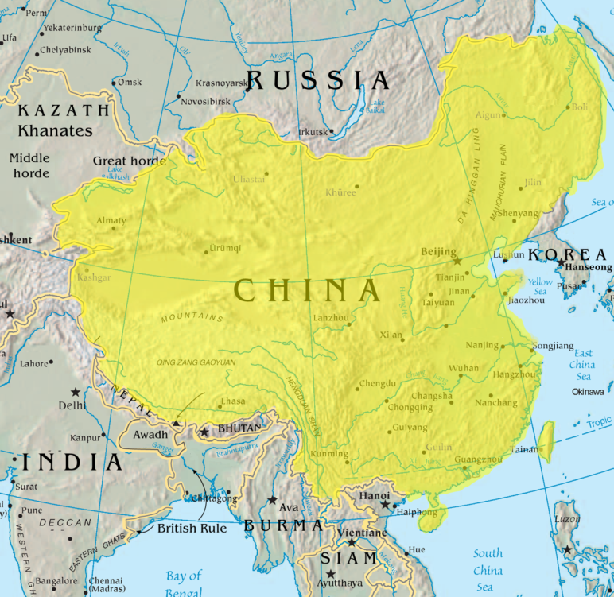
Chinese Dynasties
Ms. Ha
China
Day #2

Slide 2
Content Objective:
SWBAT: trace the earliest dynasties that helped China flourish as it grew.
LANGUAGE OBJECTIVE:
“I can” explain how the earliest dynasties contributed to how China flourished for 2,000 years by listening, writing and discussing our notes today.

Slide 3
I. China’s First Dynasty
A. Xia (Shah) 2000-1500 BC
1. Little known
2. Overthrown in 1500 BC

Slide 4
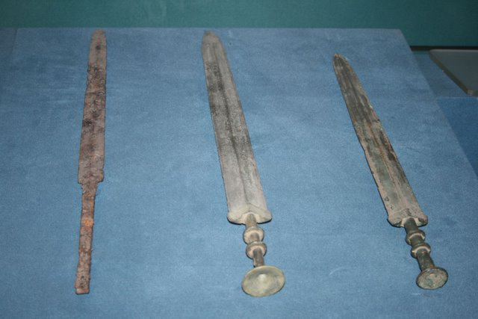
B. Shang Dynasty came to
power
1. Artists
a) Beautiful figures
b) Religious objects
c) Weapons from
bronze

Slide 5
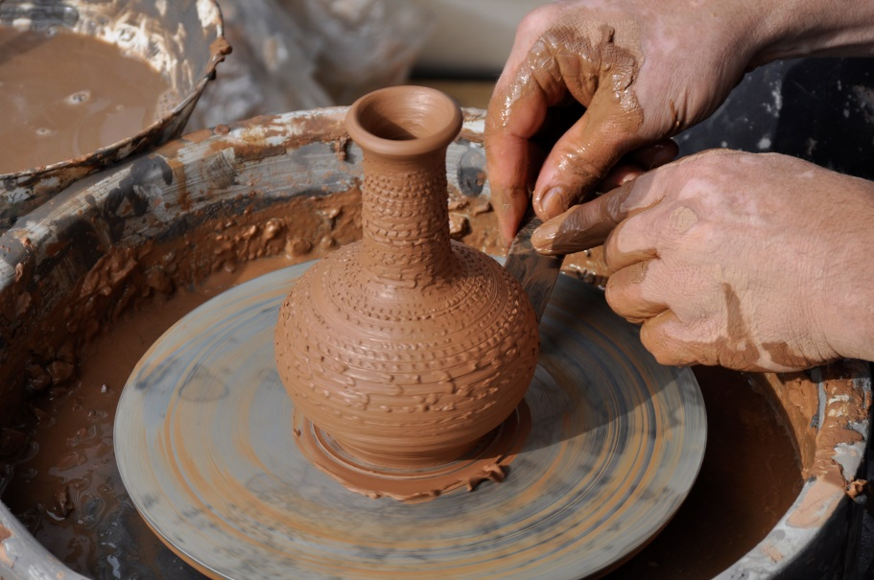
2. Two great inventions:
a) Potter’s Wheel: shaped clay into
useful objects
b) Characters for writing: developed here

Slide 6
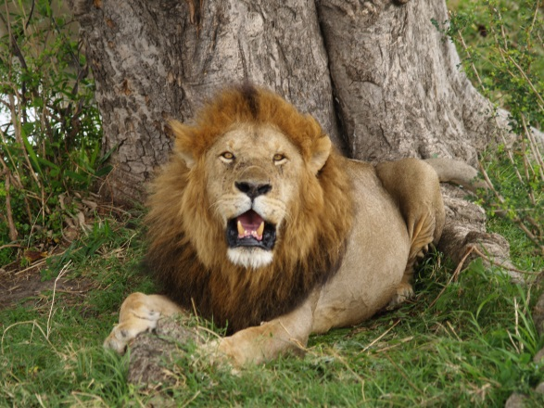
3. Shang dynasties: cruel rulers
4. Human + animal sacrifices
5. Used cruel games & torture to
amuse
6. Driven out after several hundred
years

Slide 7
II. Zhou (jah) in western China
A. New dynasty
1. Duke Fa: famous fighter
2. He drove out the Shung
3. Took the name: Wu Wang
4. FIRST: Warrior King 1100 BC

Slide 8
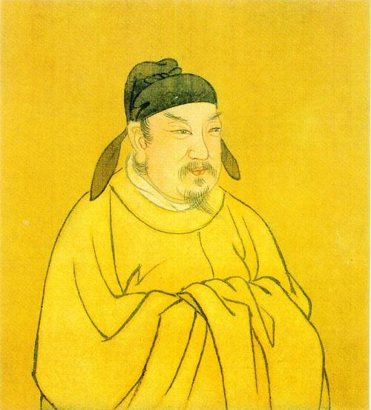
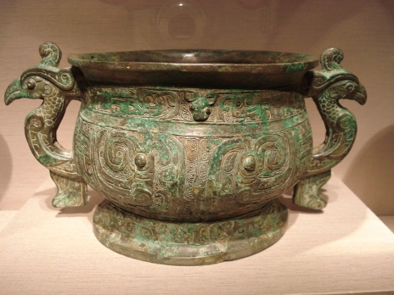
B. Zhou Dynasty
1. LONGEST in Chinese history
2. Lasted from 1100 BC to around 256 BC
3. Size of China expanded
4. From Seacoast in East to Chang River
Valley in South

Slide 9
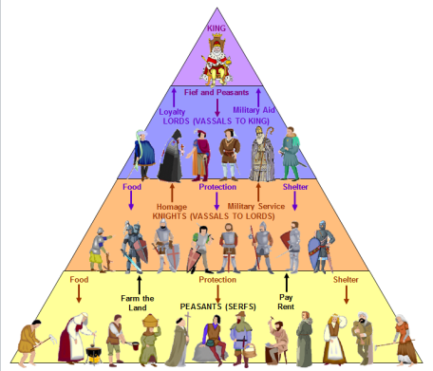
C. Problem: Zhou were strong warriors
but weak rulers
1. Feudal System developed
2. (Used in Europe 1,000 years later)
3. Small kingdom given to friends + trusted
military leaders
4. Nobles, owed allegiance to ruler
5. Life revolved around war, prep for war

