Slide 1
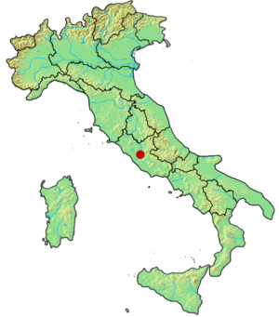
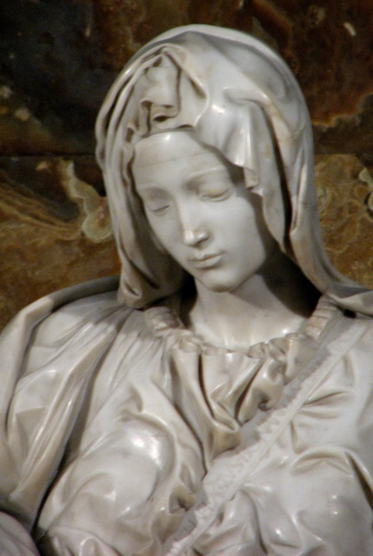
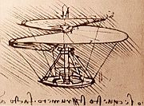
Renaissance Men By: Ms. Ha

Slide 2
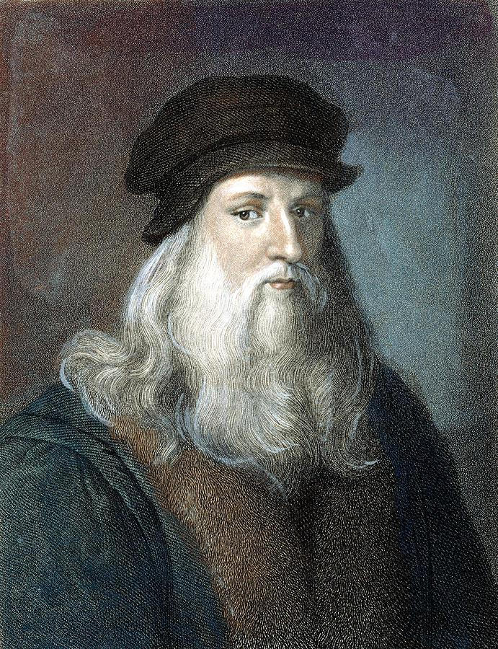
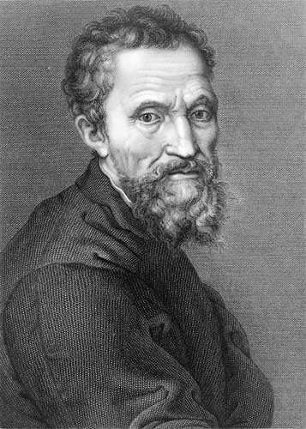
THE Renaissance Men
LEONARDO DA VINCI
MICHELANGELO

Slide 3
CONTENT OBJECTIVES:
1. SWBAT: compare and contrast the
great Renaissance artists Leonardo
da Vinci and Michelangelo.
2. SWBAT: to identify and explain two
major works of art from each of
these Renaissance artists.

Slide 4
LANGUAGE OBJECTIVES:
1. “I CAN” compare and contrast the great
Renaissance artists Leonardo da Vinci and
Michelangelo by taking notes, looking at
pictures and using class discussion.
2. “I CAN” distinguish the different works of art
through pictures, class discussions and a
foldable.

Slide 5
I. Leonardo da Vinci
A. Background
1. Poor upbringing
2. Father put him into training
at a young age
for artwork

Slide 6
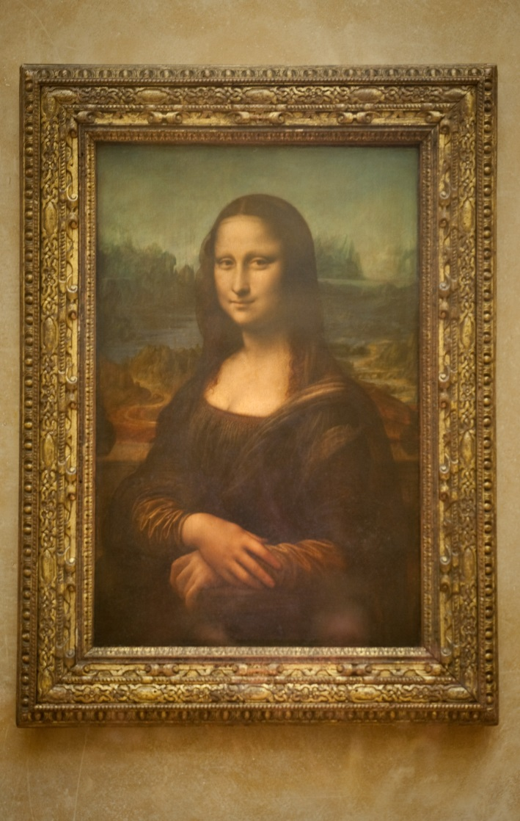
B. Two best pieces of work
1. The Mona Lisa
a) Famous painting
b) PORTRAIT: a drawing
of a person
c) PATRON: person who
supports an artist with
money
MONA LISA

Slide 7
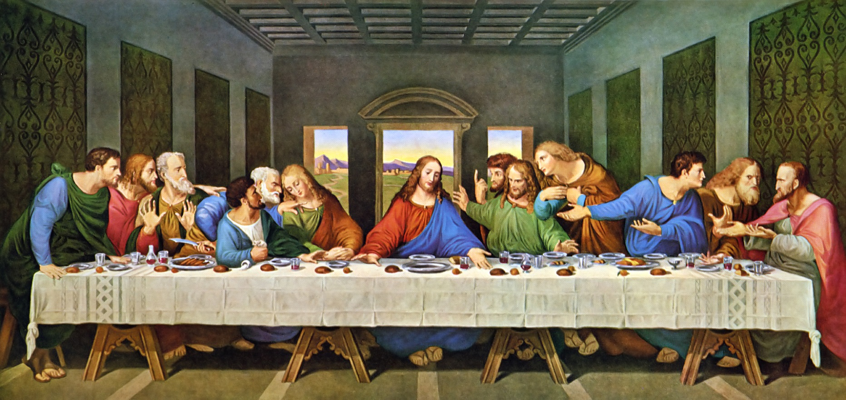
c. Leonardo: second piece
1. “The Last Supper”
2. Jesus of Nazareth eating with disciples the
night before he was executed

Slide 8
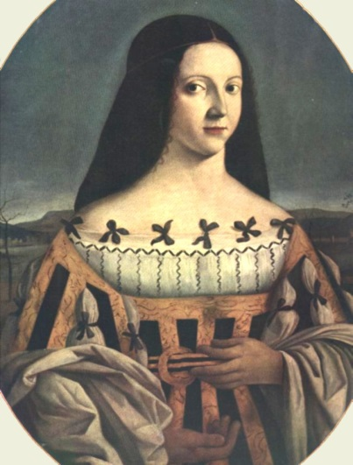
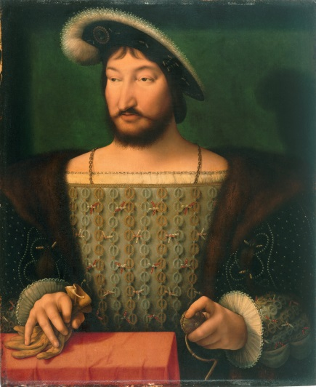
3. FRESCO: a painting done in wet plaster on a wall
4. The Last Supper: painted in wet plaster
a) PLASTER: a mixture of sand, water, and lime
that gives a smooth finish to a wall.
b) Famous patrons: Beatrice d’Este and king of
France, Francis I

Slide 9
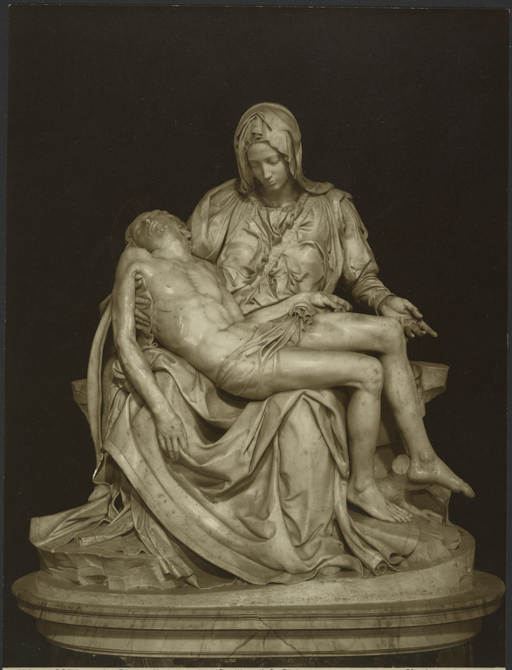
II. Michelangelo
A. Born near Florence in 1475
1. Always a sculptor first
a) Lorenzo de Medici helped him
b) First masterpiece: Pieta
c) Means “pity”
d) Mary holding her dead son Jesus

Slide 10
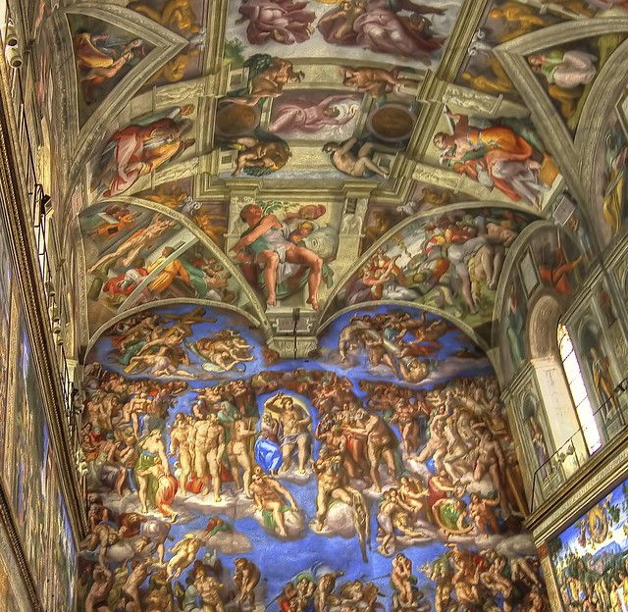
B. Sistine Chapel
1. He was asked to
paint ceiling of
Vatican in Rome
2. Sistine Chapel:
small Church
3. Vatican:
Pope lives
4. Bible Stories:
Creation to
Flood

Slide 11
QUICK FACTS: true or false
1. The Sistine Chapel ceiling took 22
years to paint.
2. There are over 300 figures on the
ceiling.
3. Some figures are over 10 feet tall.
4. Michelangelo painted by candle
light.

