Slide 1
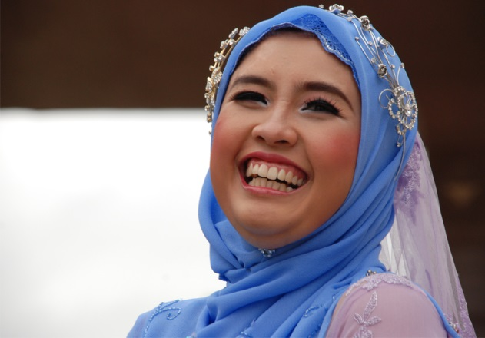
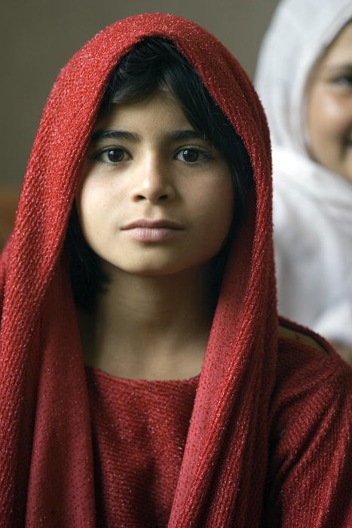
Islam Women & Trade
Ms. Ha

Slide 2
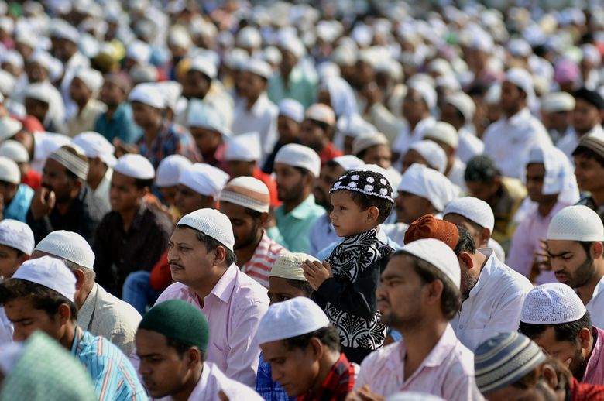
I. Muslim Society
A. Islam
1. Set guidelines for way people live
2. Rules for family life, business &
religious practices

Slide 3
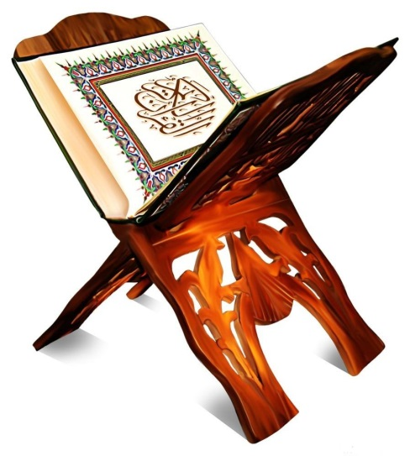
B. Family Life & Role of Women
1. Equality for all believers
before God
2. Quran: men are responsible
for women

Slide 4
3. Role of women improved
4. Men limited to four wives
(polygamy)
a. Be fair to all four wives
b. Be kind to them all

Slide 5
5. Rights of women
a. Women controlled their own
property
b. If divorced, she kept property
she had
c. She could inherit property from
father
d. She could remarry

Slide 6
6. Women & Education
1. Many learned to read and write
2. Women at home: household tasks
3. Shop and go to mosque on Friday

Slide 7
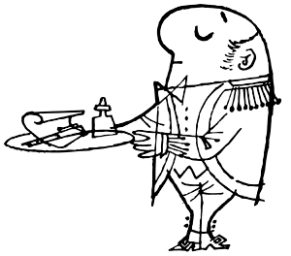
7. Married women entitled to:
a. Own rooms
b. Servants

Slide 8
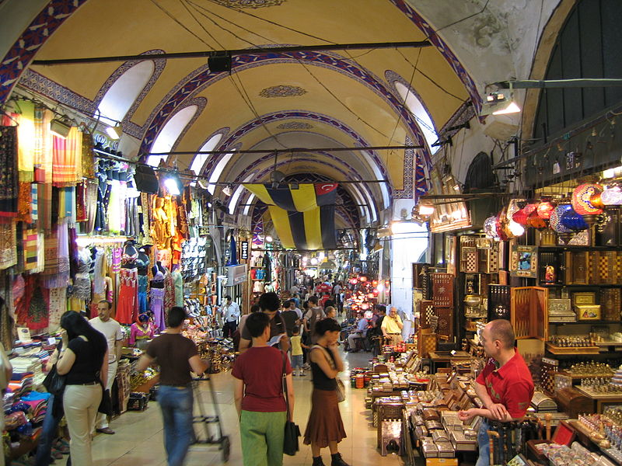
II. Trade & the Bazaar
A. Muslim merchants dominated trade throughout
The Middle East & North Africa until A.D. 1400’s
1. Caravan travel: Baghdad to China
2. Muslim traders: Rubies from India / Silk from China
& spices from Southeast Asia
3. From Africa: gold, ivory, and enslaved people
4. Islamic world sent: spices, textiles, glass and
carpets
5. Bazaars: marketplaces

