Slide 1
AMERICA
IN THE FIFTIES

Slide 2
RETURNING HOME

Slide 3
IT’S 1945, AND WORLD WAR II IS OVER!
the US is euphoric over its victory in the war
the US has established itself as the world’s superpower
the peace won, 10 mil Americans came home to rebuild their lives

Slide 4
post war
america

Slide 5
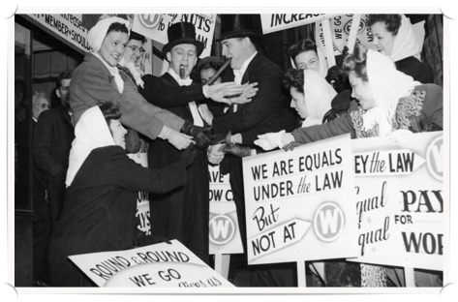
ECONOMIC READJUSTMENT
AFTER WWII, THE US ECONOMY CONVERTED FROM WARTIME TO PEACETIME GOODS
defense contracts were cancelled, unemployment rose, vets couldn’t find jobs
WHEN WARTIME PRICE CONTROLS WERE REMOVED, PRICES ROSE AND WAGES SANK
threatened by post-war depression, Truman ordered gov controls on prices & wages
AS CONDITIONS WORSENED, THE NATION FACED MASSIVE LABOR STRIKES THAT THREATENED TO CRIPPLE THE ECONOMY
Truman ended the strikes by threatening to draft striking workers in to army

Slide 6
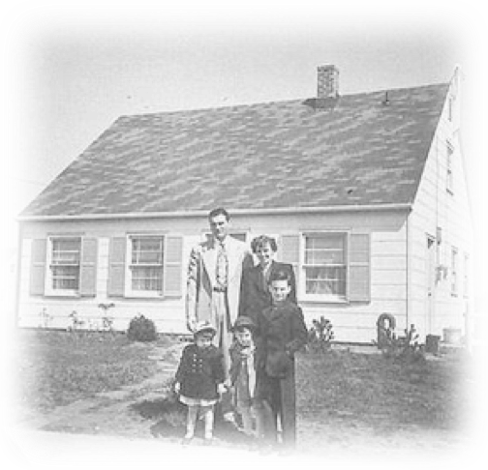
QUICK ECONOMIC RECOVERY
AS THE NATION RETURNED TO NORMAL, CONSUMERS BEGAN TO REVIVE THE ECONOMY
Americans saved over $135 billion during WWII in savings, bonds and were ready to splurge
AMERICANS BOUGHT HOMES, CARS, APPLIANCES (WANTS) & OTHER GOODS RATIONED DURING WWII
high demand for products meant businesses created jobs so they could increase supply
unemployment sank, income increased & the standard of living rose
6000
TO FIGHT THE COLD WAR, US GOV. INCREASED DEFENSE SPENDING & FOREIGN AID
5000
family income in dollars
$100 billions were spent in the private sector, helping stimulate the economy
4000
3000
1950
1952
1954
1956
1958
1960

Slide 7
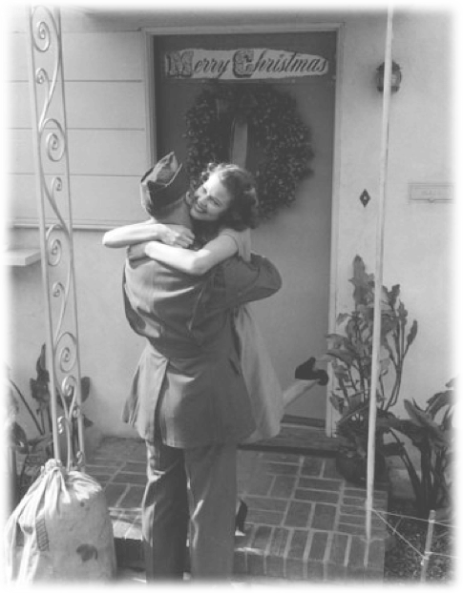
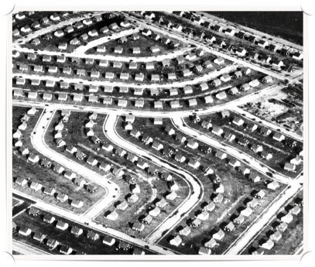
CHANGING Lives
LATE 1940S - AMERICANS WANTED TO SETTLE DOWN AND BUILD THEIR LIVES
GI BILL OF RIGHTS
SERVICEMEN’S READJUSTMENT ACT HELPED WWII VETERANS EASE BACK INTO CIVILIAN LIFE
provided low interest loans, unemployment benefits, tuition aid, ability to buy homes
suburban housing
MASS PRODUCTION TECHNIQUES WERE USED TO MAKE TRACT HOMES IN SUBURBS OUTSIDE OF CITIES (Levittown)
houses were identical, had yards, planned streets, small town feel, were under $7000
Americans had the ability to settle down, have a family, a home, a yard, a normal life

Slide 8
post war
politics

Slide 9
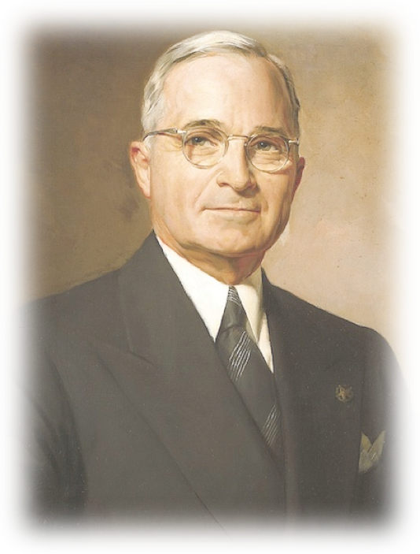
HARRY S TRUMAN
TRUMAN’S LEGACY
tHE A-BOMB, “THE BUCK STOPS HERE” & truman doctrine
A HUMBLE MISSOURI FARMER, TRUMAN WAS NOT A POLITICIAN, BUT WAS HONEST
he could make tough decisions and took responsibility for the consequences (“buck”)
WELL LIKED, HE ULTIMATELY WAS BLAMED FOR THE BAD POST-WAR ECONOMY
the GOP takes control of Congress in the 1946 elections & ignores Truman’s wishes

Slide 10
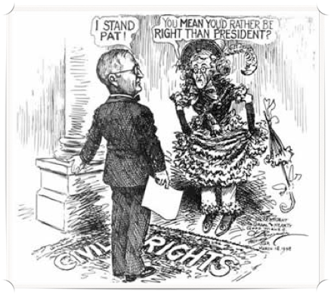
TRUMAN & CIVIL RIGHTS
FRUSTRATED BY CONGRESS, TRUMAN STAKED HIS RE-ELECTION IN 1948 ON CIVIL RIGHTS
he saw it as a good, moral cause & believed it immoral that black vets were denied rights
W/ CONGRESS REFUSING TO ACT, TRUMAN SIGNS EXECUTIVE ORDERS ON CIVIL RIGHTS
Truman integrated the US military so blacks would serve alongside whites for 1st time ever
truman also made it illegal to discriminate based on race when hiring gov employees
IN PROTEST, WHITE SOUTHERN DEMOCRATS LEFT THE PARTY AND FORMED THE DIXIECRATS
the South had been democratic since the end of the Civil War, but that was about to change

Slide 11
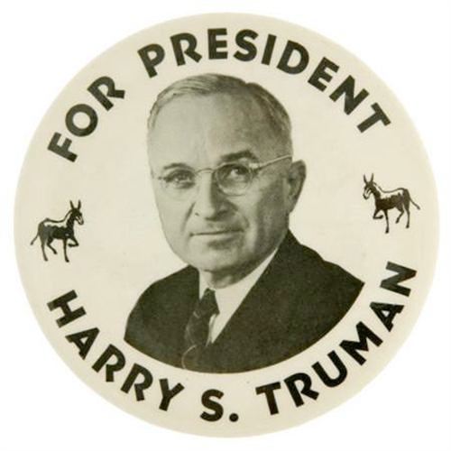
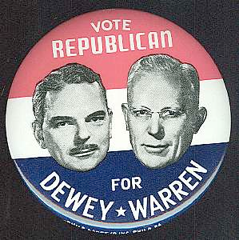
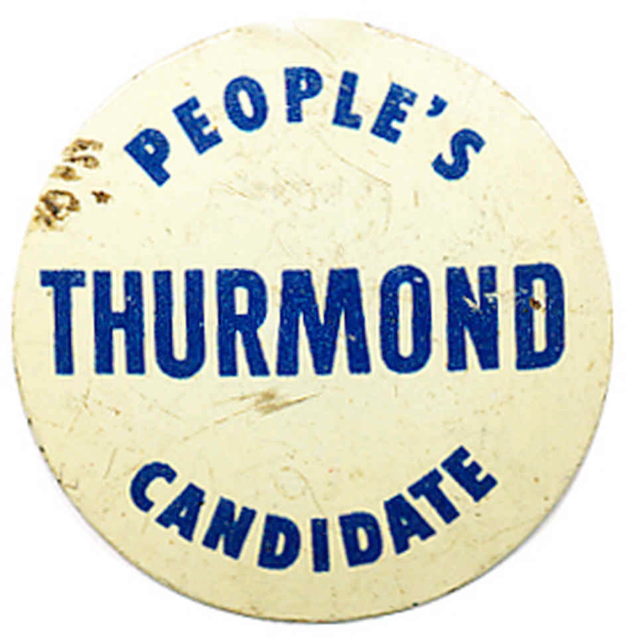
the election of
1948

Slide 12
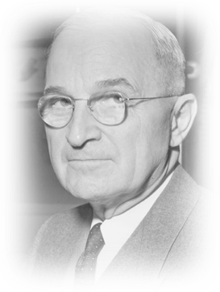
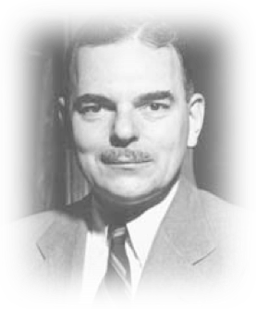
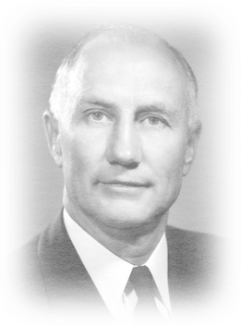
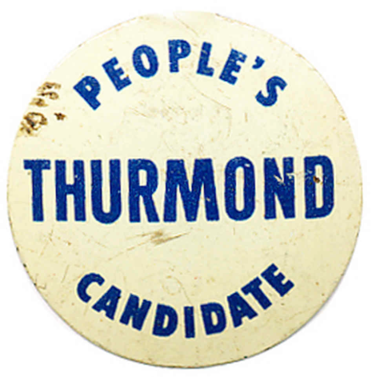
THE ELECTION OF 1948
WITH THE DEMOCRATS DIVIDED, TRUMAN’S CHANCES FOR RE-ELECTION WERE GRIM IN ’48
Southern Dixiecrats backed Strom Thurmond in protest of Truman’s stance of civil rights
A MAJORITY OF THE COUNTRY BACKED CONSERVATISM AND GOP’S THOMAS DEWEY
the GOP successfully blamed the economy on Truman & tapped into anti-civil rights voters
the night before the election, Dewey held a comfortable lead & Truman thought he’d lose
TRUMAN PULLS OFF THE GREATEST UPSET IN AMERICAN POLITICAL HISTORY AND WINS!

Slide 13
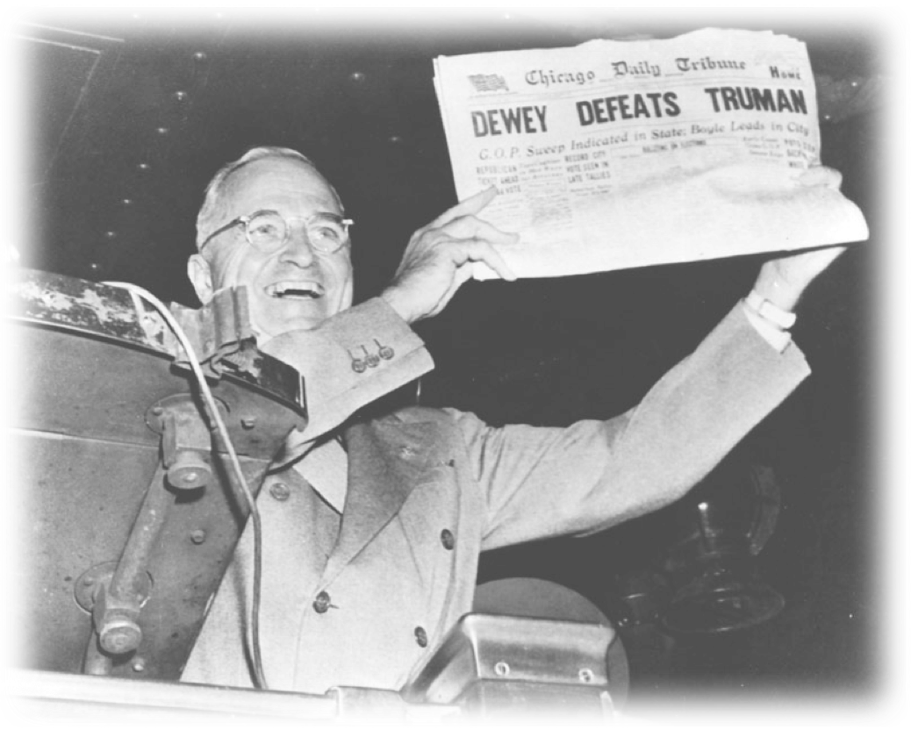
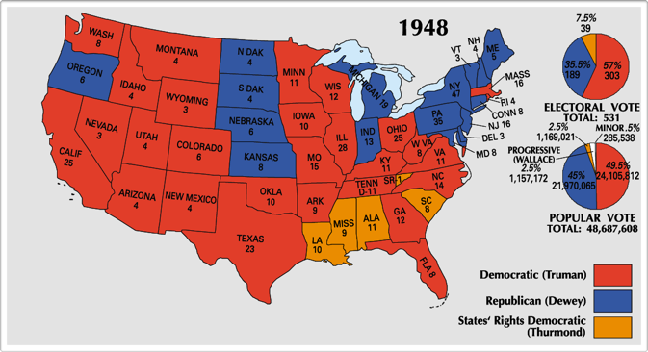

Slide 14
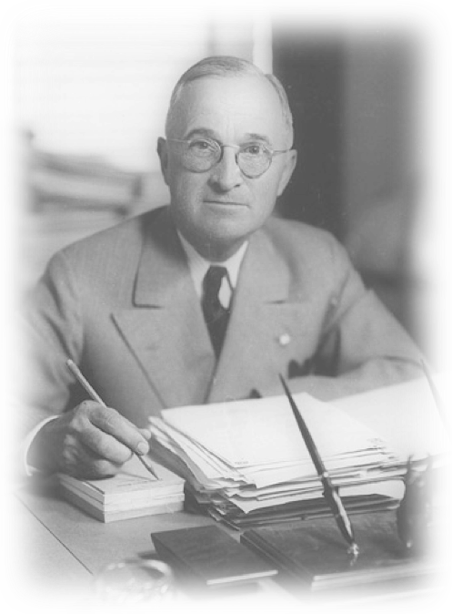
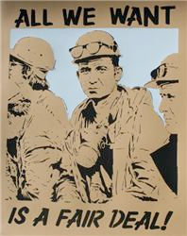
TRUMAN’S “FAIR DEAL”
ONCE RE-ELECTED, TRUMAN PURSUED AN AGGRESSIVE DOMESTIC PLAN: THE FAIR DEAL
he saw it as a extension of FDR’s New Deal
TRUMAN WAS SUCCESSFUL IN THE FOLLOWING:
Raising the minimum wage to boost US income
extended Social Security coverage for 10 mil
initiating programs to clean up city slums
HOWEVER, CONGRESS DEFEATED HIS PRIMARY PROGRAM OF UNIVERSAL HEALTH CARE
the rest of Truman’s presidency would be dominated by the Cold War abroad

Slide 15
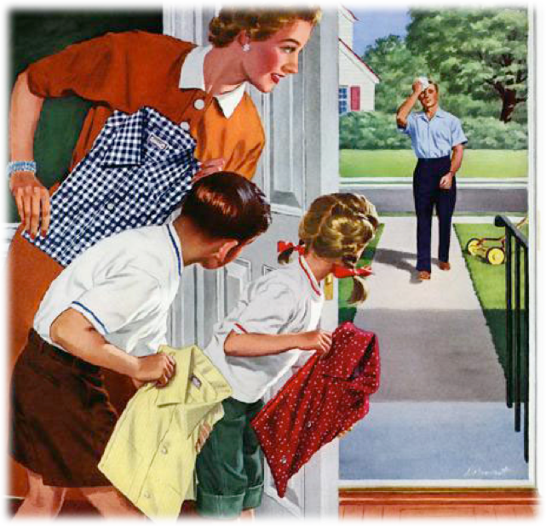
CLOSURE
ANALYZE THE FOLLOWING:

