Slide 1
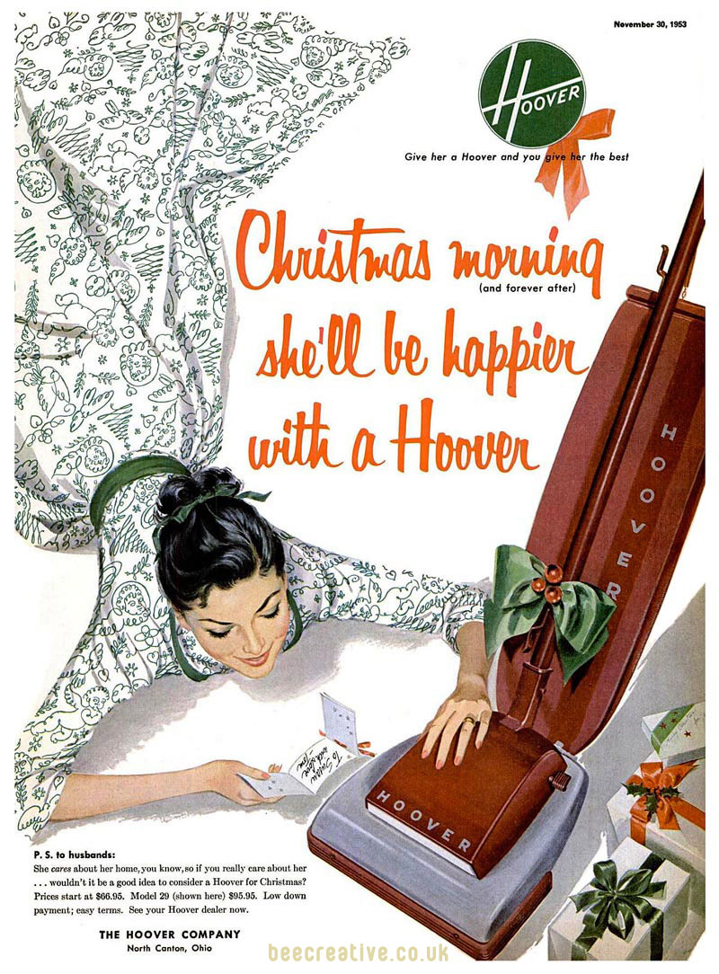

Slide 2
Daily News, Tuesday, September 5, 1950

Slide 4
An Advertisement for a Levittown house with a special offer for Veterans

