Slide 1
Total Gross Pay $1,608.00
Social Security Tax Withholdings: Adjusted Gross Pay*** x 6.20% = $___________________
Medicare Tax Withholdings: Adjusted Gross Pay***x 1.45% = $___________________
State Tax Withholdings: * Adjusted Gross Pay*** x 2.5838% = $___________________
Federal Tax Withholdings: * Adjusted Gross Pay*** x 9.956% = $___________________**
Health Insurance Premium: Gross Pay x 3.1119% = $___________________
401k Employee Contribution: Gross Pay x 10% = $____________________
$1,608 - ____________________ = $ ___________________________ Gross Pay Sum of deductions Net Pay Notes: * Federal and State tax calculations are more complicated than a flat percentage. However, for simplicity of this example, we have found the percentages applicable at this income level and for a 401(k) contribution of 10%. ** Notice on the Paycheck Calculator table that Federal Taxes decrease as 401(k) contribution increases. ***Health Insurance and 401(k) contributions are pre-tax deductions. Subtract the amount of employee paid health insurance premiums and employee 401(k) contribution (up to federal limit) to arrive at adjusted gross pay (or after tax deduction amount).

Slide 2
Additional
Employment Costs
Employer Portion
Employer Portion of Social Security Tax: Gross Pay x 6.20% = $___________________
Employer Portion of Medicare Tax: Gross Pay x 1.45% = $___________________
401(k) Employer Match: = $___________________ (Depends on Plan selected. Plan 1 = $0, Plan 2 = $8.04, Plan 3 = $8.04)
Employer Portion of Health Insurance Premium = $188.22 in this example
Federal Unemployment Tax
Workers Comp Insurance
Life Insurance
Short Term Disability Insurance
Long Term Disability Insurance
Employer Only Costs

Slide 3
Monthly Income Est. =
Net Pay x 2 = $_______
Monthly Income Estimate | $
Rent expense | $
Car loan expense | $
Gas & Electric Utilities expense | $
Cell Phone expense | $
Cable / Internet expense | $
Allocation for less frequent bills like car insurance & renter’s insurance | $
What’s left for daily expenses (on credit card in simulation) and savings for unexpected events? | $

Slide 4
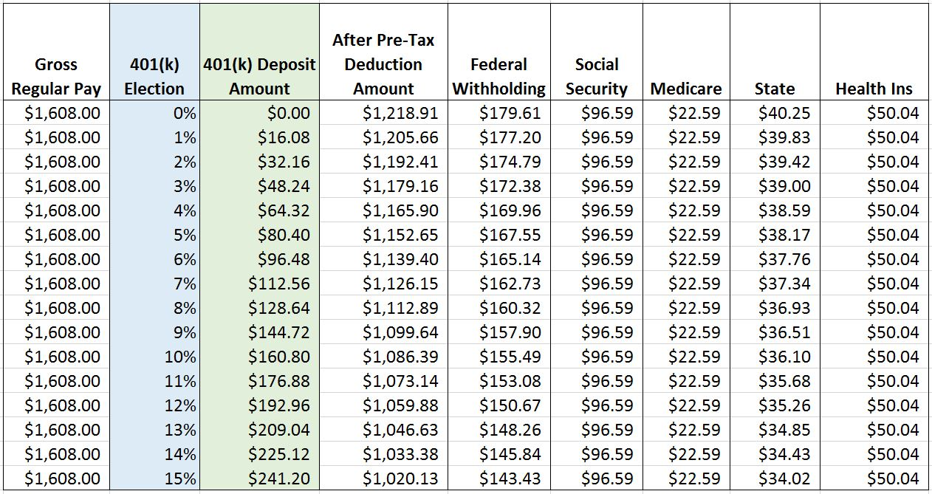
Paycheck Calculator Example

