Slide 1
Election Economics

Slide 2
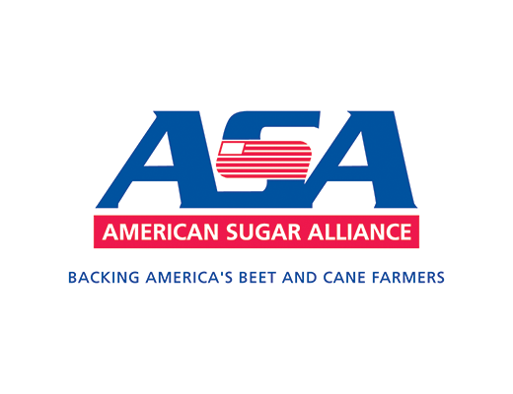
ONE OF AMERICA’S MOST PROTECTED INDUSTRIES
The U.S. Sugar Program is a set of policies with origins dating back to 1934 and the Great Depression.
This set of guidelines written by Congress and administered by the USDA, provides a great deal of financial support and risk reduction for America’s sugar processors, as well as the sugar cane and sugar beet growers.

Slide 3
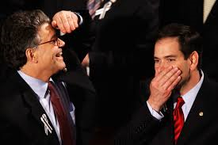
STRANGE BEDFELLOWS
Senator Al Franken (D-MN) and Senator Marco Rubio (R-FL) agreeing?
A rare case of bi-partisanship?
Several thousand jobs in the sugar industry exist within their constituencies.

Slide 4
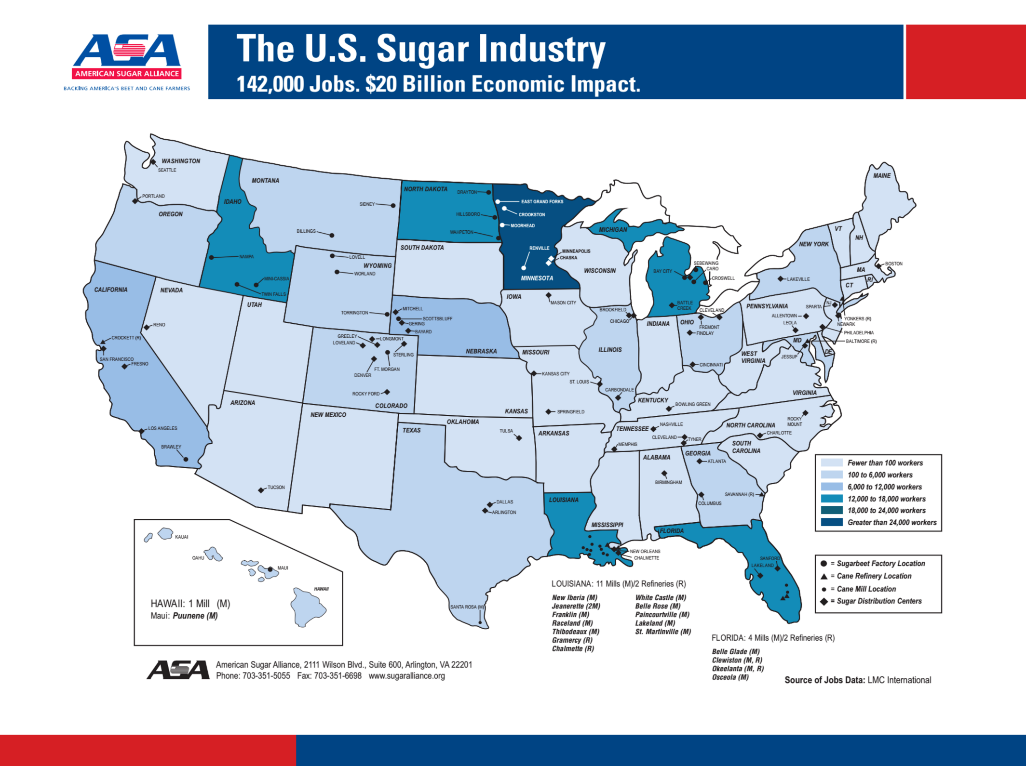
JOBS IN THE U.S. SUGAR INDUSTRY

Slide 5
SUGAR AND SWEETENERS
U.S. is the world’s largest consumer of sweeteners.
One of a few countries with a significant output of both sugar cane and sugar beets.
The U.S. is one of the largest importers of sugar as well. Mexico is our biggest supplier.
The U.S. government heavily influences the sugar market.
70% of sugar in U.S. products and
homes is sourced domestically
30% is imported from
40 different countries
*USDA December 2015 WASDE Report

Slide 6
SUPPORT FOR THE SUGAR PROGRAM
"For sugar producers and refineries, the bill continues the existing sugar program. The U.S. sugar program supports over 140,000 American jobs including 500 jobs at Domino Sugar located at the Port of Baltimore. Significant reforms to this program will put these jobs at risk and they may be shipped overseas.” Senator Mikulski (D-MD)
*https://www.mikulski.senate.gov/newsroom/press-releases/mikulski-cheers-passage-of-farm-bill-to-help-sustain-and-create-jobs-in-maryland-agriculture
“Removing the protections we have for our domestic sugar producers will do nothing but kill an American industry and outsource jobs to our competitors,” Franken said during a Senate floor debate this spring. Rubio, in the same debate, warned colleagues of the “risks to American jobs if reforms to our sugar program were to pass.”
*https://www.washingtonpost.com/politics/2013/12/07/f5959c06-5ac4-11e3-bf7e-f567ee61ae21_story.html

Slide 7
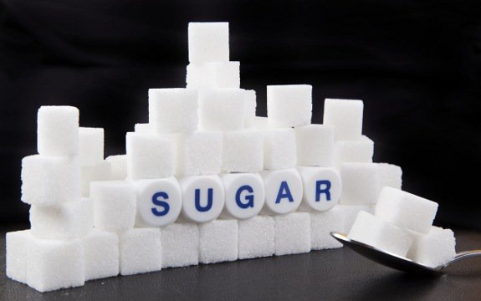
THE U.S. SUGAR PROGRAM
The sugar program provides a price guarantee to the processors of sugarcane and sugar beets, and in turn, to the producers of both crops.
The USDA uses four tools:
price support loans
marketing allotments to limit the amount of sugar that each processor can sell
import quotas to restrict the amount of sugar allowed to enter the U.S. market
a sugar-to-ethanol policy—available if marketing allotments and import quotas fail to keep market prices above guaranteed levels
http://nationalaglawcenter.org/wp-content/uploads/assets/crs/R42535.pdf

Slide 8
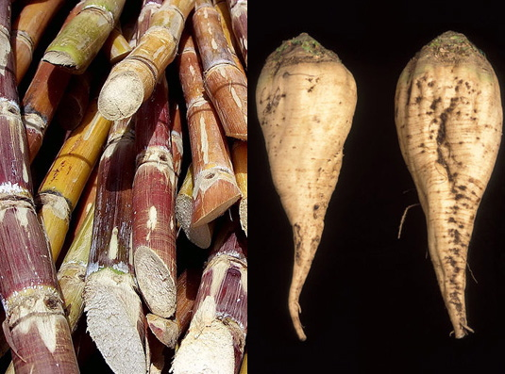
HOW SWEET IS THE DEAL?
Producers are guaranteed minimum prices through federal loans that allow them to borrow against their sugar supplies at a specific per-pound rate.
If market prices drop below the specified price, producers can forfeit the sugar instead of repaying the loans in cash *http://articles.latimes.com/2012/jul/06/business/la-fi-sugar-program-20120706

Slide 9
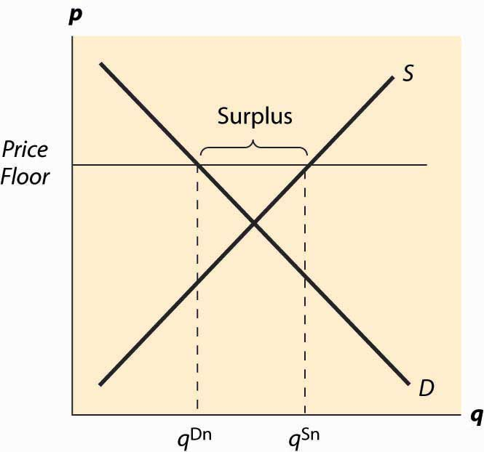
PRICE FLOOR
The price guarantee is an example of a price floor.
The floor is a government- mandated minimum price that the seller should expect to receive.
For sugar producers, the minimum price is meant to protect the producer from market factors that may cause the price to fall to low levels that harm U.S. producers.

Slide 10
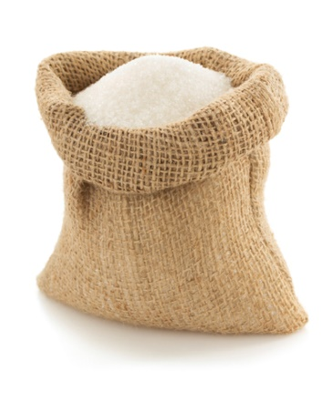
HOW SWEET IS THE DEAL?
Under the program, at least 85% of sugar sold in the U.S. must come from domestic processors.
The government also can buy up excess sugar and sell it to ethanol makers — even at a loss — to avoid price slumps.
*http://sugarcane.org/global-policies/policies-in-the-united-states/sugar-in-the-united-states

Slide 11
IMPORT QUOTAS
Limits on the quantity or total value of a product that can be imported into a country.
The cap on imports is meant to protect domestic industries of the same product from foreign competitive forces.
Justifications for the sugar quota include protecting U.S. jobs and defending U.S. from foreign producers who may receive assistance from their governments.

Slide 12
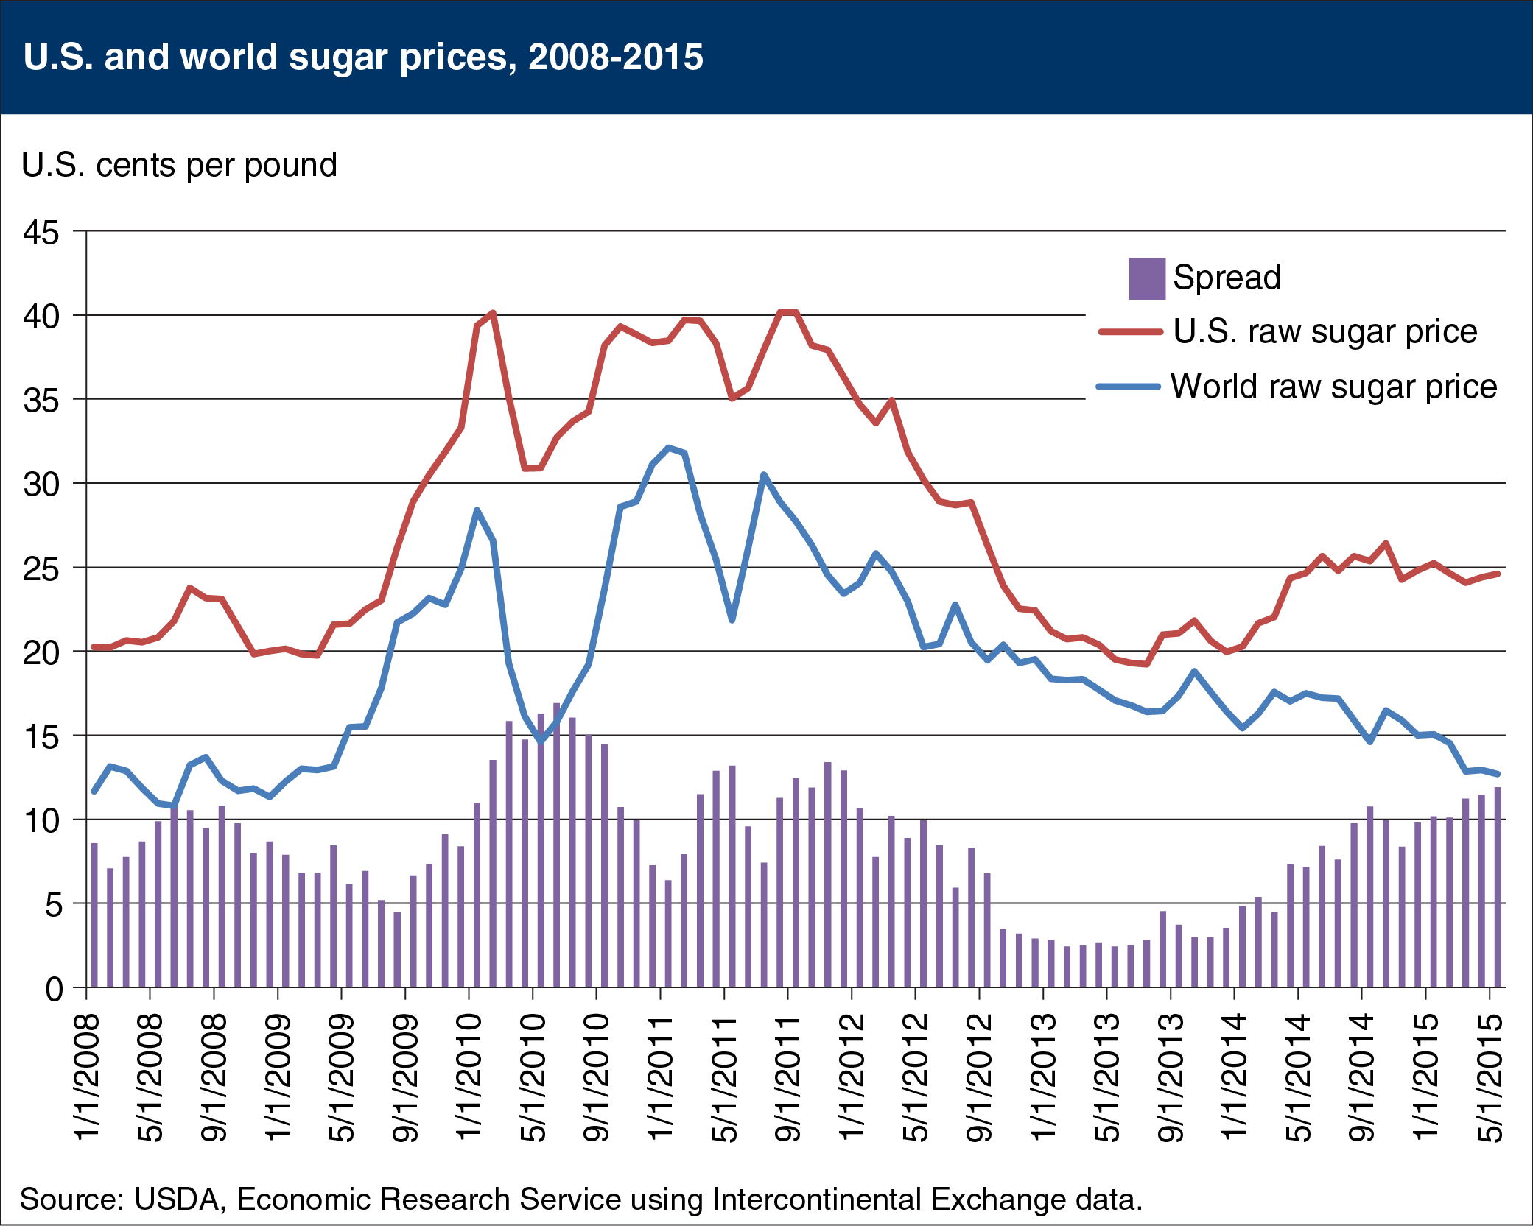
U.S.D.A. IN ACTION
From October 2012 to April 2013, U.S. sugar companies borrowed $862 million to finance their operations.
Some borrowers were underwater on their loans because of an 18% slide in domestic sugar prices.
To boost prices and prevent loan defaults, the USDA bought 400,000 tons of sugar.
*http://www.wsj.com/articles/SB10001424127887324096404578356740206766164
http://www.ers.usda.gov/data-products/chart-gallery/detail.aspx?chartId=53159

Slide 13
OPPOSITION TO THE SUGAR PROGRAM
“Higher consumer prices and lost U.S. jobs are the legacy of America’s outdated sugar program. Born during the Great Depression, the sugar program drives up costs for American consumers and businesses and sends American jobs overseas. We’re America’s candy makers – more than two-thirds of which are small and medium-sized, family-owned businesses that have been in operation for decades. We employ 200,000 Americans, yet these jobs are threatened by the current sugar policy.”
National Confectioners Association
*http://sugarreform.org/2012/09/20/the-u-s-sugar-program-is-not-so-sweet-for-small-business/
“The sugar program has resulted in US consumers paying three times the current world price for sugar. Defenders of the sugar program claim that it is critical to the viability of our domestic sugar industry. A close examination of this program reveals that its true benefits are only realized by big sugar tycoons. Only by political clout has this corporate welfare program survived. I believe we should end the subsidies to the sugar industry and eliminate the sugar program that is unfair to consumers.”
John McCain (R-AZ)
*http://www.ontheissues.org/Celeb/John_McCain_Labor_+_Farming.htm

Slide 14
DON’T FORGET THE RULES OF A SUCCESSFUL ACADEMIC CONTROVERSY!
Practice active listening
Challenge ideas, not persons
Try your best to understand the other positions
Share the floor: each person in a pair MUST have an opportunity to speak
No disagreeing until consensus-building as a group of four

