Slide 1
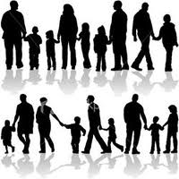
Do Now:
How would you rate your importance in your home?
Highest, High, Middle, Low, Lowest
If your younger brother or sister grew up to be your Boss – would you be comfortable with it?
In your group of friends – who usually makes most of the decisions?

Slide 2
Social Structure
Structure helps us know what is expected of us
Ensures stability from one generation to the next – even though the actual society changes
Social Structure: network of interrelated statuses and roles

Slide 3
Defines where you fit in society
Ascribed Status: assigned according to things outside your control. (age, gender, etc.)
Achieved Status: role you achieve through your own efforts. ( occupation, college graduate, basketball player, wife, mother, etc.)
Master Status: One rank that determines your social identity. Can change throughout life. (Fulltime Mom, Police Officer, Grandparent, etc.)

Slide 4
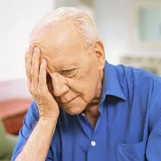
Do you know anyone who has chosen an a master status that is not good for them?
Do you know anyone who is having a difficult time moving away from a master status?

Slide 5
Roles
Statuses are social categories – but roles bring statuses to life
You occupy a status – you play a role

Slide 6
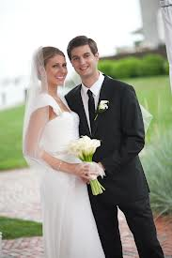
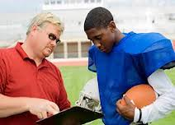
Types of Roles
Reciprocal Roles: define interaction with others. Can’t be fulfilled alone. Example: you can’t perform the role of husband without a wife.
Examples of reciprocal roles:
Doctor-Patient Athlete – Coach
Employee – Boss Friend – Friend.

Slide 7
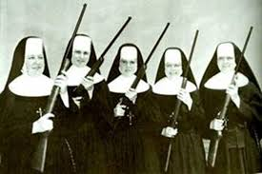
Role Expectations
Socially determined behaviors expected are Role Expectations
Example: Doctors treat their patients with skill
Parents provide for their children, Police uphold the law.
Role Performance: actual role behavior that doesn’t always match what society expects.
Example: Doctor neglects patient, Parent fails to provide for child.
Problems: even when performing expected role does not meet expectations – this is because we play many roles
Sometimes roles contradict each other.

Slide 8
Role Conflict & Role Strain
Role Conflict: conflict between statuses. Example: working fulltime and having young children at home.
Role Strain: difficulty meeting the role of a single status. Example: Boss trying to motivate employees while having to lower their salaries.

Slide 9
Section 1: Building Blocks of Social Structure
Status
Examples of Roles
Examples of Conflict / Strain
Put out fires, save lives, wear a uniform
Voluntarily puts self in danger, but has loved ones who need him or her
Firefighter
Provide food and shelter, nurture family, discipline children
Fatigue and long shifts make household tasks and interactions difficult
Mother
P.T.A. President
Run meetings, recruit new members, plan activities
Has trouble getting members to attend and follow through on promises

Slide 10
Section 3.1: Building Blocks of Social Structure
People’s particular roles and statuses affect how they relate to one another
Statuses are ways of defining where individuals fit in society and how they relate to others
Most roles have reciprocal roles that define the patterns of interaction between related statuses, such as husband and wife or teacher and student

Slide 11
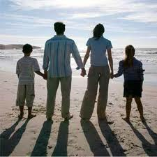
Social Institutions
Statuses and roles determine the structure of society.
When statuses/roles are organized to satisfy a basic need = Social Institution
Schools, family, economy, religion, media, medicine, etc.

Slide 12
Wrap Up
Social Structure: network of interrelated statuses and roles\
Status: Defines where you fit in society
Ascribed Status: assigned
Achieved Status: role you achieve through your own efforts
Master Status: One rank that determines your social identity.
Role: you play - bring statuses to life
Reciprocal Roles: define interaction with others
Role Expectations: Socially determined expected behaviors
Role Conflict: conflict between statuses.
Role Strain: difficulty meeting the role of a single status.

Slide 13
What is the Most Common Type of Social Interaction?
When you play a role – you are interacting with others
Some interactions stabilize the social structure
Some interactions promote change.
There are five (5) types of interaction that takes place in society

Slide 14
1.) Exchange
Interacting in an effort to receive a reward or return for actions.
Most common form of interaction
Example: Working, dating, family life, friendship, politics.
Reciprocity: you do something – other person owes you. Basis for Exchange.
Example: a “Thank You” from your parents when you wash the dishes.
Exchange Theory: Belief that people are motivated by self interest. Cost/Benefit analysis.

Slide 15
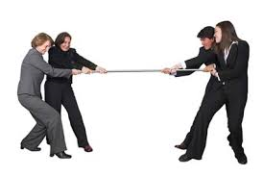
2.) Competition
When two or more people oppose each other to achieve a goal only one can have.
Example: College applications, Football Games, Contests
Positive: Rules of accepted proper conduct are followed.
Negative: Can lead to stress, lack of cooperation, inequality and conflict

Slide 16
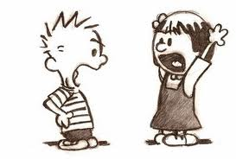
3.) Conflict
Competition is about achieving a goal – but with Conflict, the emphasis is on defeating the opponent.
Deliberate attempt to control a person by force, oppose or harm someone.
Four major sources of Conflict: wars, disagreements, legal disputes, ideology
Sometimes competition becomes conflict
Example: Business undercuts another business on price to force them into bankruptcy.
Can be negative, but also Positive: reinforces loyalty by focusing on outside threat, draws attention away from internal problems, can lead to social change

Slide 17
4.) Cooperation
Two or more people work together to achieve a goal that benefits more than one person.
Example: Employees of a company work together to increase sales.
Gets things done. No group can achieve its goals with cooperation.

Slide 18
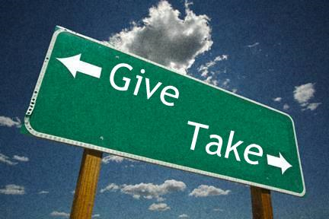
5.) Accommodation
State of balance between cooperation and conflict
Give a little, take a little.
Example: compromise, truce, mediation, arbitration

Slide 19
Section 2: Types of Social Interaction
Competition
Exchange
Types of Social Interactions
Conflict
Cooperation
Accommodation

