Slide 1

Chapter 1- Section 2
The Development of Sociology

Slide 2
Why did the field of Sociology develop?
Methods for studying physical world in a systematic and scientific manner helped them study society
There were rapid social and political changes taking place in Europe during the 17th-18th centuries [Industrial Revolution]

Slide 3

Industrial Revolution
Instead of farms and cottage industries, they changed to large-scale production
With factories came growth of cities and paid employment
With urban population came social problems like housing shortages, unemployment, crime, pollution, impersonality
So couldn’t ignore impact of society o n individual … individual liberties and freedoms became the focus then of Revolutions [like American and French]

Slide 4
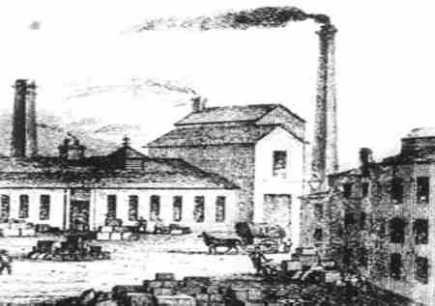
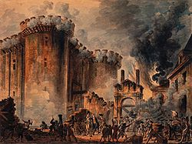
History of Sociology
Study the following pictures. Why did sociology develop during these time periods?

Slide 5
Origins of Sociology
Social upheaval
  People forced to rethink social life
Tradition vs Science
    Success of natural sciences
      Failed by tradition → people turn to scientific method

Slide 6
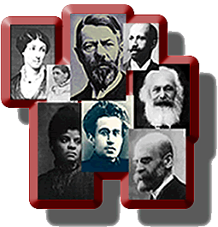
The Early Years
Started in the 19th century in France, Germany, and England
Most influential sociologists:
  Auguste Comte
  Karl Marx
  Herbert Spencer
  Emile Durkheim
  Max Weber

Slide 7
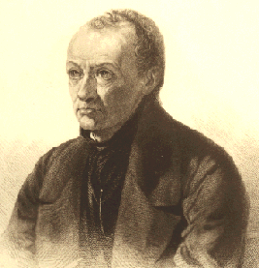
Auguste Comte
1798-1857, French, Founder of Sociology because he first used the term Sociology as the study of society
Believed sociologists should use the scientific methods to uncover the laws that govern the operation of society
Lived during the French Revolution and believed his philosophy would bring stability to the world

Slide 8
Comte Cont.
Concerned with two things:
  Order
  Change
Used the term social statics to describe the processes by which the overall structure of a society remains relatively stable, or unchanged, over time… relates to order
Used the term social dynamics to the processes by which elements within the society change in a systematic fashion to allow for social development … relates to change

Slide 9
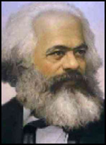
Karl Marx
1818-1883, German, middle-class parents
Got his doctorate from the University of Berlin, never taught, and instead chose to work for a radical newspaper which ended up being shut down by the government for its political view
Moved to Paris but was expelled from there at the request of the German government…moved to Brussels and then London

Slide 10
Marx Cont.
Believed that the overall structure of society is influenced by how the economy is organized
Society is divided into two:
  Those that own the means of production [materials and methods used to produce goods and services like factories and raw materials] [owners and they control society ]
  And those who own only their labor [workers]
This imbalance of power leads to a conflict between owners and laborers

Slide 11
Most interested in a capitalist society because he was troubled by the social conditions there
  Long hours
  Low pay
  Harsh working conditions
Didn’t think he should just be a passive observer of society, but that he should help transform it…
  Saw that the ills of the capitalist system would not be solved until the workers overthrew those in power.

Slide 12
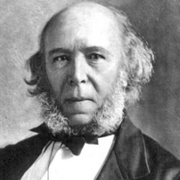
Herbert Spencer
1820-1903, English, inherited a large amount of money that freed him from working on the railroad
Influenced by Charles Darwin and so adopted a biological model of society

Slide 13
Spencer Cont.
In a living organism, the biological systems work together to maintain the health of the organism… so he saw society as a set of independent parts that work together to maintain the system over time
Took the theory of evolution to describe the nature of society: saw social change and unrest to be natural occurrences in a society’s evolution toward stability and perfection

Slide 14
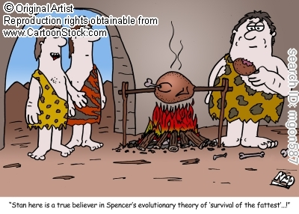
Thought that since the best aspects of society will survive over time [“survival of the fittest”], we shouldn’t correct social ills
Thought that the fittest societies would survive over time, which will lead to a general upgrade of the world as a whole
Started type of sociology called Social Darwinism: the perspective that holds that societies evolve toward stability and perfection

Slide 15
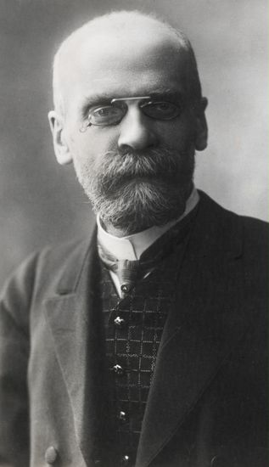
Emile Durkheim
1858-1917, French, taught philosophy before switching and offering the first social science course in France
First to apply the scientific method to the study of society

Slide 16
Durkheim Cont.
Focused on social order and like Spencer, saw society as interdependent parts that maintain the system over time
  Saw those roles as functions
  A function is a positive consequence that an element of society has for the maintenance of the social system
  Shared beliefs and values are the glue that holds society together
    Especially how religion maintains social order and suicide

Slide 17
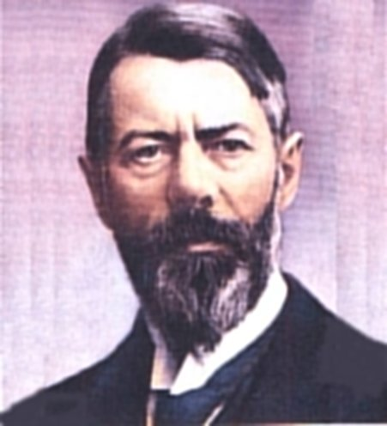
Max Weber
1864-1920, German, doctorate from the University of Berlin, later would become Professor of Economics at the University of Heidelberg
Founded German Sociological Society in 1910

Slide 18
Weber Cont.
Unlike other, he was interested in groups within society as a whole and so he analyzed effects of society on the individual
  Wanted sociologists to uncover feelings and thoughts of individual through a method called Verstehen: empathetic understanding of the meanings others attach to their actions
    So, you put yourself in another person’s shoes and see the situation from their eyes

Slide 19
Weber Cont.
Also used concept of ideal type: description of the essential characteristics of some aspect of society
  How to figure out ideal type:
    Examine many different examples of a phenomenon and then describe the essential features
    So not all examples of this phenomenon might contain all the characteristics of the ideal type

Slide 20

Weber Cont.
Let’s practice..
  Describe to me your ideal mate
  Describe to me your ideal school
  Describe to me your ideal vacation

Slide 21
Current Perspectives
A theory is a systematic explanation of the relationship among phenomena to guide their work and help interpret their findings
A theoretical perspective is a general set of assumptions about the nature of phenomena and it outlines certain assumptions about the nature of social life
  3 for sociology… each presents a different image of society or focuses on different aspects of social life

Slide 22
Sociology in North America
Early History
University of Kansas (1890)
University of Chicago (1892)
  developed the symbolic interactionist perspective
  dominated sociology
Atlanta University (1897) – all black
Many women denied faculty appointments
  Little distinction between sociology and social work
  social activism

Slide 23
Jane Addams and Social Reform
came from wealth and privilege
co-founded Hull House
  aged, immigrants, sick and poor
strived to bridge gap between powerful and powerless
worked with others to win the eight-hour work day and pass laws against child labor
co-won the Nobel Prize for work in social reform
  only sociologist to win

Slide 24
W.E.B. Du Bois and Race Relations
Became the first African American to earn a doctorate at Harvard
Taught Greek and Latin and Wilber-Force University and then hired by Atlanta University (most of career)
poor (couldn’t attend meeting of the American Sociological Society)
  When he could attend, subsequent meetings, hotels and restaurants would not allow him to eat or room wit the white sociologist
  US would not issue passport
    Feared he would criticize United States
Says more successful African Americas are breaking ties with other African Americans to be accepted by whites
    Weakened and deprived African American Community
Founded National Association for the Advancement of Colored People (NAACP)
Was neglected; sociology rediscovered and receiving respect

Slide 25
Talcott Parsons and C. Wright Mills: Theory vs. Reform
social reform → social theory
Parsons → abstract models of society
  Influenced a generation of sociolgists
Mills → urged return to reform
  Saw coalescing of interest on the power elite (top leaders of business, politics and military) as a threat to freedom
Notes:
Emphasis shifted from social reform to social theory.

Slide 26
Continuing Tension and Rise of Applied Sociology
applied sociology – use of sociology to solve problems from the micro level of family relationships to the macro level of crime and pollution
  EXAMPLE: founding the NAACP
  middle ground between observation and social reform

Slide 27
Sociological Perspectives
Theories- An explanation of relationships between elements in society.
Theoretical Perspectives- A general set of assumptions and ideas about social life.
Three Sociological Perspectives:
Functionalist, Conflict, and Interactionist

Slide 28
Interactionist Perspective (MICRO)
Important People: Max Weber, Charles Hooley, William Thomas, George Mead
Focus on how Individuals interact with one another in society.
  Individuals evaluate their own conduct by comparing themselves with others
  Society is composed of symbols and shared perceptions that people use to establish meaning and develop views of the world.
    Symbols – things to which we attach meaning
      Used to define relationships (Examples: brother, sister, etc.)
Notes:
What are some symbolic meanings that we all agree on?
What must we do to change people’s perception of reality?

Slide 29
Symbols
Without symbols, our social life would be no more sophisticated than that of animals
Symbols allow relationships to exit
  Without them, we could not coordinate our actions with others
Applying Symbolic Interactionism: Divorce Rates (p. 23-25)

Slide 30



#1 Functionalist Perspective
Supported by Spencer and Durkheim
Definition: See society as a set of interrelated parts that work together to produce a stable social system
Society held together through consensus because most people agree on what’s best for society so they work together to ensure that it runs smoothly

Slide 31
View the different parts of society in terms of their functions for society, and there’s 2 types:
  Positive consequence for society
    i.e. division of labor, education
  Since not everything in society is positive, a dysfunction is the negative consequence an element has for the stability of the social system
    i.e. crime, drugs

Slide 32
Functions can also be
  Manifest Function- intended and recognized consequence of some element of society…you know why it was made
  --- Ex: cars: a manifest function is to provide fast transportation from one place to another
  2. Latent function- unintended and unrecognized consequence of an element of society…something it does but it wasn’t meant to do it
      ---Ex: cars: use cards to show your social standing and display your wealth

Slide 33

#2 Conflict Perspective
Supported by Marx
Definition: focus on the forces of society that promote competition and change
Interested in how those who possess power control those with less power ..
  Look at violent conflict
  Look at nonviolent competition between groups in society like men and women, old and young, white and black
  Study things like decision making in the family, labor dispute, relationships among races

Slide 34
The basis of social conflict is competition over scarce resources like power and wealth
  Once a group gains society’s resources, they establish rules and procedures that protect their interests at the expense of other groups
  Inequality leads to social conflict when those with less power attempt to gain access to desired resources, and those with power try to keep it
  Conflict -------> social change

Slide 35


#3 Interactionist Perspective
Supported by Weber
Definition: focus on how individuals interact with one another on society in society and how they respond to one another in everyday situations
  Interested in the meanings individuals attach to their own actions and to the actions of others

Slide 36
Interested in the role of symbols which are anything that stands for something else
  members of society must agree on the meaning
  Could be
    Physical objects: flag, evil eye
    Gestures: military salute, hand shake, thumbs up
    Words: love
    Events: 4th of July, Eid Al-Adha, Christmas
  Focus on interaction between people that takes places through the use of symbols, which is called symbolic interaction

Slide 37
All Three At Once
Scenario: Worker Strike at the Ford Plant
Functionalist perspective
Most concerned with how strike is disrupting production
Conflict perspective
Focus on economic dispute between workers and management
Interactionist perspective
Interested in learning how the strike is affecting the family lives of the workers since they’re not making $

Slide 38
What are the Sociological Methods
In order to collect data, or scientific information, on society and human behavior, use the following:
Historical method: examine materials from the past
Content analysis: count the number of times a particular word, phrase, idea, event, or symbol appears in a given context..best to analyze forms of communication

Slide 39
3. Survey: collect data on attitudes and opinions from large numbers of people through questionnaires or interviews
4. Observation: watch the behavior of individuals in actual social setting
--detached observation: from a distance and don’t know they’re observed; more natural
--participant observation: observers are involved in the situation
5. Case study: intensive analysis of a person, group, event or problem
6. Statistical analysis: use of mathematical data and analyzing data already collected to determine strength of the relationship that may exist between two or more variable

