Slide 1
Spring 2011 European Tours Proposal
Ellen Latsky
Tour Developer-Europe
Quest Specialty Travel

Slide 2
Tour Development Goals
Focus on significant experiences
  Preserve QST values
Price tours reasonably
Create learning opportunities
  Offer local guides
  Provide experts

Slide 3
Tour Strategy Objectives
Provide low cost tours
  Use local transportation
Provide educational experiences
  Have meaningful cultural exchanges
    Utilize local knowledge of geopolitical history
Provide tours for different physical abilities
Aim
Higher

Slide 4
Focus Group Data Analyzed
TRENDS
MAJOR FINDINGS
CONCLUSIONS

Slide 5
Focus Group Analysis-Trends
Trends for American Tourists
  Concern for safety a high priority
  Middle East and Asian travel less popular
  European destinations more popular than Pacific Islands
  Trip destination correlated to trip length

Slide 6
Focus Group Analysis-Findings
Major Findings by Age
  18-35 - look for adventure
  36-49 - seek culture experiences
  50-75 - desire to be safe and comfortable
  45-70 - travel more than other age groups combined

Slide 7
Focus Group Analysis-Conclusions
General Conclusions
  Stress safety issues and concerns
  Target tours for 45-65 yr. olds
  Target economic travelers of all ages
  Expand adventure tour offerings

Slide 8
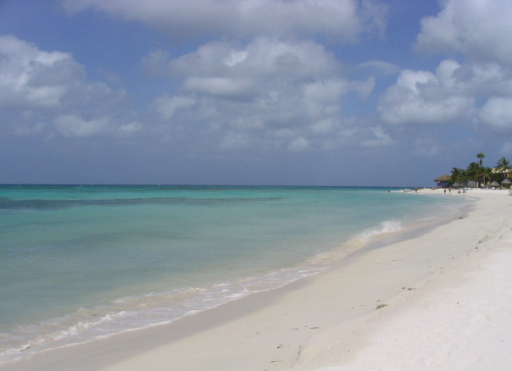
Mediterranean Islands Bike Tour
Mallorca Spain
A view of the beach along the north side of Mallorca near the village of Alcudia.
Travel for 135 miles from Palma to La Puebla over 6 days
Notes:
Make sure Ellen sees photo and approves.

Slide 9
On-line Survey Results
Notes:
Make sure this data is accurate before making final. Ask Ellen for any changes.

Slide 10
Adventure Series
Self Guided | Family | Cruise | Extreme
Mallorca Bike Tour | Italian Alps Camping | Mediterranean Catamaran Tour | Russian Arctic Tour
Black Forest Tour | Black Sea Cottage | UK to Spain Ocean Voyage | Climbing Mt. Elbus
Amalfi Coast Walking Tour | Alicante Beach House | Adriatic Sea Cruise
Kerry Coast Bike Tour
Notes:
Ask Ellen for any additions or changes.

