Slide 1
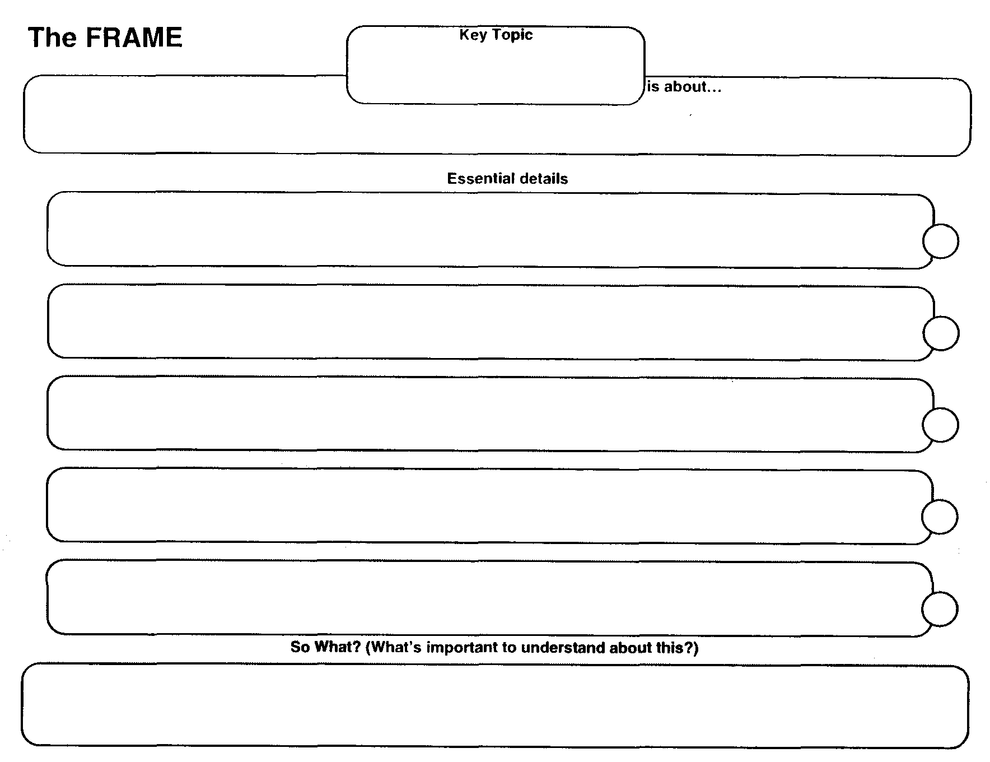
Nationalism

Slide 2
Nationalism

