Slide 1
Name ALL lines and segments.

Slide 2
Name all rays.
Are ray LP and ray PL opposite rays?

Slide 3
Name three points that are collinear
Solution:
D, E and F lie on the same line, so they are collinear.
H
G
D
E
F

Slide 4
Name four points that are coplanar.
Solution:
D, E, F, and G lie on the same plane, so they are coplanar. Also D, E, F, and H are coplanar; although, the plane containing them is not drawn.
H
G
D
E
F

Slide 5
Name three points that are not collinear.
Solution:
There are many correct answers. For instance, points H, E, and G do not lie on the same line.
H
G
D
E
F

Slide 6
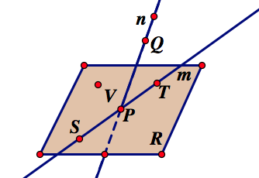
Name two coplanar points, lines.
Name three non-collinear points.
Name the plane two different ways.
Name two intersecting lines at what points do they intersect

Slide 7
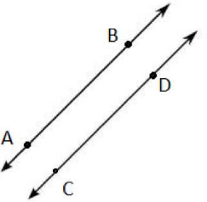
Parallel Lines
Coplanar Lines that do not intersect. (2 dimensional)

Slide 8
Use the figure to name each of the following.
A line containing point K
A plane containing point L
J
M
K
L
B

Slide 9
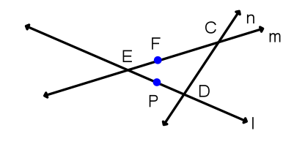
Example 1
a) Are points E, F, and C collinear? If so, which line are they on?
b) Are points E, F, and D collinear? If so, which line are they on?
c) Name line l in 3 other ways.

Slide 10
le 2:
A. Name four coplanar points.
B. Name three lines.

Slide 11
Where does Plane ABCD intersect
Plane ACEG?
What plane contains the points
C, D, and B?
What plane contains the points
E, F, and C?
A
B
C
D
E
F
G
H

Slide 12
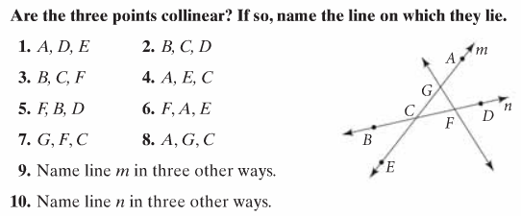
Practice

Slide 13
Example 8:
How many planes appear in this figure?
Name 3 points that are collinear.
Are points A, B, C, and D coplanar? Explain.
At what point does DB and CA intersect?
A
C
B
S
D

Slide 14
Lesson Quiz: Part I
1. Two opposite rays.
2. A point on BC.
3. The intersection of plane N and plane T.
4. A plane containing E, D, and B.

Slide 15
Example 4:
Draw and label each of the following.
A. a segment with endpoints M and N.
B. opposite rays with a common endpoint T.
C. Draw and label a ray with endpoint M that contains N.

Slide 16
Ex. 2: Drawing lines, segments and rays
Draw three noncollinear points J, K, and L. Then draw JK, KL and LJ.
K
Draw J, K and L
Then draw JK
J
L

Slide 17
Ex. 2: Drawing lines, segments and rays
Draw three noncollinear points J, K, and L. Then draw JK, KL and LJ.
K
Draw KL
J
L

Slide 18
Ex. 2: Drawing lines, segments and rays
Draw three noncollinear points J, K, and L. Then draw JK, KL and LJ.
K
Draw LJ
J
L

Slide 19
Ex. 3: Drawing Opposite Rays
Draw two lines. Label points on the lines and name two pairs of opposite rays.
Solution: Points M, N, and X are collinear and X is between M and N. So XM and XN are opposite rays.
M
Q
X
P
N

Slide 20
Ex. 3: Drawing Opposite Rays
Draw two lines. Label points on the lines and name two pairs of opposite rays.
Solution: Points P, Q, and X are collinear and X is between P and Q. So XP and XQ are opposite rays.
M
Q
X
P
N

Slide 21
Lesson Quiz: Part II
Draw each of the following.
5. a line intersecting a plane at one point
6. a ray with endpoint P that passes through Q

Slide 22
Ex. 4: Sketching intersections
Sketch the figure described.
A line that intersects a plane in one point
Draw a plane and a line.
Emphasize the point where they meet.
Dashes indicate where the line is hidden by the plane

Slide 23
Ex. 4: Sketching intersections
Sketch the figure described.
Two planes that intersect in a line
Draw two planes.
Emphasize the line where they meet.
Dashes indicate where one plane is hidden by the other plane.

