Slide 1
Guiding Principles Presentations

Slide 2
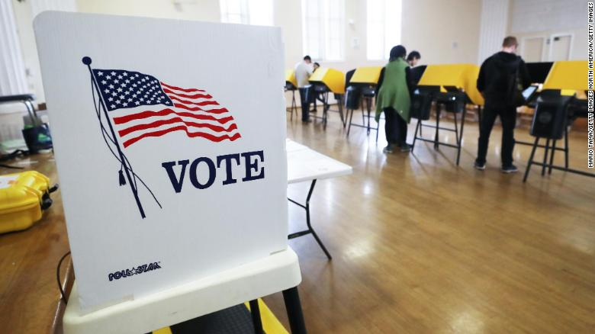
Popular Sovereignty
Sovereignty means power
A government in which the citizens rule.
‘Power of the People!’
People participate through the voting process!
The voting process for the new President has began. Ex. Super Tuesday!

Slide 3
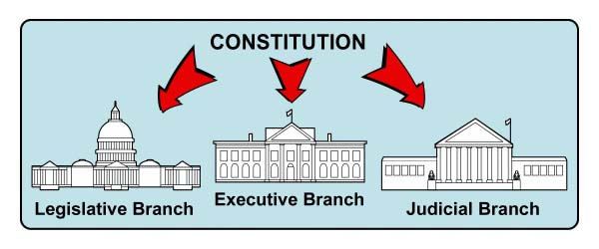
Separation of Powers
Divide the role of government into three branches or parts.
Executive (President), Legislative (Congress) & Judicial (Courts and Judges).
Why? So no one person or group becomes too powerful!

Slide 4
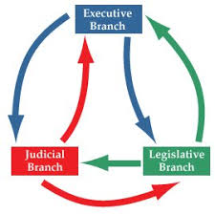
Checks & Balances
Each branch of government has SOME control.
Each branch checks the other two branches.
Example: Federal Judges of the Judicial Branch are nominated by the President of the Executive Branch and approved by Congress of the Legislative Branch.

Slide 5
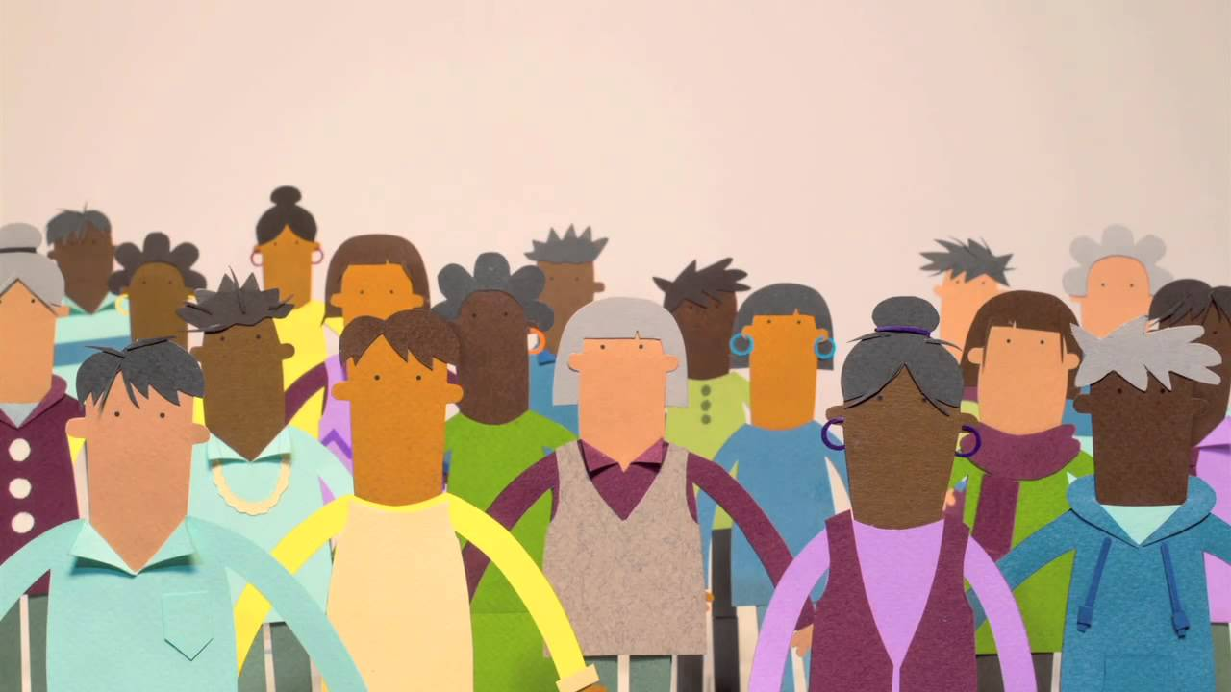
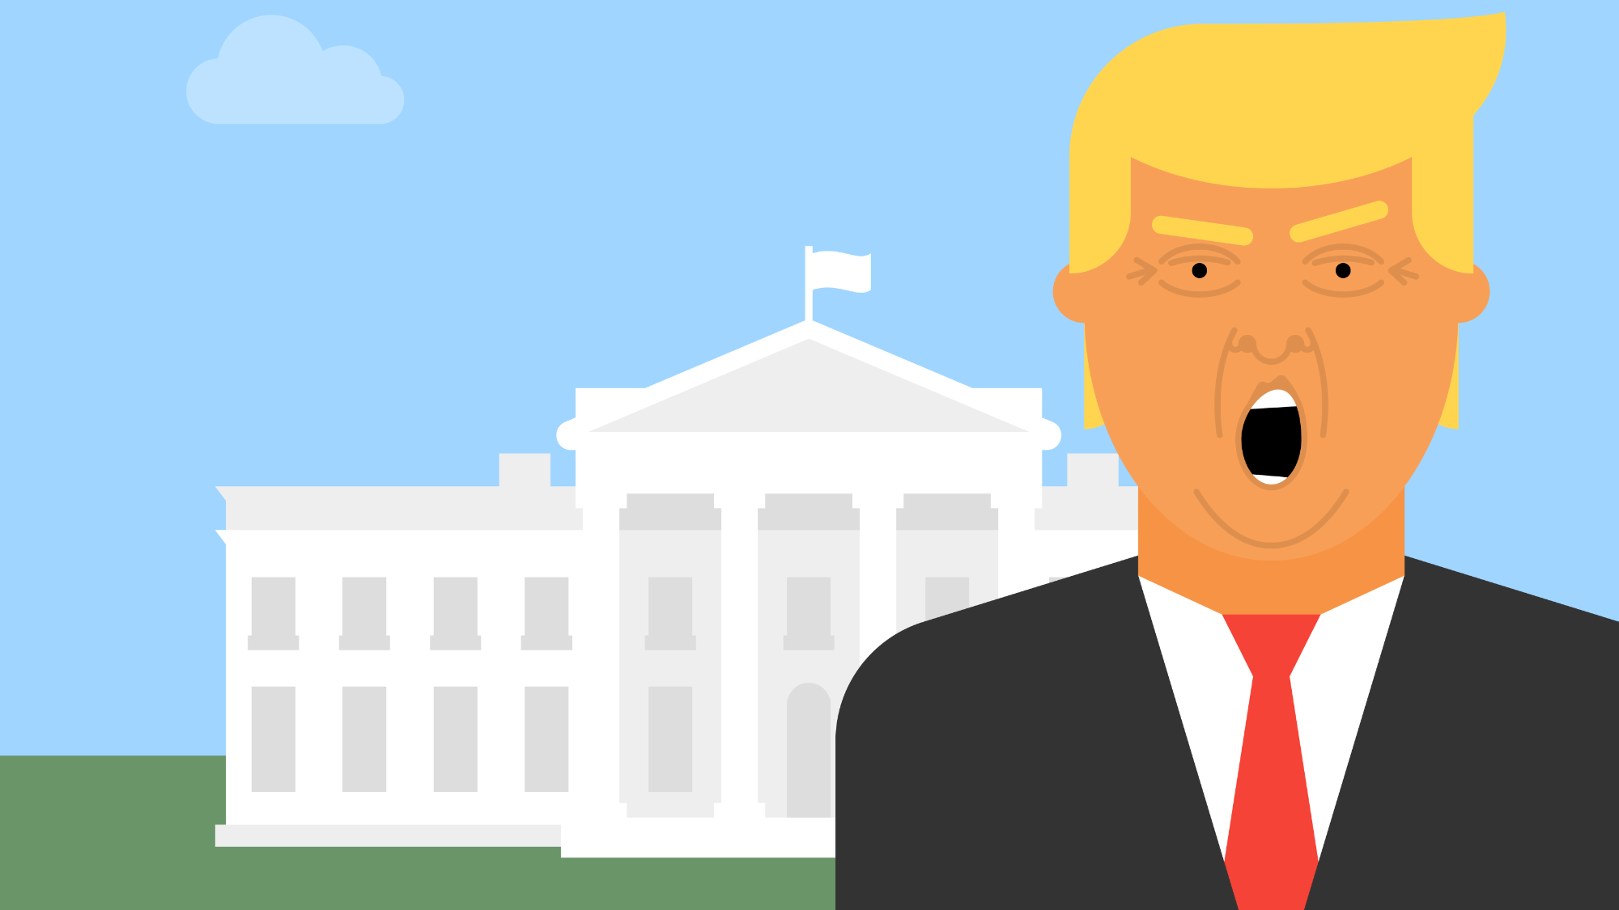
Limited Government
Everybody has to follow the same laws.
Citizens and government officials are alike.
Example: If a representative commits a crime, they face trial like everyone else.

