Slide 1
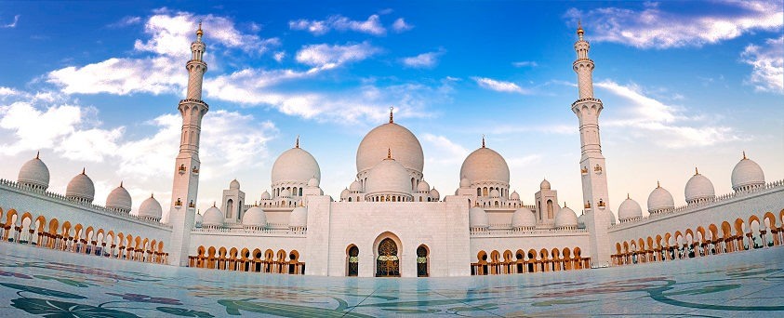
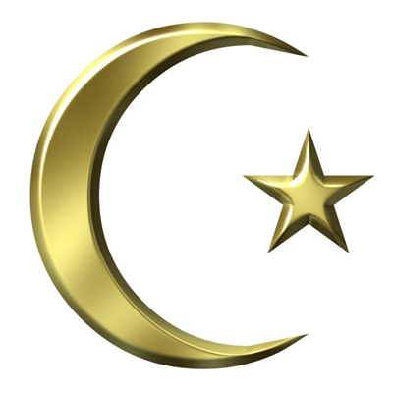
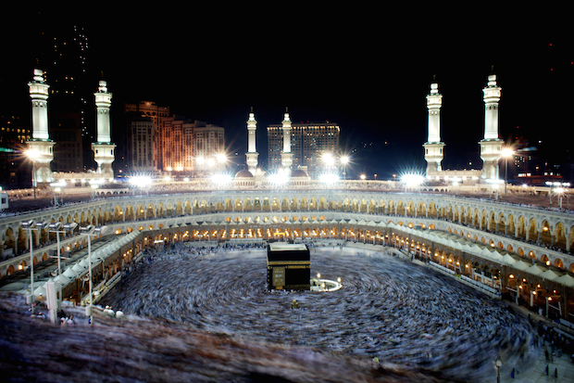
Islam

Slide 2
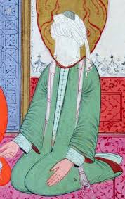
Founder
Muhammad

Slide 3
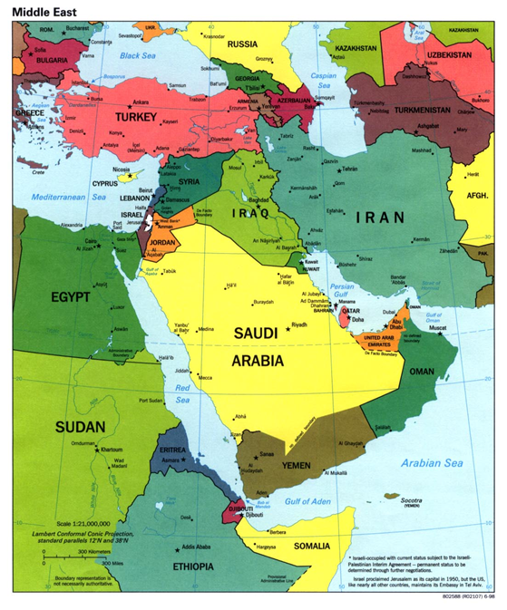
Where/ When it Began
Mecca, Saudi Arabia
Around 610 C.E.

Slide 4
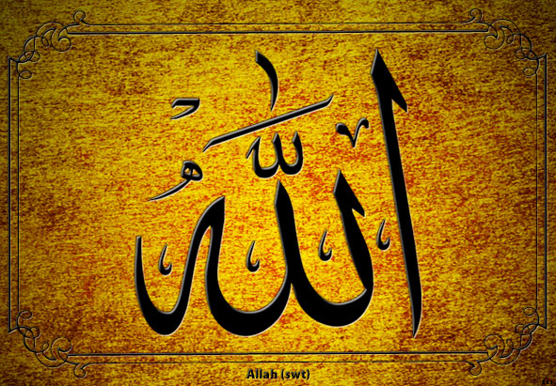
Supreme Being/ God
Allah, God

Slide 5
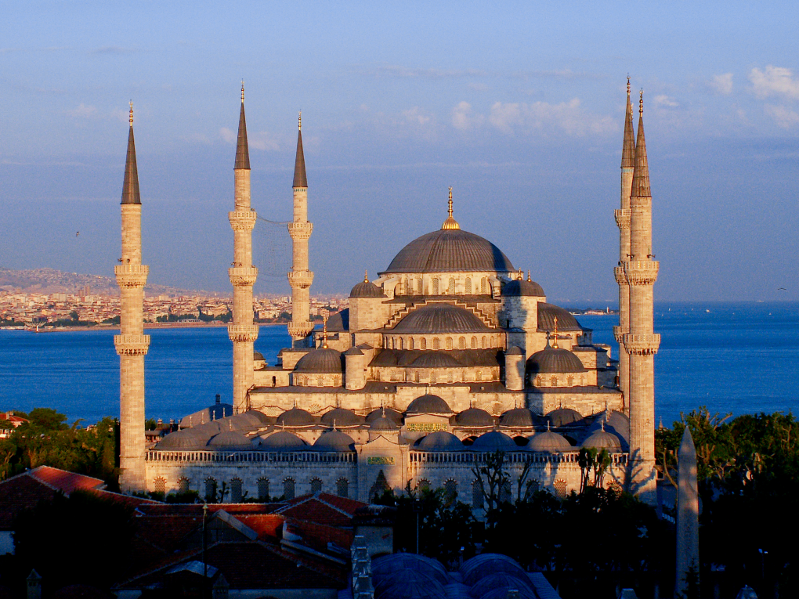
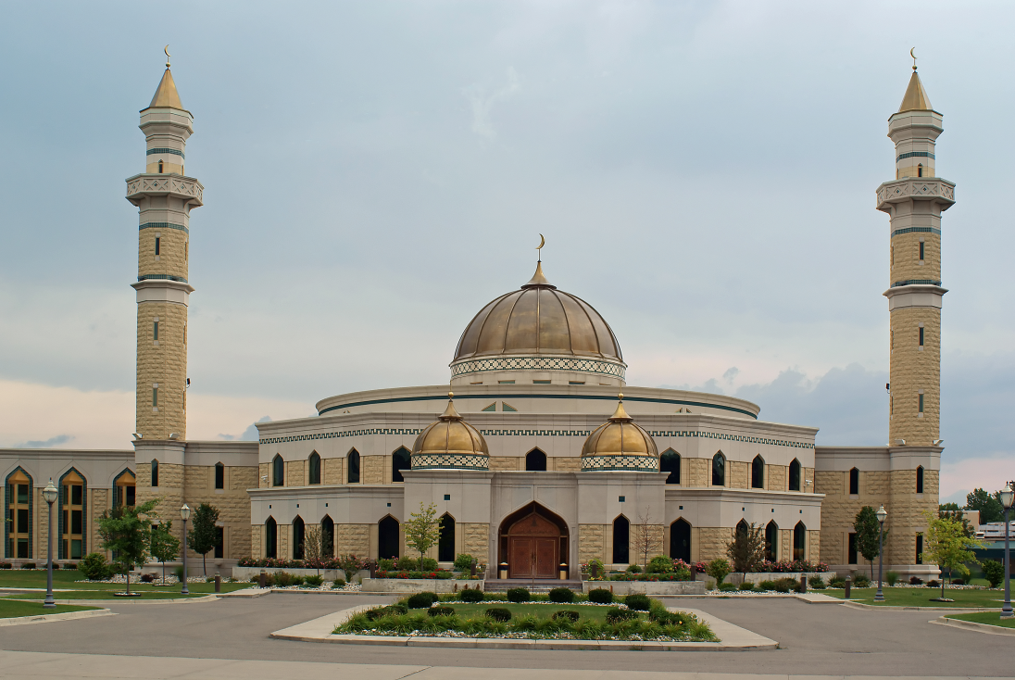
Place of Worship
Mosque

Slide 6
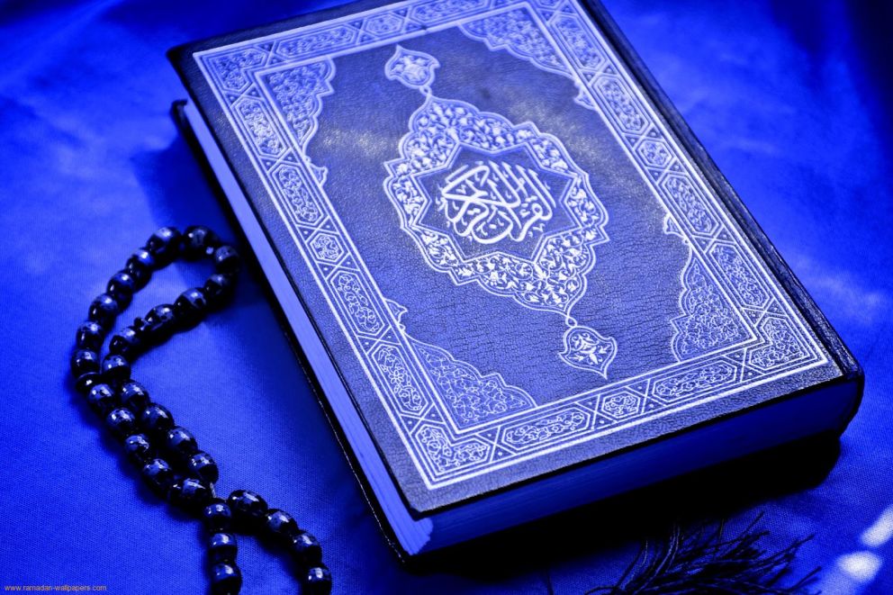
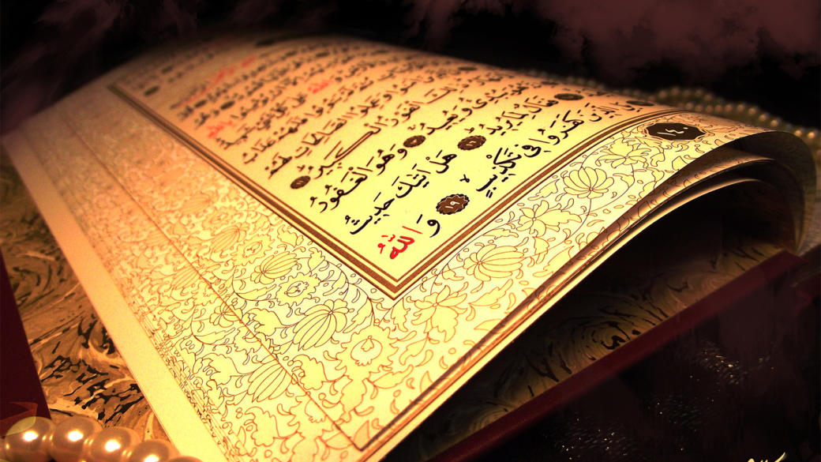
Sacred Books/ Texts
Qur’an
Hadiths

Slide 7
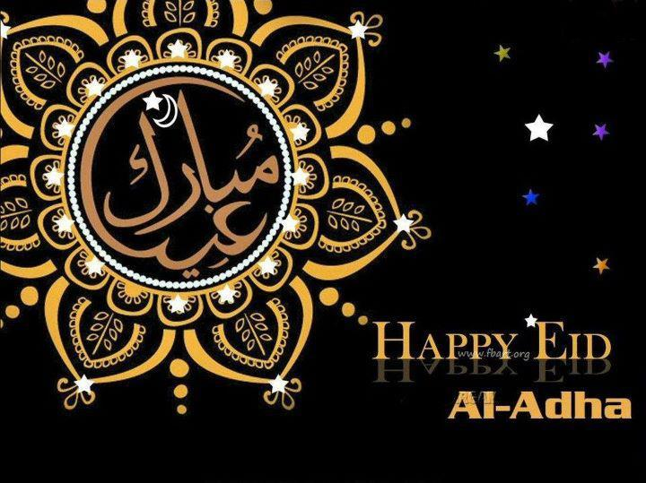
Holy Days
Ramadan
9th month in Islamic calendar
Fast from sunrise to sunset
Eid-Al-Adha
Feast of Sacrifice
Abrahams willingness to
Sacrifice his son to GOD
Celebration after Hajj

Slide 8
Basic Beliefs
Monotheism
Muhammad is Allah’s messenger
5 Pillars
Shahadah – Claim Allah is your God and Muhammad is his messenger
Salat – Pray 5 times a day facing Mecca
Zakat (alms giving) – Charity, give percentage to poor
Siyam – Fast and self-control during the holy month of Ramadan
Hajj – Pilgrimage to Mecca at least once in lifetime

