Slide 1
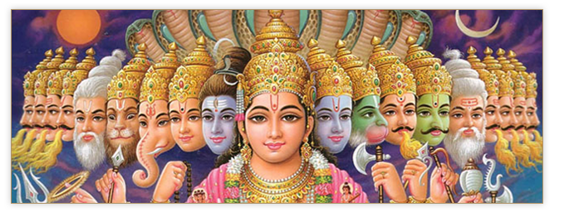
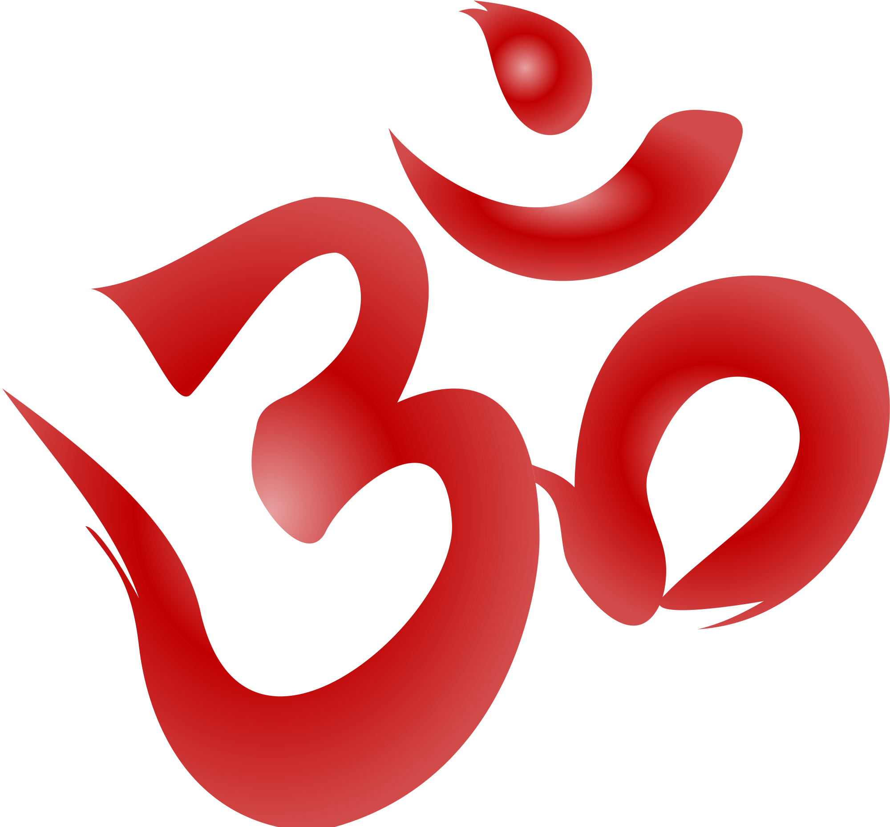
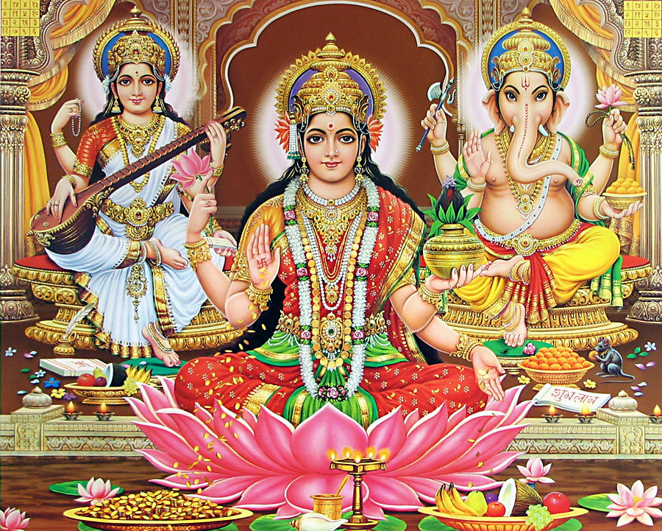
Hinduism

Slide 2
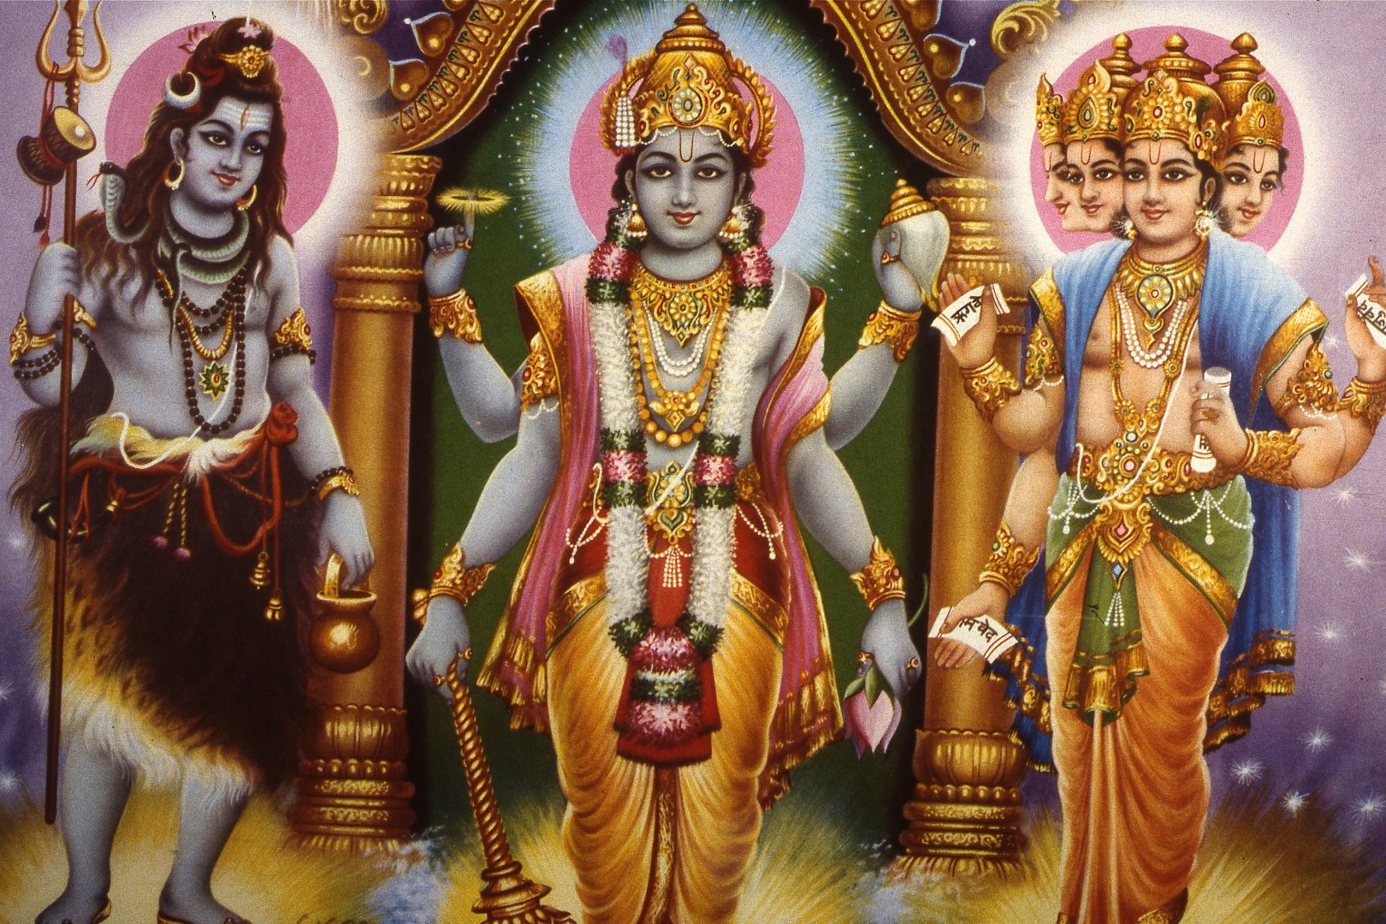
Founder
There is no one founder for Hinduism as it was not founded as a religion

Slide 3
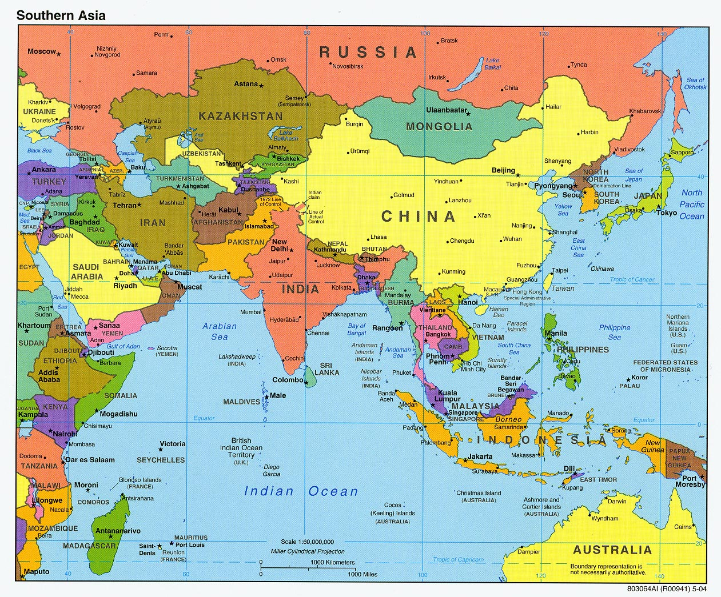
Where/When it Began
Started around 2000 B.C.E. though it can date its origins back to 10,000 B.C.E.
Began in India

Slide 4
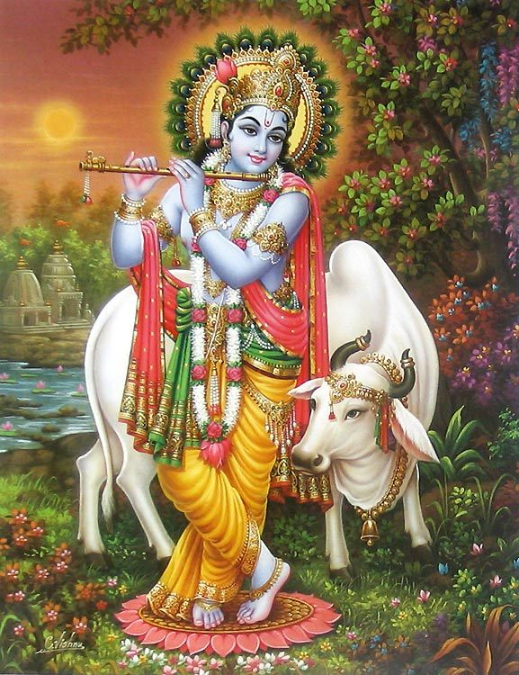
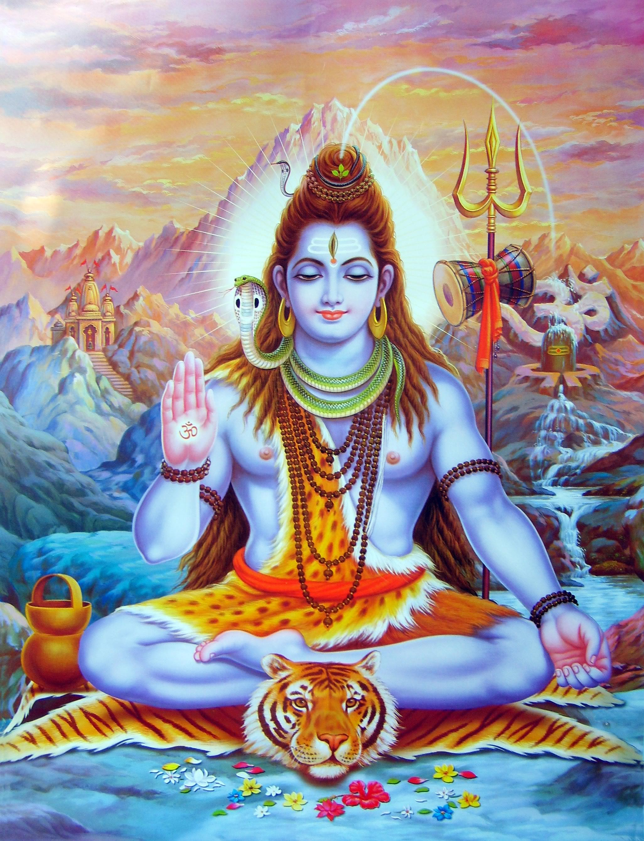
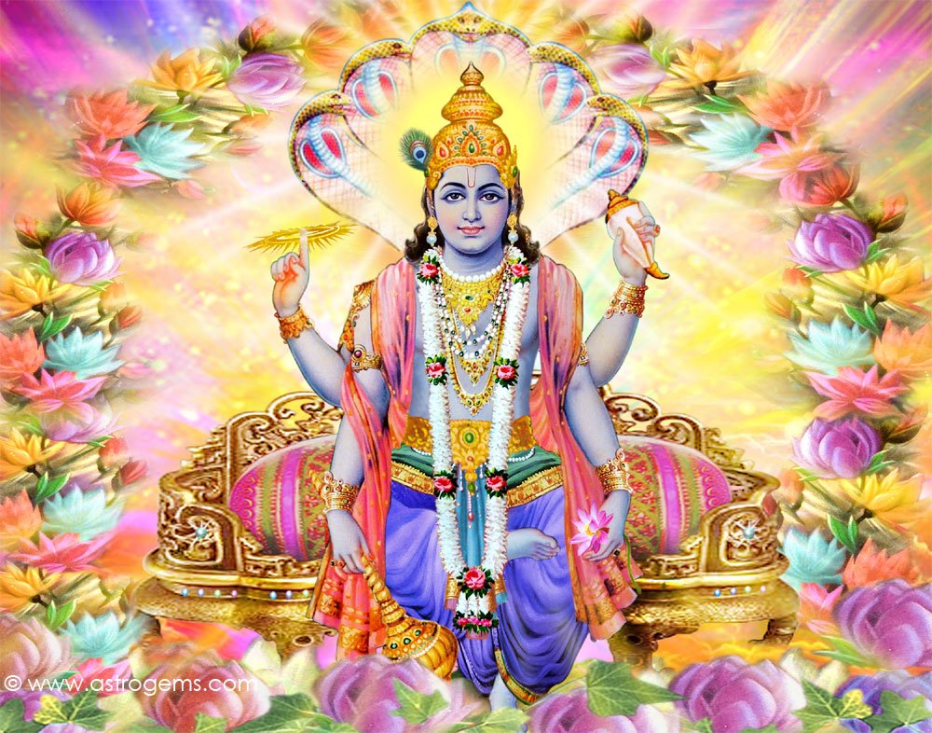
Supreme Being or God
Brahman: the ultimate truth
Most Hindus believe in a diversity of Gods/Goddesses
Most famous: Vishnu, Krishna and Shiva

Slide 5
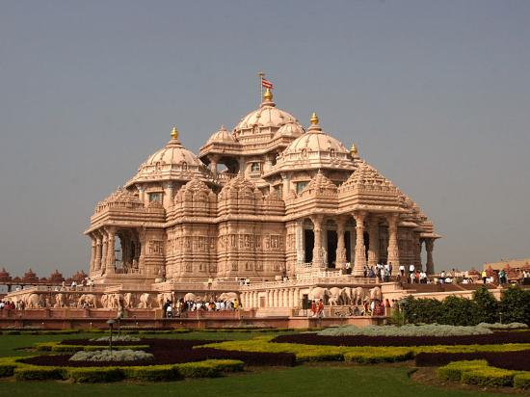
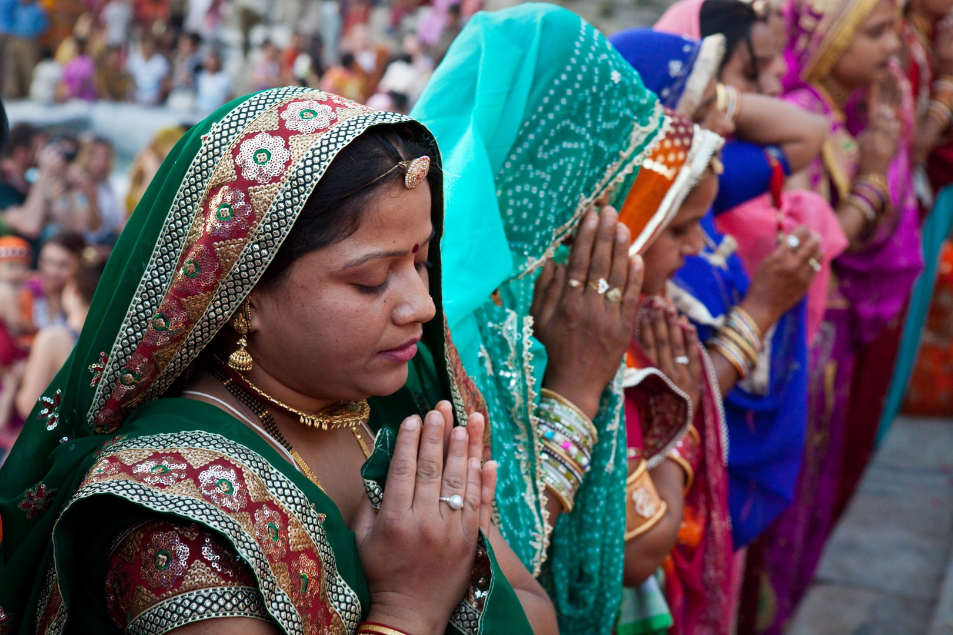
Place of Worship
Shrines and temples
However, Hindus can worship at home or in public

Slide 6
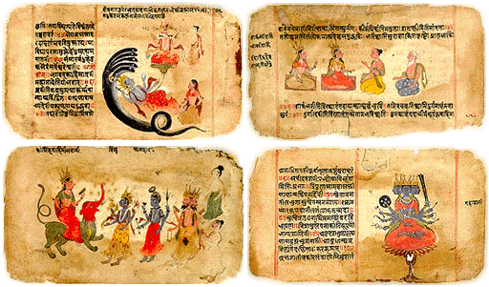
Sacred Book/Texts
The Vedas
The Ramayana
These are a collection of different texts

Slide 7
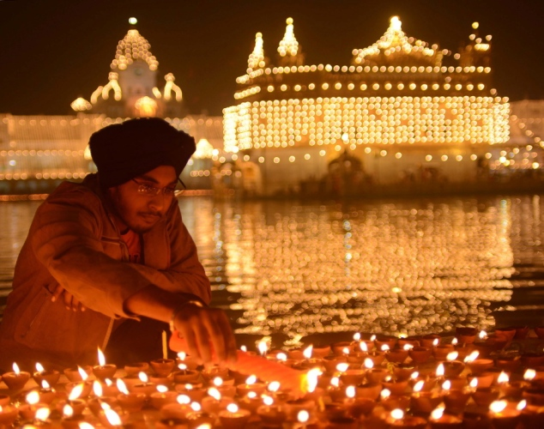
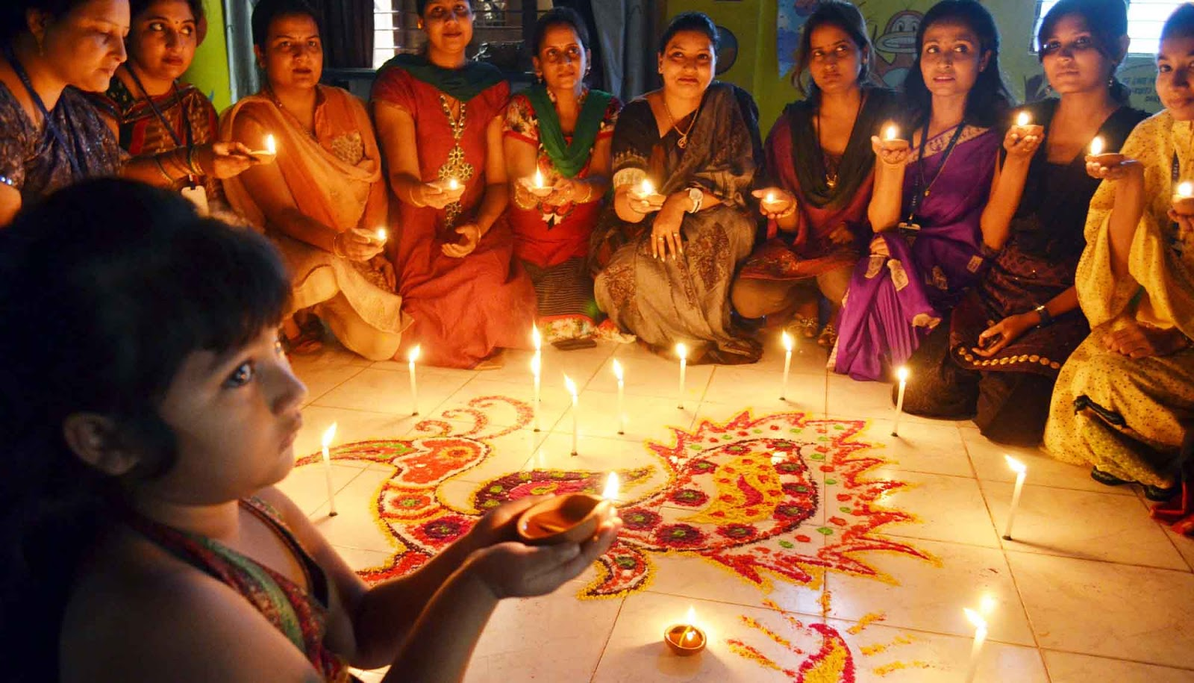
Holy Days
Divali (Diwali)
  Festival of lights to celebrate New Year

Slide 8
Basic Beliefs
Karma
  Good and evil done in a past life determines your next life
Reincarnation
  Belief that a person’s soul is reborn into a new body after death
Dharma
  Law, duty, and obligation

