Slide 1
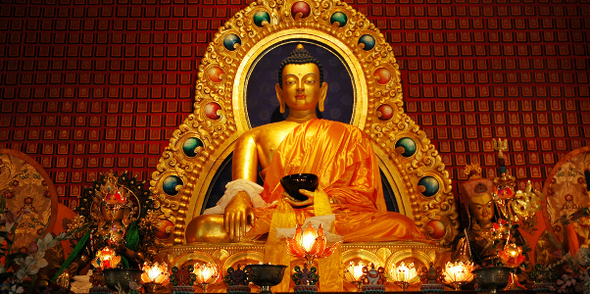

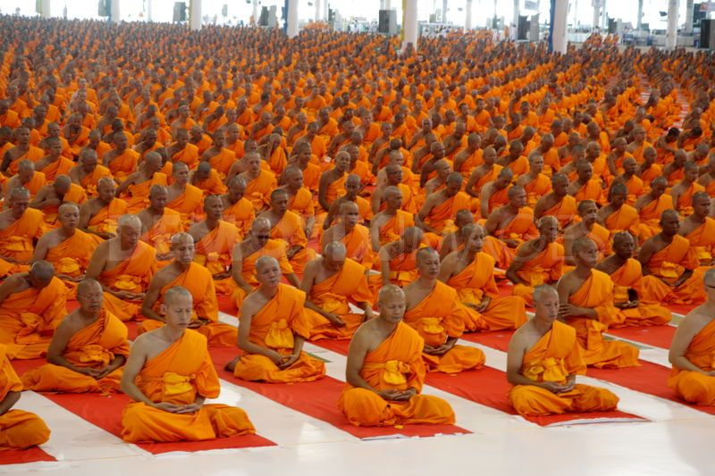
Buddhism

Slide 2
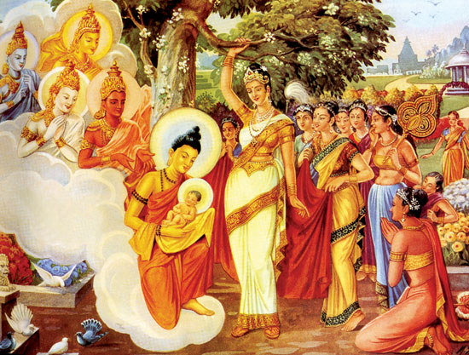
Founder
Siddhartha Gautama (The Buddha)
  Below is Queen Maya holding Prince Siddhartha

Slide 3
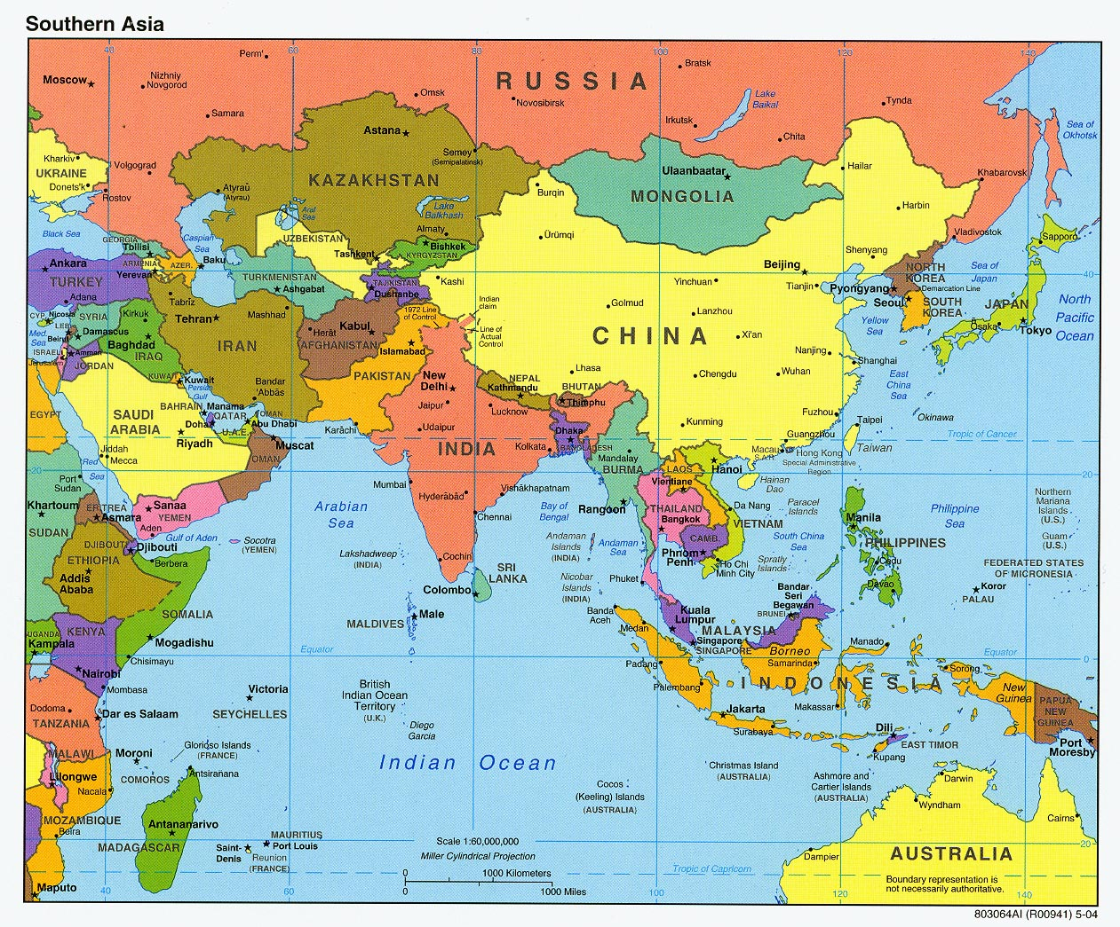
Where/When it Began
About 500 B.C.E.
Began in India

Slide 4
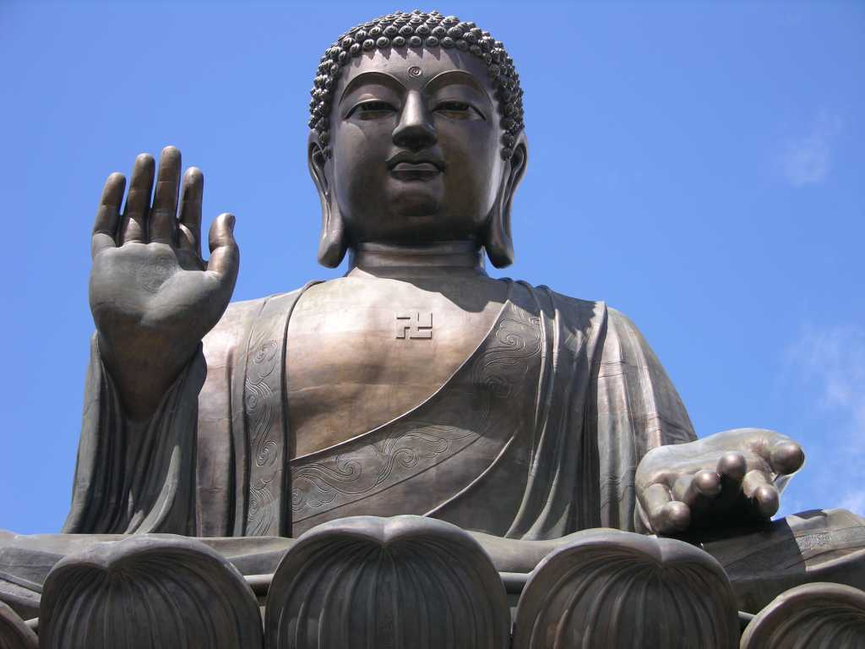
Supreme Being/ God
No God
  However some variations believe in deities
The Buddha is their great teacher

Slide 5
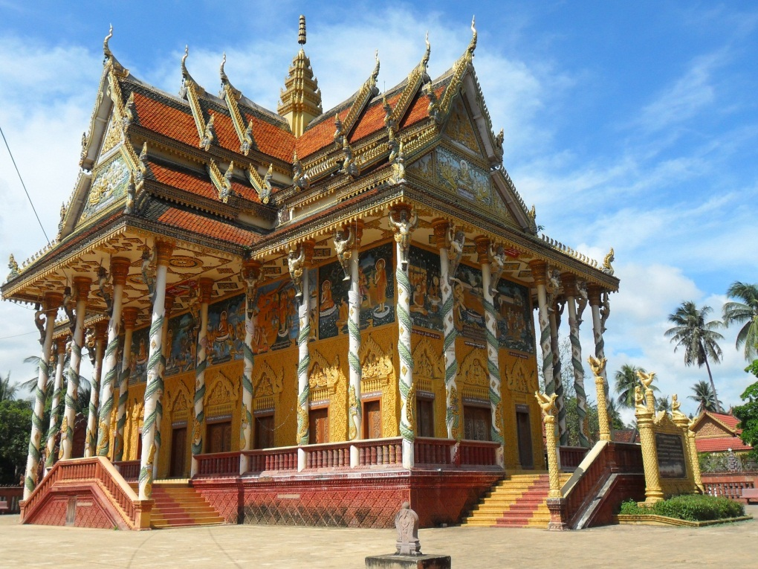
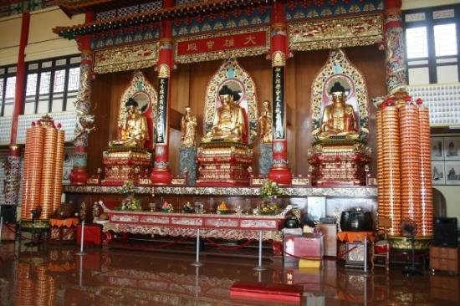
Place of Worship
Temples and Home
  Practicing meditation to reach nirvana

Slide 6
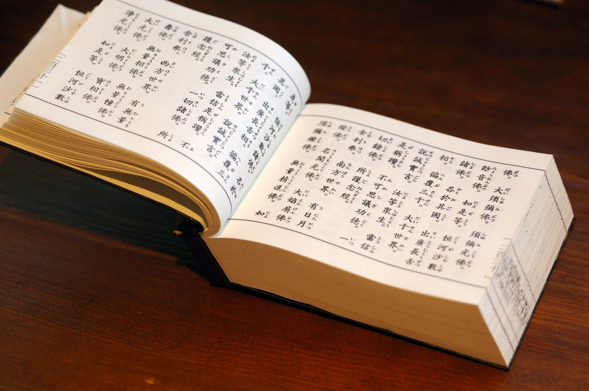
Sacred Books/ Texts
The Sutras
  Believed to be the word of The Buddha

Slide 7
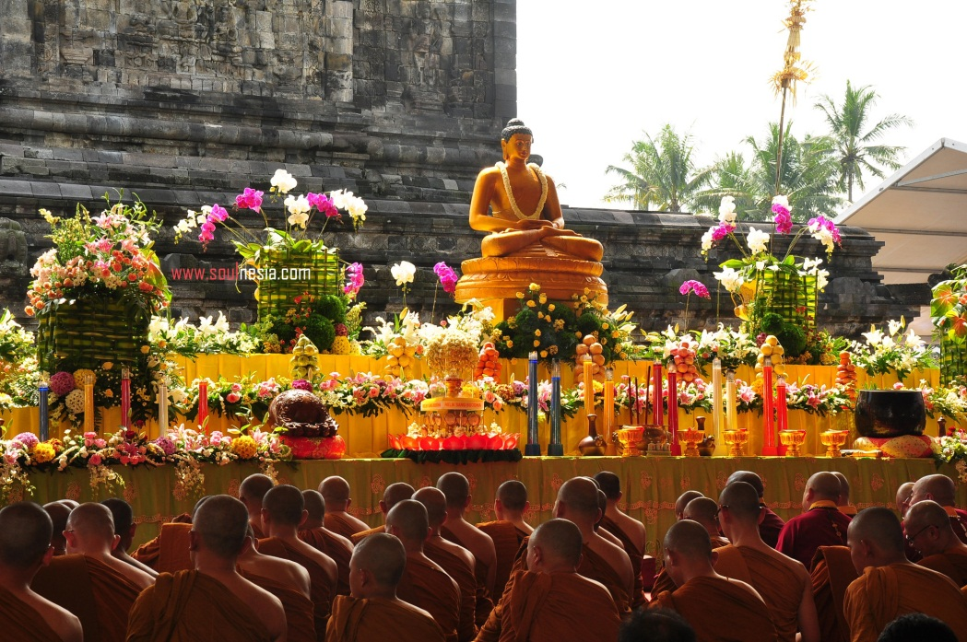
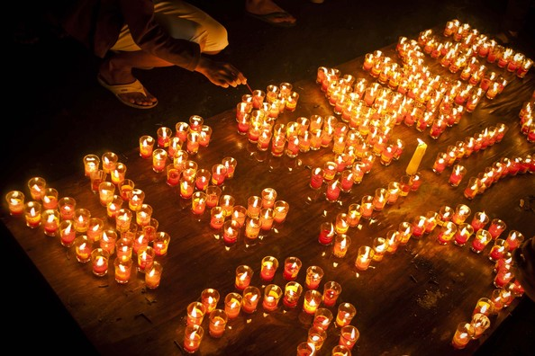
Holy Days
Vesak
  Celebrate birth of Prince Siddhartha

Slide 8
Basic Beliefs
Nontheism
  No supreme God, they must follow the teachings of The Buddha to reach nirvana or enlightenment
Four Noble Truths
  Suffering is caused by wants or cravings, and to end that, you must follow the eightfold path
Eightfold Path
  Follow these teachings to reach enlightenment, or inner peace

