Slide 1
National Junior Honor Society
Woodworth Middle School

Slide 2
What is NJHS?
NATIONAL JUNIOR HONOR SOCIETY
High achieving students
Selected by teachers
Plan and carry out service projects
Earn a Certificate of Honor
Invited to the Inauguration Ceremony
Only the best students get accepted

Slide 3
National Junior Honor Society
National Junior Honor Society (NJHS) is more than just an honor roll. The honor society chapter establishes rules for membership that are based upon a student’s outstanding performance in the areas of: Scholarship, Service, Leadership, Character, Integrity, and, Citizenship. These criteria for selection form the foundation upon which the organization and its activities are built.

Slide 5
Scholarship - Having a high level of learning; and achievement.

Slide 6
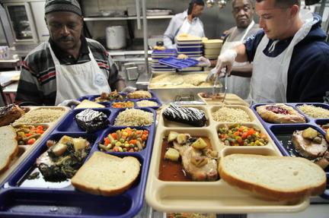
Service
an action of helping or doing work for someone.

Slide 7
Leadership
Resourceful in proposing new problems, applying principles, and making suggestions.
Exemplifies a positive attitude.
Inspires positive behavior in others.
Demonstrates academic initiatives.
Able to delegate responsibility.

Slide 8
Students emulate CHARACTER by:
showing courtesy, concern ,and respect towards others.
demonstrating high standards of honesty and reliability.
being a positive reflection to the organization.
being of good character and cooperative.
maintaining a clean disciplinary record.

Slide 9
CITIZENSHIP
A person who is kind and helps other people
The student who demonstrates citizenship understands the importance of civic engagement.
Demonstrates mature participation and responsibility in activities such as, community organizations, or school clubs.

Slide 10
How Do I get in to NJHS?
Must have a 3.7 GPA or Higher
Get recommended by a teacher
Must complete and submit an application on time
Willing to cooperate with others
Demonstrates Leadership skills
Exhibits the 5 Pillars of NJHS: Leadership, Scholarship, Service, Citizenship and Integrity
Participates in Community service projects
Be responsible

Slide 12
Good Luck

