Slide 1
Welcome,
Students and Parents!
Mrs. Dearth
Room 10

Slide 2
Classroom Schedule
8:40 – 9:00 | School starts, Attendance, Lunch count, Morning Meeting, Independent Reading
9:00 - 9:45 | Writing
9:45 - 10:45 | Guided Reading, Spelling, Grammar, and Vocabulary
10:45-11:30 | Specials throughout the week, times vary. Gym, Music, Art, Instrumental
11:30 -12:30 | Math
12:35-1:12 | Lunch
1:15 – 2:00 | Science
2:00-2:10 | Break
2:10-2:25 | Recess
2:25- 3:20 | Social Studies
3:25-3:35 | Homework, Clean-up, Pack-up! Dismissal
This is what a typical day in Room 10 looks like.

Slide 3
Learn About Our Class
The teacher
Class goals and community
Subjects
Homework and field trips
Schedule/Tardiness
Supplies
Getting help
Questions? Raise your hand, please.

Slide 4
Get to Know Me
My experience
My background
This is my 22nd year teaching!
I’ve taught 4th and 5th graders.
5 years at Lowrey Elementary and 16 here at Howard.
I grew up in Ohio, but have lived in MI for 28 years.
I lived on a race horse farm in Ohio, and had my own horse!

Slide 5
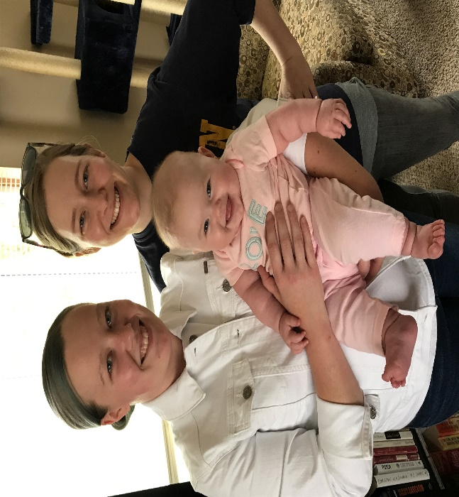
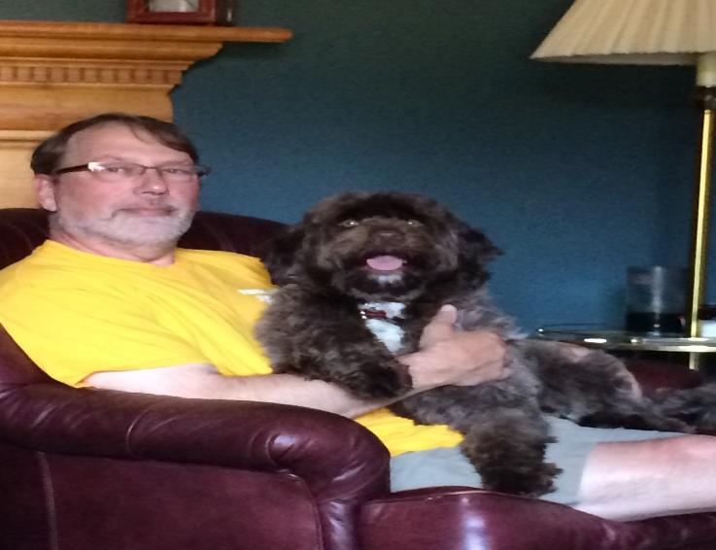
My Family
Mr. Dearth is a retired chemistry scientist for Ford Motor Company.
Anne is 29, and lives in Bowling Green, OH.
She is a professional flute musician.
Megan is 27, and lives in MI with her husband.
They have a little girl, Cora.
Brooklynn is our 4 year old Portuguese Water Dog.
I should say Mr. Dearth’s dog!

Slide 6
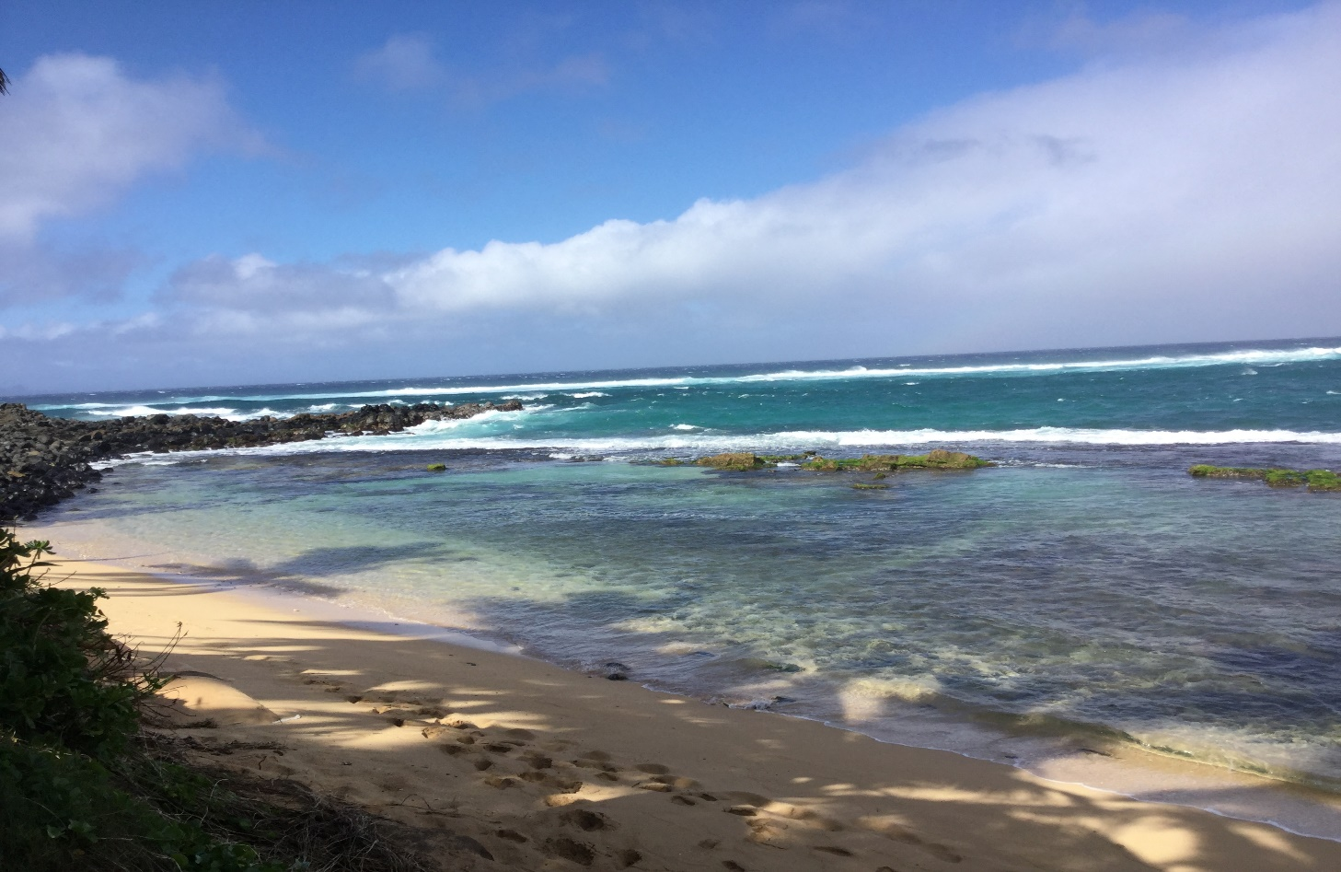
Hobbies/Interests
Family
Grandparenting
Reading!
Traveling
Island of Maui in Hawaii

Slide 7
Learning Environment
Each Other
Library & Chromebooks
Parent Volunteers
and ME!

Slide 8
Classroom Community
Our classroom rules help us get along with each other:
  Be respectful and responsible.
  Be organized, follow directions, and safe.
  Be on time.
  Be prepared.

Slide 9
Class Goals
Learn new skills
Discover new interests
Make new friends
Support each other
Have Fun!

Slide 10
Class Subjects
Language Arts, Reading, Writing(creative & cursive), Spelling, and Vocabulary
Math
Science and Technology
Social Studies
Music, Gym, Art, and Instrumental

Slide 11
Reading
Foster a love for reading!
Learn and develop strategies to be the reader you want to become!
Read daily

Slide 12
Writing
Write, write, write!
Narrative, Informational, and Opinion writings
Being creative!

Slide 13
Math
Place Value
Rounding
Fractions, fractions, fractions
Decimals
Volume/measurement

Slide 14
Science
Matter
Solar System
Ecosystems
Earth Systems

Slide 15
Social Studies
Themes of Geography
American History
-Native Americans
-Colonization
-American Revolution
-Government

Slide 16
Technology
Google Classroom
Google Docs
Research
Word Processing
Blogs

Slide 17
Homework
Read every night.
Complete class work/math practice
Need extra time? Ask!

Slide 18
Field Trips
We have lots of fun field trips planned for this year!
Trips are connected to curriculum
Examples:
-Detroit River science experience
-The Henry Ford American Revolution exploration

Slide 19
Tardiness
First bell 8:35. Time to unpack and get ready to start the day.
School starts at 8:40 A.M.
Running late? Check in at the school office before coming to class.

Slide 20
Supplies
Bring these items each day
Number 2 Pencil, Colored Pencils
Spiral Notebooks
Homework & Subject Folders
Make sure you bring
Your Smile!

Slide 21
Questions?
Please email or call me!

Slide 22
Communication
My email: dearthm@dearbornschools.org
My phone: 313.827.6350
Class blog: http://iblog.dearbornschools.org/dearthm/

Slide 23
Let’s Have a
Great Year!

