Slide 1
Language Arts
Mrs. Dailing
Room 15
Please sign in outside of my door!

Slide 2
Advocate
Be independent
Speak up for yourself
Problem solving on their own
Staying organized

Slide 3
Contacting the Teacher
Email first – dailine@dearbornschools.org
24 Hours to respond
Meetings will be scheduled by appointment only
All teachers will try to be in attendance
Contact any teacher to schedule a meeting
Meetings times:
Before school
Between 2:00-2:55
3:05-3:30

Slide 4
Ways to Stay in the loop
Blog-No Response
iblog.dearbornschools.org/dailing
Remind 101 – directions on syllabus sent home
Email (fastest) - dailine@dearbornschools.org
Please contact teachers with your concerns prior to contacting office/administration

Slide 5
Formative v. Summative
Formative Grades
Homework assignments
20% of students’ grade
Typically worked on in class and sent home if not completed
Summative Grades
Tests
Major Projects
Quizzes
80% of students’ grade
Given a significant amount of time and notice to prepare for

Slide 6
Assessment Retakes
Quizzes
No retakes
Aren’t given often
Tests
Students are notified in class and on the blog of retake dates
Students must have original test signed and meet assessment retake requirements (posted in class and on blog)
Students must show up for scheduled assessment retake time
Students must have no missing assignments from the unit in order to be eligible for a retake
Rewrites for Essays and Projects
Retakes will not be given for papers and projects
Teachers spend an extensive amount of time providing feedback throughout the process
Students should utilize the feedback given by the teacher and classmates throughout the process to show their academic abilities

Slide 7
Language Arts Curriculum
Reader’s Apprenticeship Framework
Reading Daily
Writer’s Workshop Daily
Reading Comprehension
Texts from literature book at grade level
NewsELA-Article of the Week
Read Theory-Non-Fiction
Vocabulary
Writer’s Workshop
Narrative
Argumentative
Compare/Contrast
Literary Analysis
CER Constructed Responses
Grammar
Interactive Notebook (ISN)
Used to keep track of all of students’ notes and in class learning
Study guide for all assessments

Slide 8
Homework
Moby Max-Language Section
Lessons are assigned to correspond with grammar units
2-3 weeks to complete
Must score 80% or higher or lesson must be redone
2 good fit books per marking period
Students should be reading a minimum of 100 minutes each week outside of the school day
Students will create a one-pager for each book they have read
Bellwork on Fridays will be a constructed response focusing on reading comprehension and relating to their good fit book
Due October 26th, January 11th, March 22nd, and June 7th at 3:05 pm
Article of the Week
NewsELA (Biweekly)
Due Friday at the end of class
ReadTheory
5 quizzes per week
Must pass quizzes
Due Friday at the end of class
Anything not completed during class time is homework – need access to internet outside of school

Slide 9
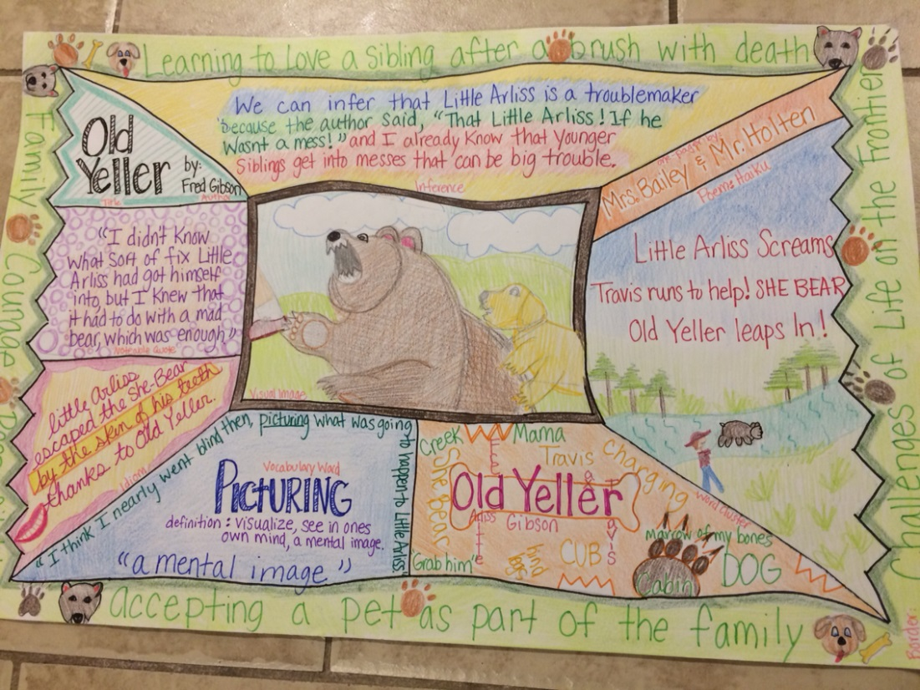
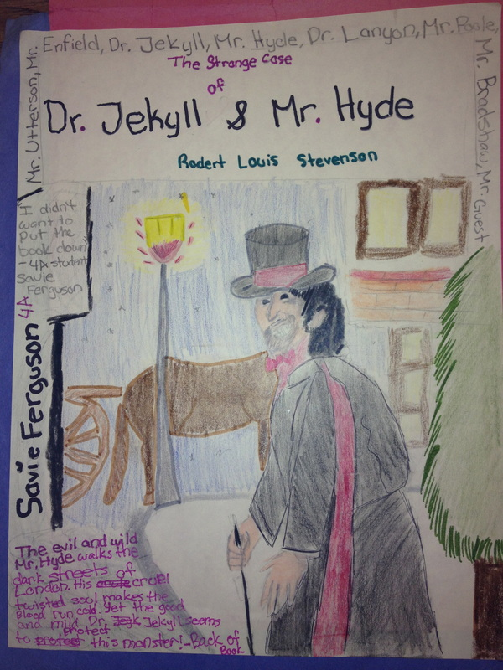
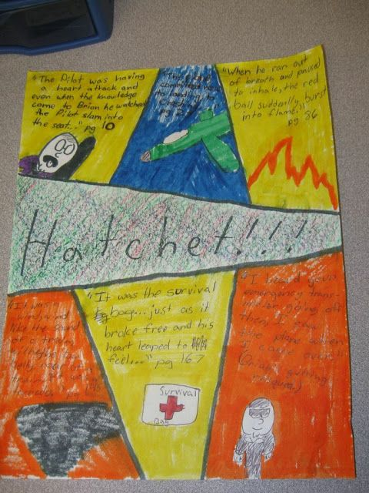
One-Pager Examples
Homework

Slide 10
Scholastic Book Order
We are getting books!
Fundraised by 6th grade LA teachers
1 new book per child per month
September through May
Student owns book

Slide 11
Questions

