Slide 1
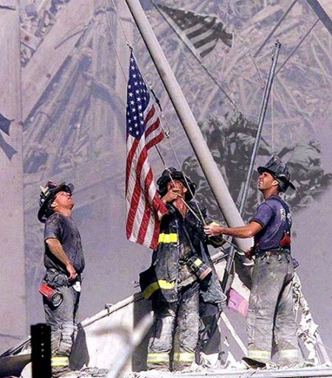
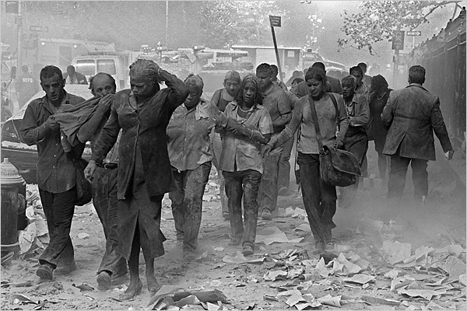
Bell Work
What do you know or remember about September 11th, 2001?

Slide 2
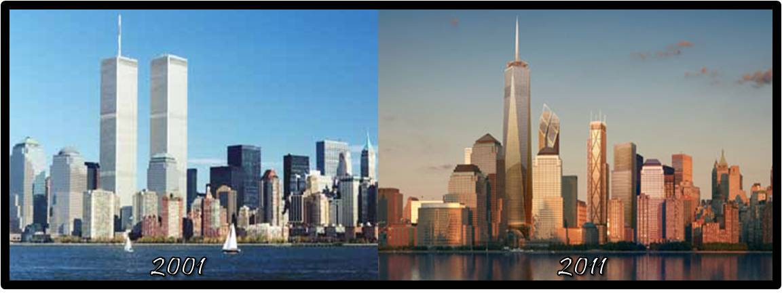
September 11th, 2001
What happened that day?
How did this happen?
How did it change every day life in the United States?
What about our future?

Slide 3
What Happened?
On September 11th, 2001 two commercial airplanes were intentionally flown into the two tallest structures in America- the north & south towers of the World Trade Center in New York City.
A 3rd plane was intentionally flown in the United States Pentagon in Washington D.C.
A 4th plane was intentionally crashed in Pennsylvania on it’s way to Washington D.C..
America had not been attacked on it’s own soil from external enemies since December 7th, 1941 when the Japanese bombed Pearl Harbor, Hawaii.
September 11th, 2001 Timeline
September 11th, 2001 Statistics
Artifacts from Ground Zero

Slide 4
Group Discussion: Part 1
In groups of 3-4 people from your table answer the following questions in 3-5 sentences.
Be prepared to discuss it with the class!
1.) If you were the Mayor of New York City, how would you handle this situation?
2.) If you were the President of the U.S., how would you handle this situation?

Slide 5
America’s Response
Immediate Response:
Get emergency responders to the scene & get everyone out of Lower Manhattan. Secure New York City. Secure America.
Alert the President & Vice President
Shut down all non-government air traffic across the U.S.
(Flight 93 & Lucky Penney)
Secure the safety of the President & Vice President
Later Response:
Figure out who did this & decide on how to take action
Begin clean up & support efforts
Give a Presidential speech for the world to see how America handles tragedy & terrorism (“We will not negotiate with terrorists”)
Prepare for war? With who? Where?

Slide 6
How Has 9/11 Changed America?
U.S. Morale: Immediately after 9/11 attacks, national pride soared & people banded together to send aid to NYC, the Pentagon, & to the families who lost loved ones.
Economics: hundreds of NYC based companies were unable to work for weeks or months, the New York Stock Exchange closed until Sept. 17th, Wall Street shut down, & the U.S. lost $1.2 trillion in one week…
Some believe we are still recovering economically…
The U.S. waged a “War on Terror”. We have engaged in wars in Iraq & Afghanistan in efforts to defeat the spread of terrorism.
Security & travel were immediately evaluated & strengthened through various federal regulations & the Patriot Act.
How does the world view the United States because of 9/11?
As a response to 9/11, prejudice, profiling, & immigration have been huge topics in America.

Slide 7
Group Discussion: Part 2
In the same groups of 3-4 people from before answer the following questions in 3-5 sentences.
Be prepared to discuss it with the class!
1.) How do we still see & feel the effects of September 11^{th,} 2001 today in 2014? (3+ examples)
2.) Who were some of the heroes of September 11th?
3.) What can we learn from September 11th as a nation? What can we learn as individuals?

