Slide 1

Judaism
“A 4000 year old tradition with ideas about what it means to be human and how to make the world a holy place”
  -Rabbi Harold Kushner, To Life
A faith, a people, a way of life…
Jewish religion & Jewish culture are often closely connected

Slide 2
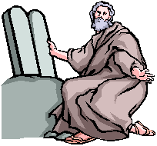
Beliefs of the Jewish Faith
Monotheistic: One God, creator of the universe
Moses once saved the enslaved Hebrews & later God revealed the Torah to him on Mt. Sinai
There is a covenant between God & the Jews
God will someday send a messiah (a savior) who will redeem them from exile & usher in an era of world peace
Pray directly to God, live a moral life, & care about humanity

Slide 3
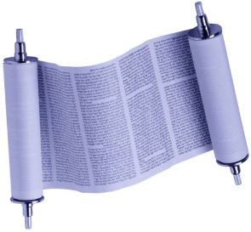
Sacred Texts
The Torah contains the first five books of the Hebrew Bible
  religious, moral, & social law to guide Jews (613!)
  history of the Jewish people originally written in Hebrew
  contains the Ten Commandments
  the Hebrew Bible does not include the New Testament; it is the Old Testament in the Christian Bible
  Hebrew Bible is split into 3 sections: the Torah, the Prophets, & the Writings
The Talmud contains Jewish teachings, legal discussions & narratives about Jewish history, ethics, & traditions
  typical printing includes 12,800 large pages!

Slide 4
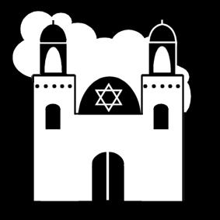
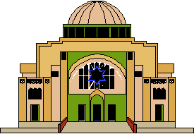
Sacred Sites & Leaders
The Western Wall, or the Wailing Wall, is what remains of the structure surrounding the Second Jerusalem Temple & it is for prayer
Israel: roots for the Jewish people & Judaism
Temples & synagogues are Jewish places of worship & meetings
Rabbis are male teachers of the Jewish faith
Moses is the greatest of the Jewish prophets

Slide 5
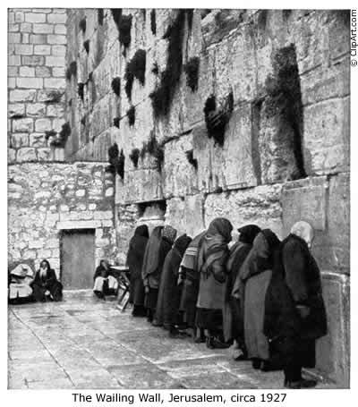
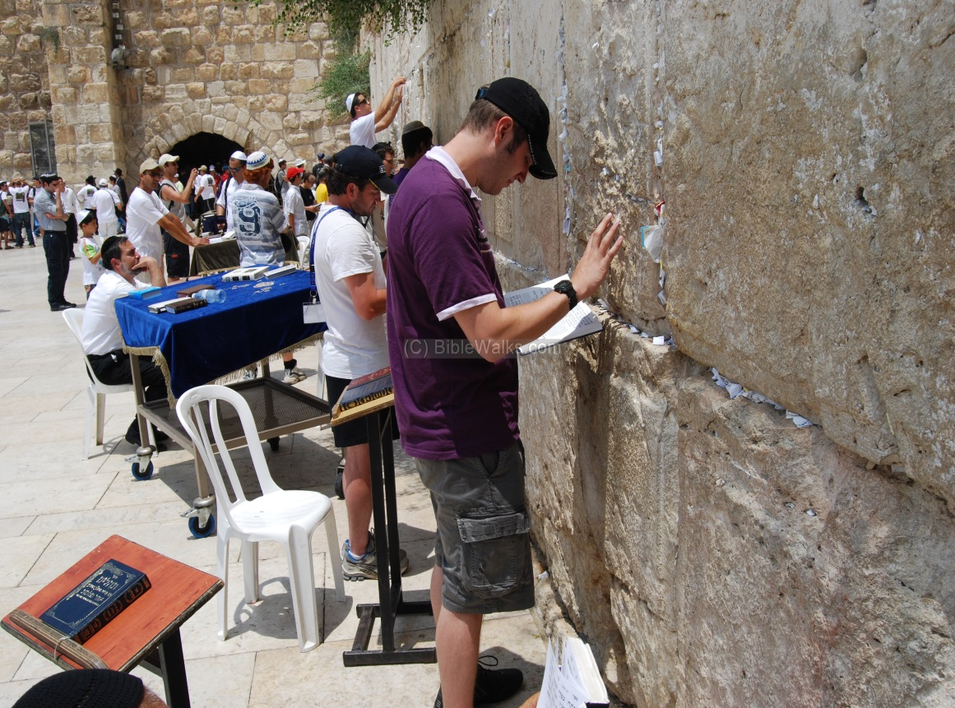
The Wailing Wall

Slide 6
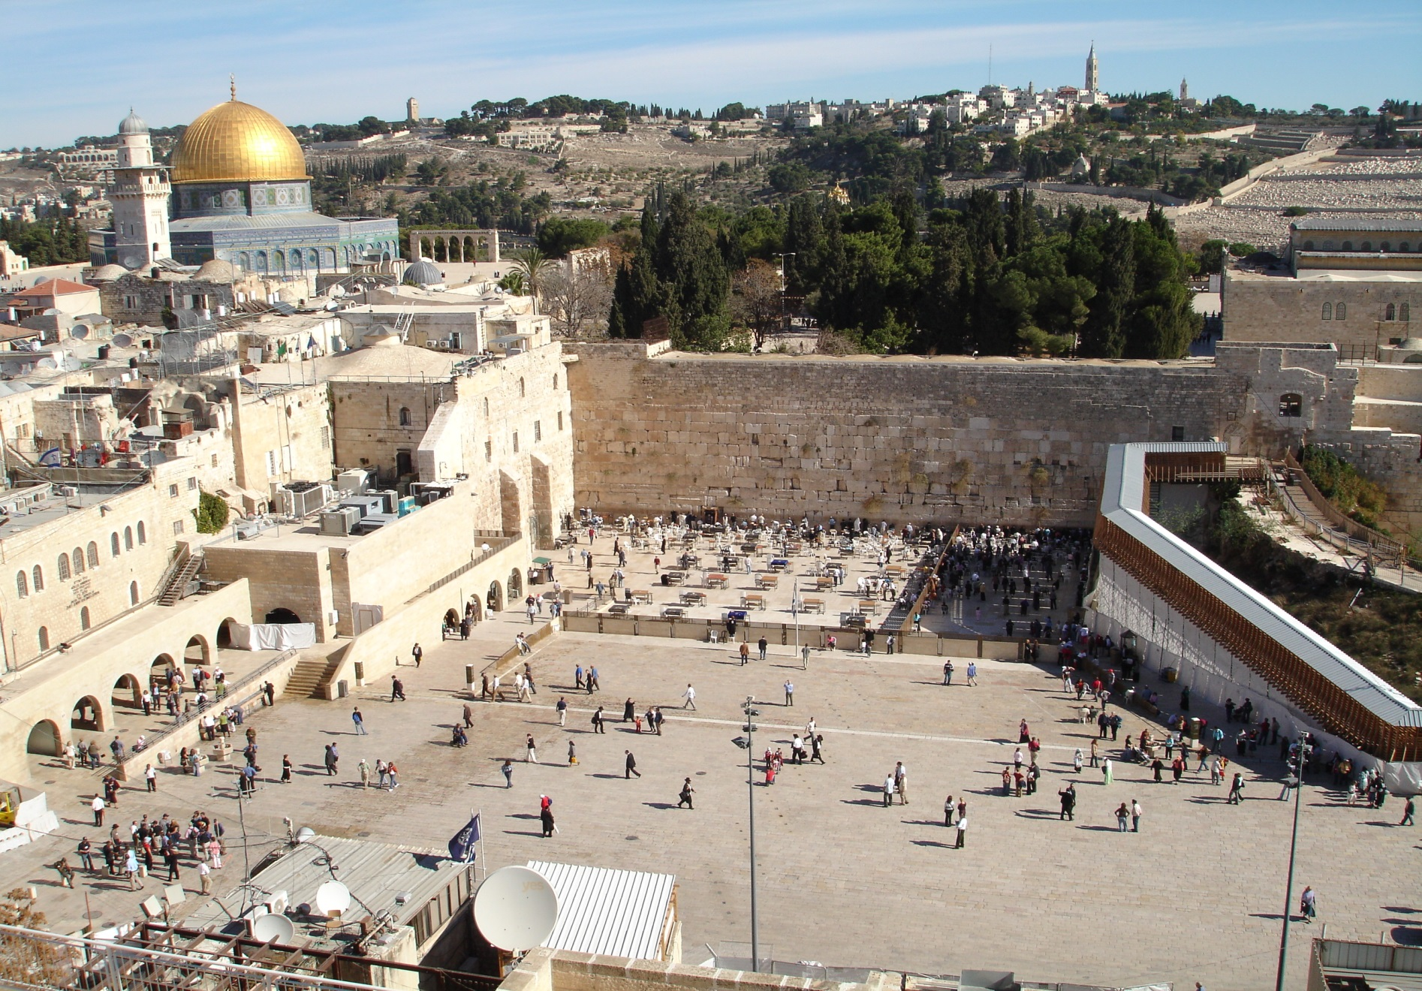

Slide 7
Sects of Judaism
Orthodox: most traditional; strictly observe Jewish laws; incorporate modern dress & life
Conservative: moderate Jews; believe Jewish laws should adapt, but keep main values
Reform: most liberal; Torah was written by multiple human sources, not directly from God
Hasidic: strictly observe Jewish laws & do not integrate into modern society; dress distinctly & live separately from the modern world
Kabbalah: Jewish mysticism on how life works

Slide 8
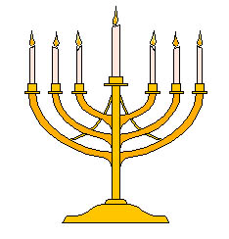
Sacred Symbols
The Menorah: 7 candles; oldest symbol; represents the burning bush Moses saw on Mount Sinai; end of each branch is a lamp lit by olive oil; used in the Temple in Jerusalem & in synagogues
It is used during Hanukkah (“festival of lights”) with 9 candles.
Yarmulke: a cap worn on the head by Jewish males during prayer to show that they respect God
Tallit: a tasselled shawl worn during prayer
Tefillin: ribbons with small boxes attached to them; worn near the head to show they are thinking about God or hanging near the chest to show that they love God
Star of David: named after King David of ancient Israel

Slide 9
Christianity
Founded by Jesus Christ:
  Jesus was born in 0 CE & He died around 33 CE
  He was raised a Jew; Jerusalem
  He was crucified on the orders of Pontius Pilate
  It took 3 days on the cross to die before He was buried in a tomb
  Jesus resurrected from tomb
  40 days later He rose into Heaven
The12 Apostles & His disciples spread His teachings after his death

Slide 10
Christian Beliefs
Monotheistic
Follow the life & teachings of Jesus Christ
Jesus is the son of God making Him fully human and fully divine
He died for humanity’s sins
One can achieve eternal life in Heaven through faith in Jesus Christ
Holy Trinity: Father, Son, Holy Spirit
Celebrate Rites of Passages through the seven sacraments

Slide 11
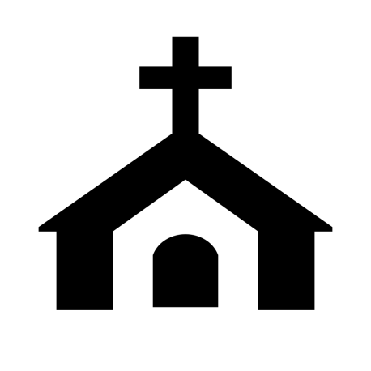
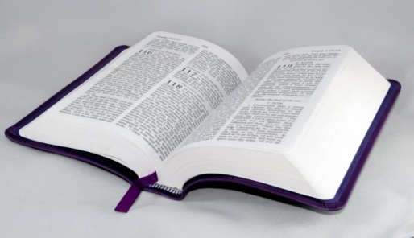
Sacred Texts & Sites
Sacred Text:
  the Holy Bible: inspired by the word of God
    Old Testament (the Torah in Judaism)
    New Testament: the gospels by Matthew, Mark, Luke, & John
  The Ten Commandments
Sacred Sites:
  Bethlehem where Jesus was born
  Churches or chapels for worship & celebration

Slide 12
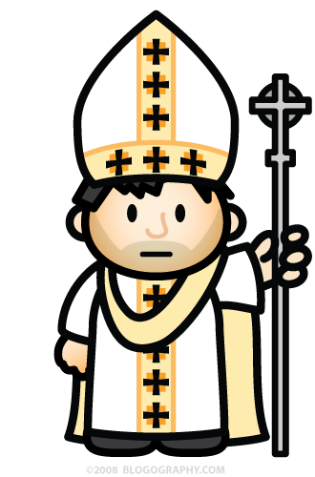
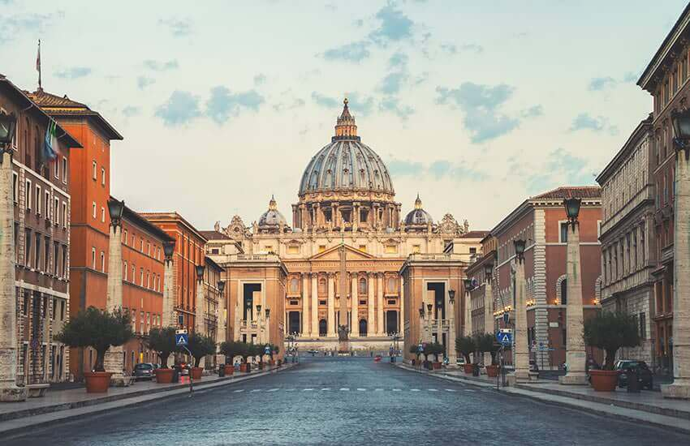
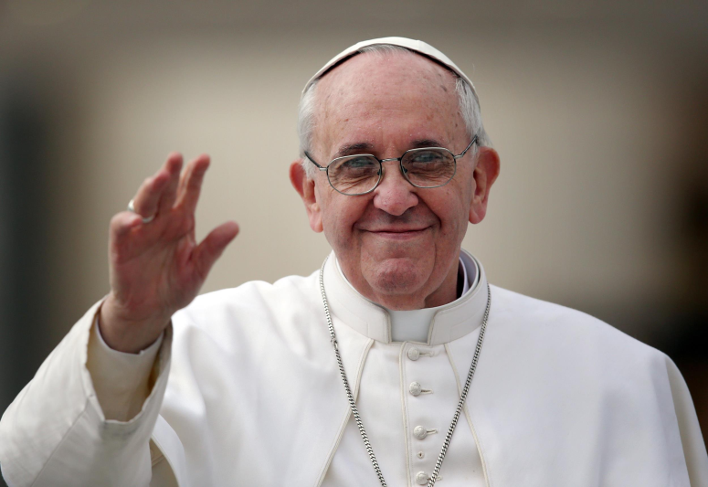
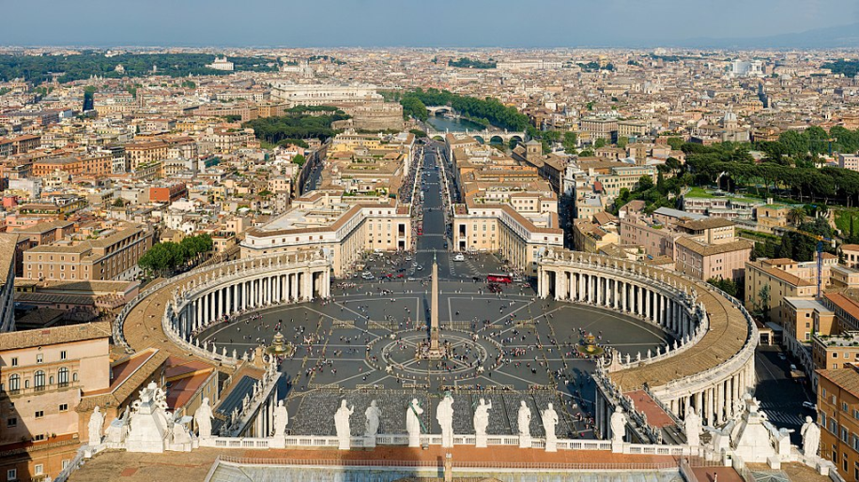
Sacred Sites
The Vatican in Vatican City (Italy) is where the Roman Catholic Pope lives.
The current Pope is Pope Francis.

Slide 13
Sects of Christianity
2.2 billion Christians have split into dozens of sects that have emerged over the last 2,000 years including:
Roman Catholic (largest)
Baptist
Mormon
Protestant
Lutheran
Eastern Orthodox
  Methodist
  Presbyterian
  Amish
  Quaker
  Anglican
  Non-denominational

Slide 14
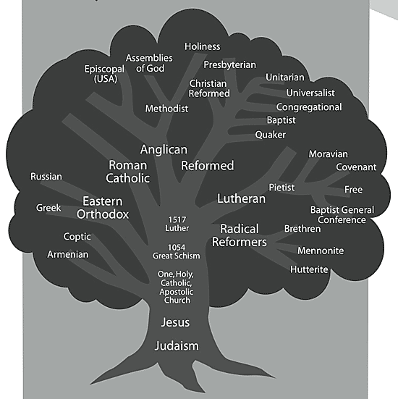
Divisions of Christianity

Slide 15
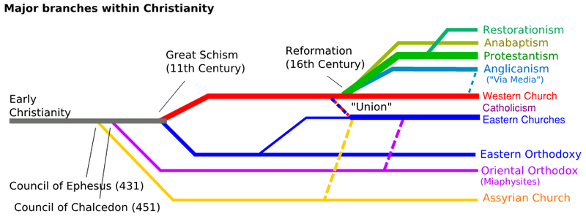
Divisions of Christianity

Slide 16
Islam
Islam is the fastest growing religion in the world
Largest numbers are found in the Middle East, Pakistan, India, Eastern Europe, Africa, & Indonesia
Metro Detroit has a large Muslim community
Islam was founded around 610 CE by Muhammad after he was visited by the angel Jibreel who ordered him to recite the words of Allah (God)
Muhammad taught in Makkah (Mecca)

Slide 17
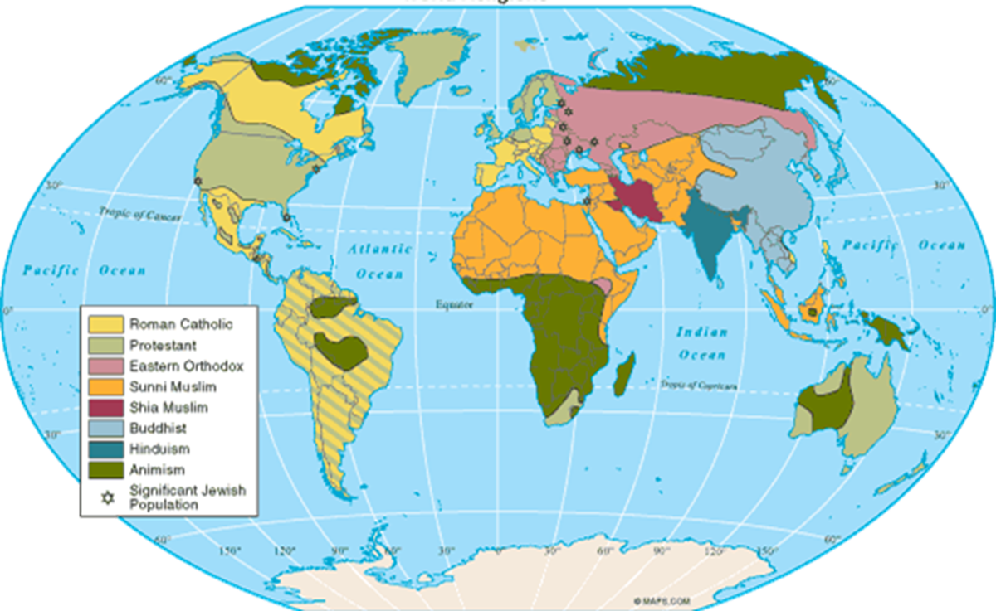
Islamic Beliefs

Slide 18
Islamic Beliefs
Monotheistic: Allah is the only God
The Five Pillars:
  Shahadah: “There is no god except Allah, Muhammad is the messenger of Allah”
  Salah: pray 5 times a day facing Mecca (ritual)
  Zakah: a fixed portion of money is donated to the poor
  Sawm: refrain from food or drink during the month of Ramadan from sun up to sun down; moves up 40 days or so each year
  Hajj: make a pilgrimage to Mecca at least once in life; hajji

Slide 19
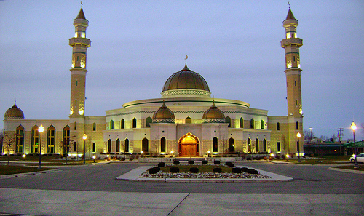
Islamic Beliefs
Mecca Video

Slide 20
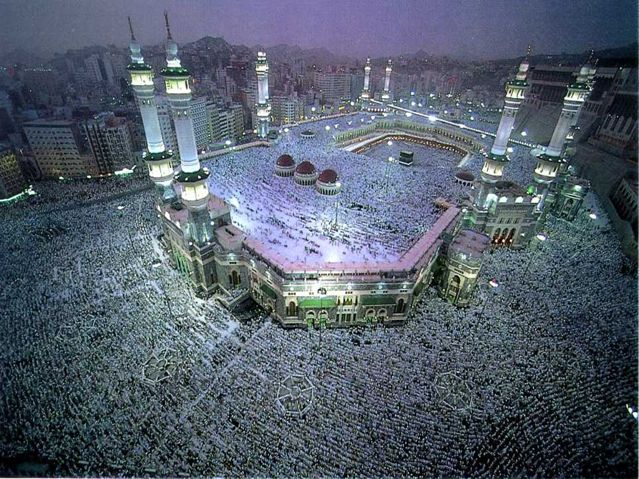
Islamic Beliefs

Slide 21
Sacred Texts, Sects, & Sites
Qur’an: Muhammad wrote down the word of Allah; also believe that the Torah & the Bible are the word of God
It is to be written & read in Arabic
Mecca: holiest place; pray facing it 5 times a day
Sects:
Sunni: believe that rulers should be followers of Muhammad; largest number of Muslims
Shi’a: believe that rulers should ascend from Muhammad

