Slide 1
Inheritance and Variation of Traits
PowerPoint Practice

Slide 2
Inherited Traits vs. Learned Behaviors
https://youtu.be/KT5BVr7vOzY
What types of inherited traits can you think of?
What types of learned behaviors can you think of?

Slide 3
Instinct

Slide 4
Carbon Dioxide

Slide 5
Energy (Plants and Animals)

Slide 6
Frog Life Cycle
Skip to minute 3:10 in the video
https://youtu.be/rJOOxlFs9Is
What are the stages of the frog life cycle?

Slide 7
Bird Adaptations https://youtu.be/ST4ZDuVOhBM

Slide 8
Raccoon Adaptation https://youtu.be/-L9uov8InsM

Slide 9
Polar Bear Adaptations https://youtu.be/1zRGzlWqce4

Slide 10
Giraffe Adaptations https://www.youtube.com/watch?v=bNYXweQ81vI

Slide 11
Is it an inherited trait or learned behavior?
Eye Color

Slide 12
Is it an inherited trait or learned behavior?
Playing the piano

Slide 13
Is it an inherited trait or learned behavior?
Freckles

Slide 14
Is it an inherited trait or learned behavior?
Height

Slide 15
Is it an inherited trait or learned behavior?
Riding a bike

Slide 16
Is it an inherited trait or learned behavior?
Dimples

Slide 17
Is it an inherited trait or learned behavior?
Using a pencil

Slide 18
Is it an inherited trait or learned behavior?
Knowing the alphabet

Slide 19
Fill in the blank
An _______________ is a behavior that does not have to be learned.

Slide 20
Fill in the blank
Plants and animals need ______________to survive.

Slide 21
Fill in the blank
During photosynthesis, a plant must capture__________________.

Slide 22
Fill in the blank
Animals must use energy to get what they ___________from their environment.

Slide 23
Fill in the blank
When an animal uses their energy, it must respond to ______________. For example, when a lion is hungry, it will hunt for food.

Slide 24
What are the names of the stages of a frog’s life cycle called?

Slide 25
How can a giraffe survive in the savannas?

Slide 26
How can a polar bear survive in the Arctic?

Slide 27
How can a raccoon survive in the city?

Slide 28
Which dog would be best suited for Michigan’s climate? Why?

Slide 29
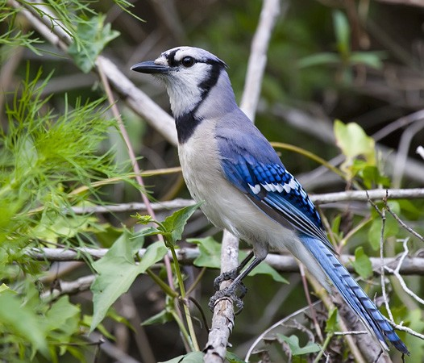
How can a bird survive in the forest? What types of adaptations does it need?

