Slide 1
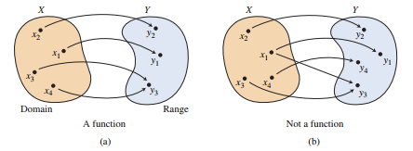
Section 1.2 p 80---98 Functions
A function from a set D to a set R is a rule that assigns to every element in D a UNIQUE element in R.
The set D of all input values is the domain of the function
The set R of all output values is the range of the function
f(2)=8
f(2)=4 Not a function
Reminder Vertical Line Test
The value of y depends on x: y is the dependent variable and x is the independent variable

Slide 2
Reminder Vertical Line Test
The value of y depends on x: y is the dependent variable and x is the independent variable

Slide 3
The Domain of some Basic Functions
The machine analogy
Polynomials
${3x}^{2}+4x$
${2x}^{3}+3x^{2}+2x−7$
$Volume of a sphere : v\left(r\right)= \frac{4}{3}$∏$r^{3}$ Domain?
The domain should fit the situation
Always Think about restrictions

Slide 4
Find the domain of each of the following functions
$f\left(x\right)=\left|x+2\right|$
$f\left(x\right)=\sqrt{x}$
$f\left(x\right)=\sqrt{x+2}$
$f\left(x\right)=\frac{2}{x}$
$f\left(x\right)=\frac{2}{x+3}$

Slide 5
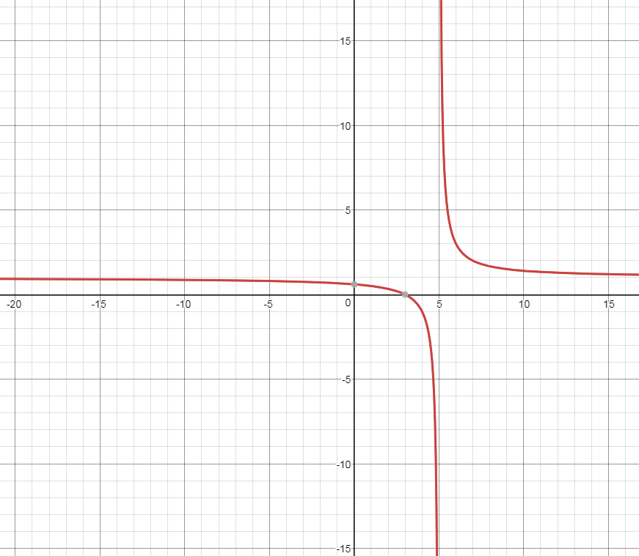
$$f\left(x\right)=\frac{(x+2)(x−3)}{(x+2)(x−5)}$$
Type of function
Restrictions?
Graph it, what do you notice?

Slide 6
$f\left(x\right)=\frac{(x+2)(x−3)}{(x+2)(x−5)}$
An asymptote is a line that a graph approaches without touching
A vertical asymptote occurs in a rational function at any value of x for which the denominator is equal to 0, but for which the numerator is not equal to 0.
When a value of x sets both the denominator and the numerator of a rational function equal to 0, there is a hole in the graph; that is, a single point at which the function has no value

Slide 7
Examples: Name the vertical asymptotes and holes in the graphs of the following equations:
f (x) = $\frac{(x−2)(x+4)}{(x−3)(x+3)(x+4)}$
f (x) = $\frac{x^{2}(x+2)}{x^{3}{(x−2)}^{2}}$
f (x) = $\frac{{(x−1)}^{2}}{(x+1)(2x−3)(\frac{1}{2}x+6)}$

Slide 9
Continuous vs Discontinuous
A function is continuous at a point, if the graph does not come apart at that point

Slide 10
Example 3 Page 82
$f\left(x\right)=\sqrt{x+3}$
$g\left(x\right)=\frac{\sqrt{x}}{x−5}$
$A\left(s\right)=\frac{\sqrt{3}}{4}s^{2}$ where A(s) is the area of an equilateral triangle and s is the length of each side
Now let’s graph all 3 and check the domain

Slide 11
$$f\left(x\right)=\sqrt{x+3}$$

Slide 12
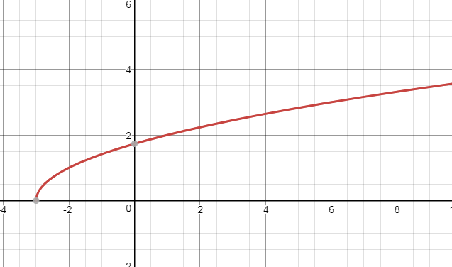

Slide 13
$$g\left(x\right)=\frac{\sqrt{x}}{x−5}$$

Slide 14
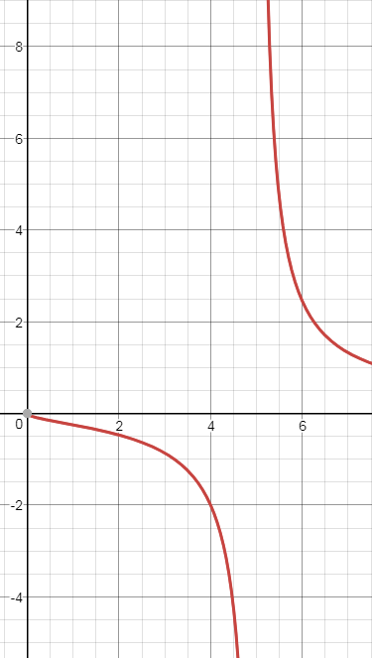

Slide 15
$A\left(s\right)=\frac{\sqrt{3}}{4}s^{2}$

Slide 16
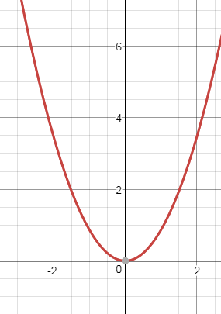

Slide 17
Find the domain of the following functions
$f\left(x\right)=\frac{x+3}{x−2}$
$f\left(x\right)=\left(x+3\right)\left(x−2\right)$
$f\left(x\right)=\frac{x^{2}−4}{x−2}$

Slide 19
Homework
page 95#9-16
Page 95#21-24

Slide 20
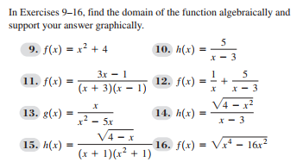

Slide 21
Find the domain of
$$f\left(x\right)=\frac{x+2}{x^{2}+5x+6}$$

Slide 22
Find the domain of the following functions

Slide 24
Discontinuity
Determine the points of discontinuity of the following functions and state whether at those points there is a vertical asymptote or a hole
$f\left(x\right)=\frac{2}{x−4}$
$g\left(x\right)=\frac{2}{x^{2}+1}$
$h\left(x\right)=\frac{(x+2)(x−4)}{(x−4)}$

Slide 25
Using a graphing calculator, graph the following functions. What do you notice?
$f\left(x\right)=\frac{2x^{3}+7x−2}{5x^{3}+6x^{2}+7}$
g$\left(x\right)=\frac{2x^{3}+7x−2}{5x^{4}+6x^{2}+7}$
$f\left(x\right)=\frac{2x^{3}+7x−2}{5x^{2}+6x+7}$

Slide 26
Horizontal Asymptotes
In order the find H.A look at the degree of the polynomials in the numerator and denominator
If both polynomials are the same degree, divide the coefficients of the highest degree terms.
Example: Both polynomials are 2nd degree, so the asymptote is at ---------------
2. If the polynomial in the numerator is a lower degree than the denominator, the x-axis (y = 0) is the horizontal asymptote.
3. If the polynomial in the numerator is a higher degree than the denominator, there is no horizontal asymptote. There is a slant asymptote, which we will study in a later lesson.

Slide 28
Identify any Horizontal or vertical Asymptotes algebraically then graph it and check your answers
$f\left(x\right)=\frac{x−5}{3x^{2}+1}$
$g\left(x\right)=\frac{2x^{2}}{4−x^{2}}$
$h\left(x\right)=\frac{x}{x^{2}−x−2}$

Slide 29
Classwork p95#55-62
Homework p95#63-66

