Slide 1
Pre calculus notes
Section P7
Page 54-59

Slide 2
Linear Inequalities Review
Solve the following inequalities and Graph the solution using a number line
X+4>0
2x+3<0
-x+5>0

Slide 3
Solving Quadratic Inequalities
Section P7: p54-59
Graphically
Graph the function
Find the parts of the parabola that are:
above the x axis if $>$
or below the x axis <
Read the corresponding interval (read x values)

Slide 4
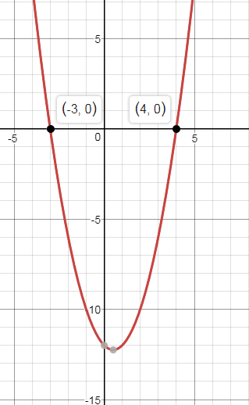
Example 3 p55
$$x^{2}−x−12>0$$
$x^{2}−x−12=0$
(x+3)(x-4)=0

Slide 5
Solve the Quadratic Inequality Algebraically
$$x^{2}−x−12>0$$
Factor it and find the zeros

Slide 6
Draw a number line (sign chart) and locate the zeros

Slide 7
Choose a number from each interval, plug in in the factored form, then check the sign of the inequality. Fill in the signs of each interval on the number line

Slide 8
Choose (highlight) the correct interval

Slide 9
$$x^{2}−x−12>0$$
(x-4)(x+3)

Slide 10
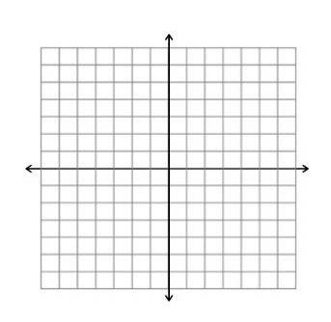
Example 4 p55
$${2x}^{2}+3x≤20$$
Solve the above inequality graphically and algebraically
Graphically

Slide 11
Algebraically
${2x}^{2}+3x≤20$

Slide 12
Example 6 page 56
$x^{2}+2x+2<0$

Slide 13
Page 58 #15
$x^{3}−x≥0$

Slide 14
Page 58#13: Solve algebraically
${2−5x−3x}^{2}<$0

Slide 15
Homework
Page 58#9-16
Page 58#17-26 (use a calculator)

