Slide 1
Chapter 8 Project
Sections 8.2-8.3 p591, p609

Slide 2
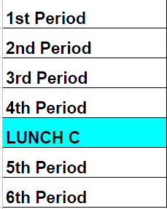
Bell work 05/15
Solve the following system of equations:
$$y=\ln{x}+2$$
$y=e^{x}−1$

Slide 4
Chapter 8 Project: Ellipses and Hyperbolas (Due Wednesday 05/22) Sections 8.2-8.3 p591, p602 to 609
Group size: up to 4 students max
Group combination: seniors separate than juniors
Format: you can decide (google slides, tri fold, 3D shapes…)
Grade: 14 summative extra credit for seniors
14 points as an assignment grade for juniors
The project should include at least 14 slides
The project should cover the following topics:
Equations
Translations
Finding vertices and foci
Real world application
Practice problems p599#1-6 (include 2 in your slides)
Practice problems p599#7-16
Practice problems p609#1-10

Slide 5
Presentation
Wednesday 05/22: 1st, 2nd and 3rd hour
Thursday 05/23: 4th and 5th
Between 11 and 15 min for each group

