Slide 1
Arithmetic & Geometric Sequences

Slide 3
Definitions
Sequences are terms organized in a particular order.
Arithmetic Sequence is a sequence with the difference between two consecutive terms constant. This difference is called the common difference.
Geometric Sequence is a sequence with the ratio between two consecutive terms constant. This ratio is called the common ratio.

Slide 4
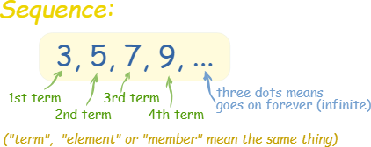
Example of a sequence

Slide 5
Section 9.4 Guessing The Sequence
Guess which sequence is arithmetic or geometric.
3, 8, 13, 18, 23, . . . 1, 2, 4, 8, 16, . . .

Slide 6
Group Work
Card sorting activity

Slide 8
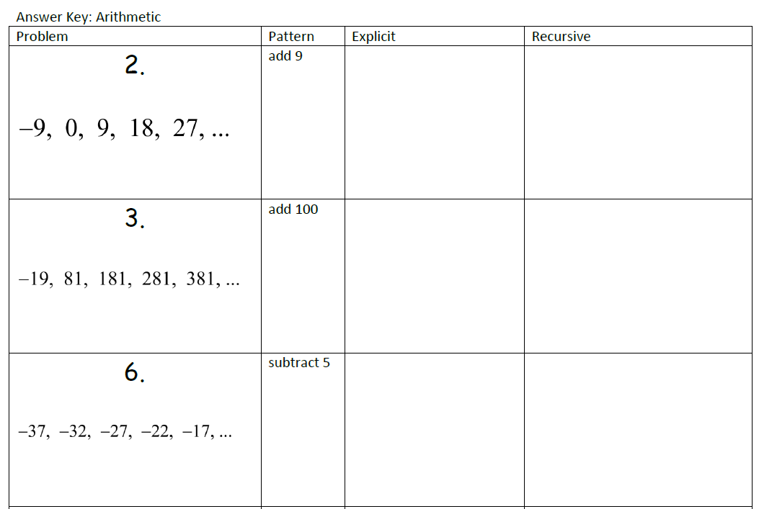
General
General
a₁₀
a₆

Slide 10
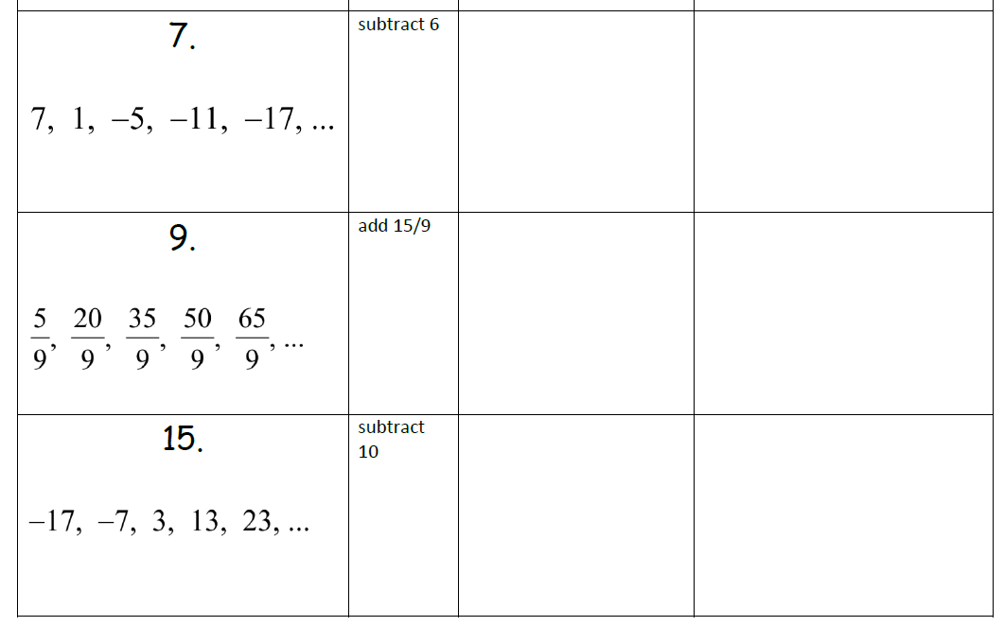

Slide 11
Practice Problems pg. 676 21-28 (part B only)
21. 6, 10, 14, 18…….. Find the tenth term.
25. 2, 6, 18, 54……… Find the eighth term.

Slide 13
Arithmetic Sequence
Arithmetic definition: Pairs of successive terms that all have a common difference.
Meaning: a sequence of numbers such that the difference between the consecutive terms is constant.
For instance, the sequence 5,7,9,11,13,15… is an arithmetic progression with the common difference being 2.

Slide 15
Recursive formula:
Each term from an arithmetic sequence can be obtained recursively from its preceding term by adding d:
a_{n}=a_{n-1}+d

Slide 16
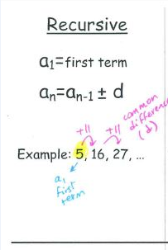

Slide 17
Example 1 Practice p676#21-24
Use the following sequnce to find:
(a)Find the common difference
(b) Find the tenth term
(c ) find a recursive rule for the nth term
(d) find the explicit rule for the nth term
-6,-2,2,6,10….

Slide 18
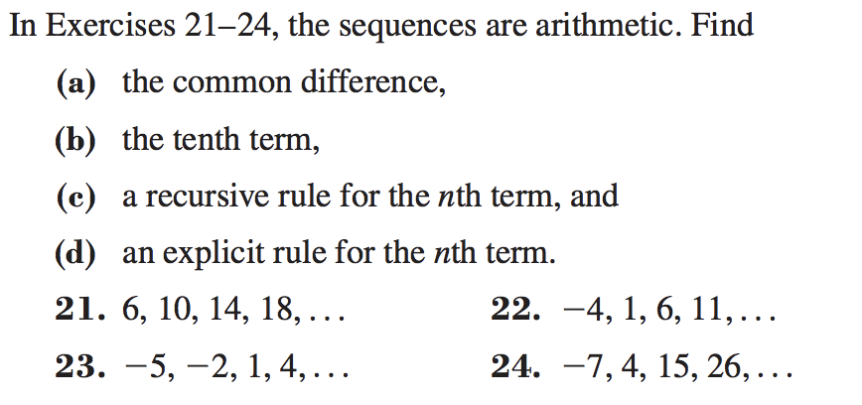

Slide 19
Geometric Sequence
A sequence of numbers where each term after the first is found by multiplying the previous one by a fixed, non-zero number called the common ratio.
R is called the common ratio.
Each term in a geometric sequence can be obtained recursively from its preceding term by multiplying by r:

Slide 20
Geometric Sequence
Recursive Formula
a_{n}=a_{n-1}*r

Slide 22
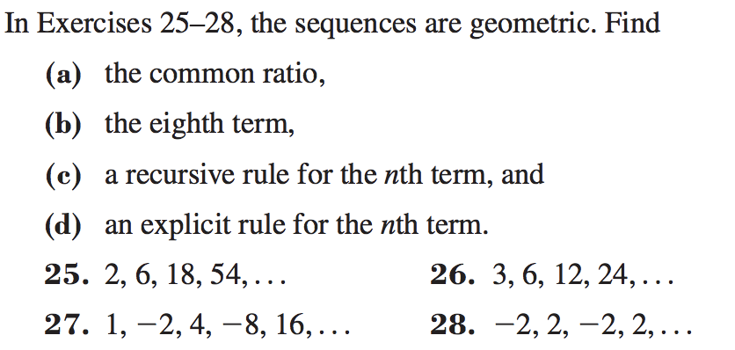

Slide 23
