Slide 1
Chapter 9
p642

Slide 2
Bellwork 05/16
Solve the following equation
$$\sin{x=\cos{x}}$$

Slide 3
9.1 Permutation/Combination
How many 3 letter “words” can be formed from the letters of the word fun? (meaning is not important)

Slide 4
How many 9 letter words (meaning is not important) can be formed from the letters of the word BUTTERFLY?

Slide 5
How many 9 letter words (meaning is not important) can be formed from the letters of the word BUMBLEBEE?

Slide 6
How many ways could you line up 4 books?

Slide 7
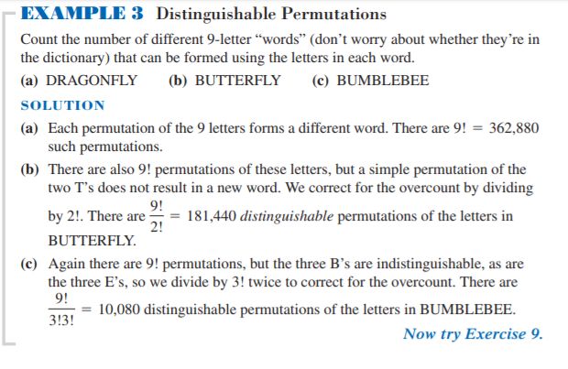
Group work
Example 3 page 644

Slide 8
Permutation Counting Formula
A teacher makes a seating chart for 22 students in a classroom with 30 desks

Slide 9
Homework p649#1-4,9,10
Copy example 6 page 646 in your notes. Copy the problem with its solution after you try it on your own (a with a, b with b…)

