Slide 1
Chapter 7
Section 7.2 Matrices

Slide 2
Bell work Tuesday 05/14
At your tables, compare your answers to #49, 50 p528.
What method did you use to solve the system of equations?

Slide 3
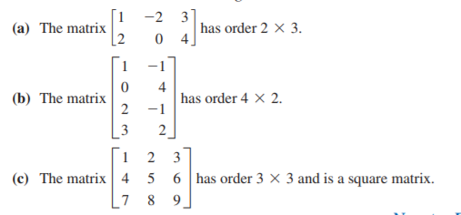
Section 7.2: Matrix
An mxn matrix (read m by n) is a rectangular arrangement (array) with m rows and n columns of real numbers.
Examples:

Slide 4
Facts
2 matrices are equal if they have same order and their corresponding elements are equal.
Matrices of different orders cannot be added or subtracted.

Slide 5
Real life application of matrices
They are used for plotting graphs, statistics and also to do scientific studies in almost different fields. Matrices are used in representing the real world data's like the traits of people's population, habits, etc. They are best representation methods for plotting the common survey things.

Slide 6
Practice Problems p540

