Slide 2
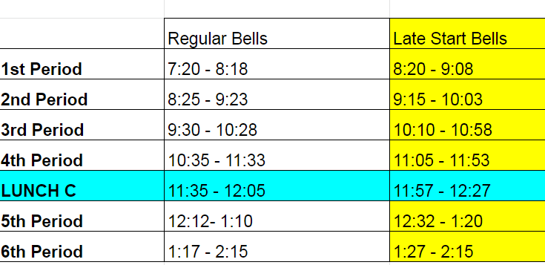
Bell work Wednesday 04/24
Accuplacer review sheet

Slide 3
Bell work key
12. A
13. D
14. C
15. B
16. C

Slide 4
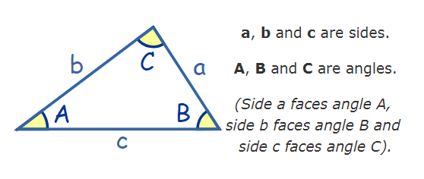
Section 5.5: The law of Sines

Slide 5
Solve triangles (AAS, ASA)
The law of sine is useful for solving triangles which means finding missing sides and angles in a triangle

Slide 7
Example 2
Solve for triangle ABC given <A=32ᴼ, <C=109ᴼ, b=40

