Slide 1
Section 4.4
Graphs of sin and cos

Slide 2
Section 4.4: Graph of sin and cos
Real life application:
Music
Architecture
Electric current
Construction
Prezi Presentation

Slide 3
Compare Both Graphs p350-351 figure 4.37A/ 4.38A

Slide 4
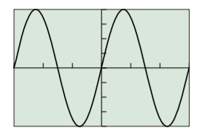
Some definitions
Amplitude: Half of the wave
Period: length of a full cycle
b number of cycles between 0 and 2∏
Frequency number of complete cycle in a unit interval
$$y=4sin\frac{2}{3}x$$

Slide 5
Practice Problems
P357#1-6 Find a
7-12 Find T
13-16 Find f
29-34 Find period, amplitude then specify viewing window, see example below

