Slide 1
Section 4.4
Graphs of sin and cos

Slide 2
Section 4.4: Graph of sin and cos
Real life application:
Music
Architecture
Electric current
Construction
Prezi Presentation

Slide 3
Compare Both Graphs p350-351 figure 4.37A/ 4.38A

Slide 4
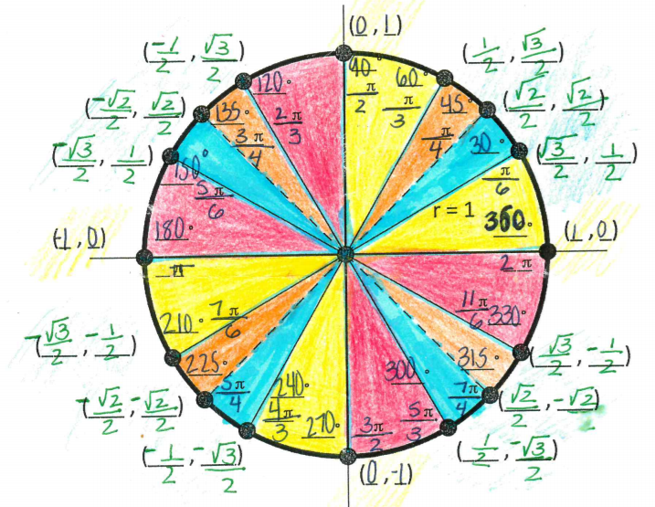
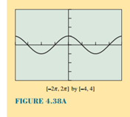
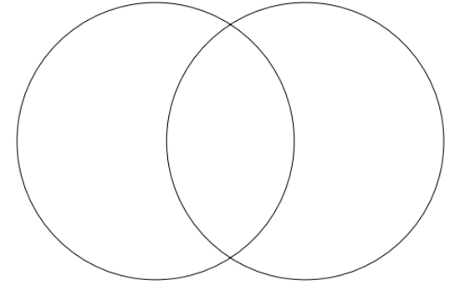

Slide 5
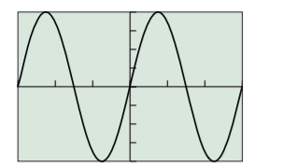
Some definitions
Amplitude: Half of the wave
Period: length of a full cycle
b number of cycles between 0 and 2∏
Frequency number of complete cycle in a unit interval
$$y=4sin\frac{2}{3}x$$

Slide 6
Practice Problems
P357#1-6 Find a
7-12 Find T
13-16 Find f
29-34 Find period, amplitude then specify viewing window, see example below

Slide 7
Desmos
Go to Desmos.com/calculator
Graph equations from p357#1-6
Open a new window
Graph equations from p357#7-12
Table talk: talk about transformations using the following word bank: v. stretch, v. compression, H. stretch, H compression, reflection across axis, Reflection across y axis
Homework check p347#7-12
P357#1-6,7-12,13-16,29-34

Slide 8
Desmos Activity
https://www.desmos.com/calculator/scgr77ajzg
https://www.desmos.com/calculator/jmzsvuetyi

Slide 9
13-16

Slide 10
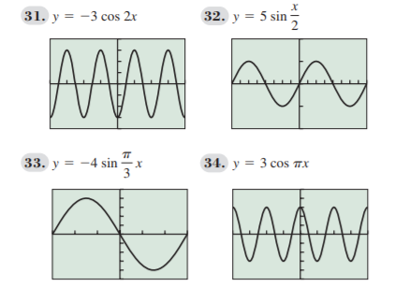
29-34

