Slide 1
SAT Bell work week 27
Week of 02/25-03/01

Slide 2
Monday 02/25
Sub

Slide 3
Tuesday 02/26
Chapter 4 Test

Slide 4
SAT Bell work Wednesday 02/27 Back of SAT sheet from last week

Slide 5
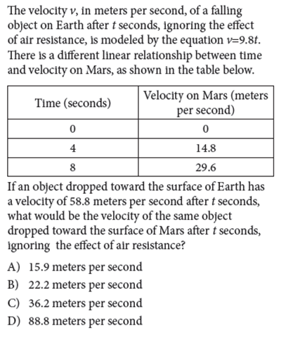
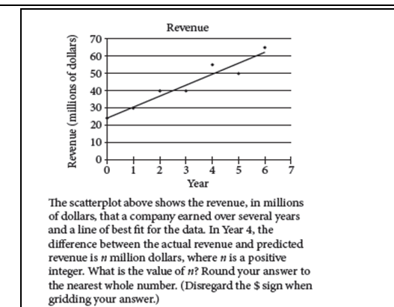
Bell work Thursday 02/28
Finish the SAT sheet (the following 2 problems are left)

Slide 6
Bellwork
Finish the SAT sheet

Slide 7
Bellwork
Finish the SAT sheet

Slide 8
Friday 03/01
SAT Bell work quiz: 01/22-02/28

