Slide 1
Bell work week 26
Week of 02/18-02/22

Slide 2
Monday 02/18
No School President’s Day

Slide 3
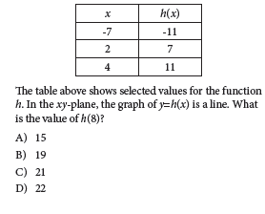
Tuesday 02/19 (calculator allowed)
Question on sheet from last week (back)
Turn in your table hw in black tray chromebooks cart (make sure your name is on it)

Slide 4
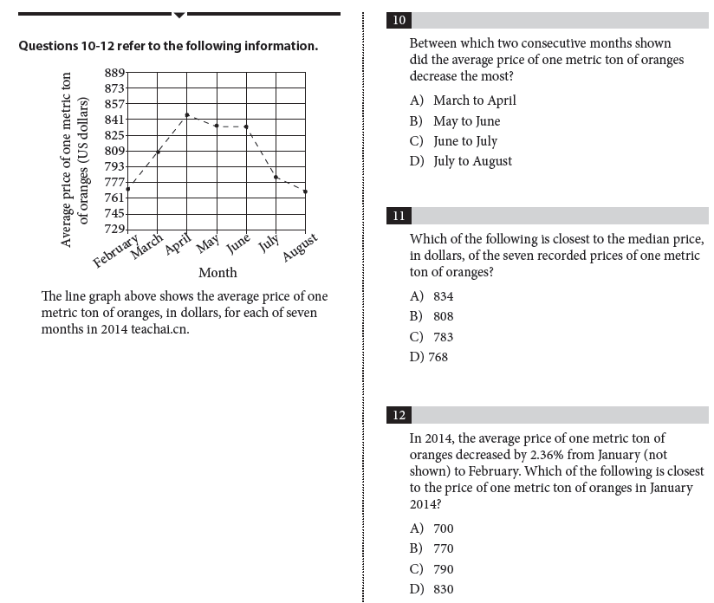
SAT Calculator Wednesday 02/20
Question 2 sheet from last week

Slide 5
Thursday 02/21
Content related Bellwork
Graph the following parent functions:
Sin x, cos x, tan x, cot x, sec x, csc x

Slide 6
Friday 02/22
SAT session 7 SHEET ON DESK
Follow calculator steps
PLZ DO NOT WRITE ON IT, IT IS A CLASS SET

