Slide 1
Bell Work week 25
Week of 02/11-02/14
(short week midwinter break)

Slide 2
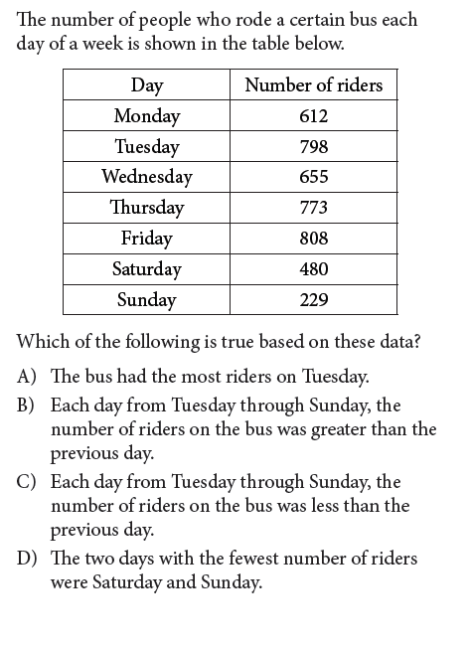
SAT calculator Monday 04/11

Slide 3
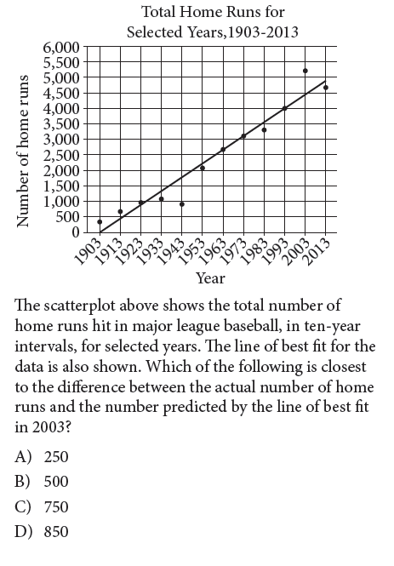
SAT calculator Wednesday 02/13 (Question 2 sheet from Monday)

Slide 4
Tuesday 02/12
No school ice day!

Slide 5
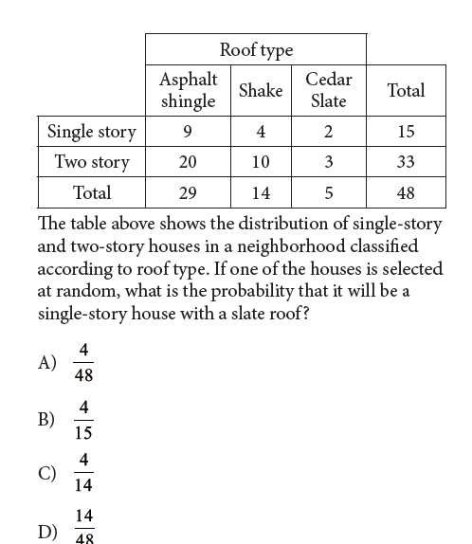
SAT calculator Wednesday 02/13

Slide 6
Thursday 02/14
On your phone graph the following equation on Desmos.com/calculator:
Describe the graph you get. Click on next slide for a surprise!

Slide 7
Happy valentine’s Day
Heart shape equation

Slide 8
Friday 02/15
No school midwinter break

Slide 9
Exit ticket
Grab your phone and graph the following equation on Desmos.com/calculator:

