Slide 1
Bell Work week 24
Week of 02/04-02/8

Slide 2
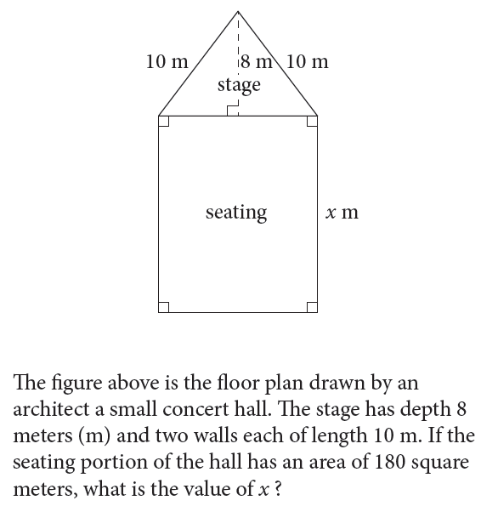
SAT books available at the library Monday 02/04 SAT Calculator

Slide 3
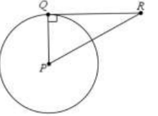
SAT NC Tuesday 02/05
In the figure above, QR is tangent to circle P at Q. If QR=1.5cm and PR=1.7 cm, what is the length of the diameter of circle P?

Slide 4
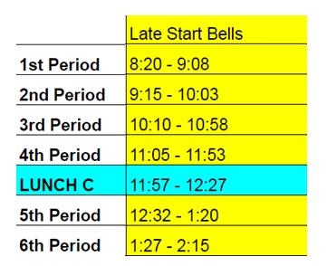
Late Start Wednesday 02/06
Snow Day!

Slide 5
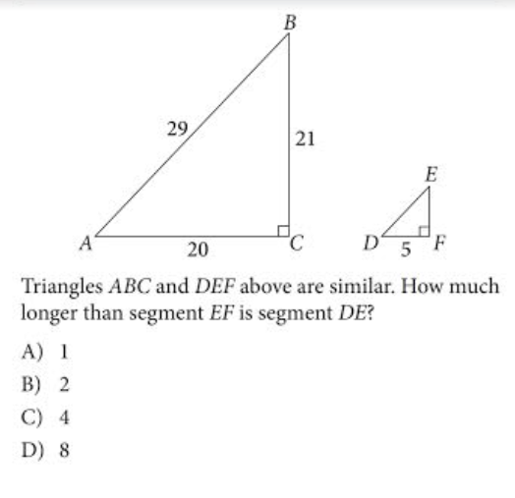
SAT Calc Thursday 2/7

Slide 6
Friday 02/08
Sub

