Slide 1
Bell Work week 23
Week of 1/28-02/01

Slide 2
Monday 01/28
Snow Day

Slide 3
Tuesday 01/29
Unit Circle Quiz+ SAT Quiz

Slide 4
Wednesday 01/30
Snow day!

Slide 5
Thursday 01/31
Snow Day!

Slide 6
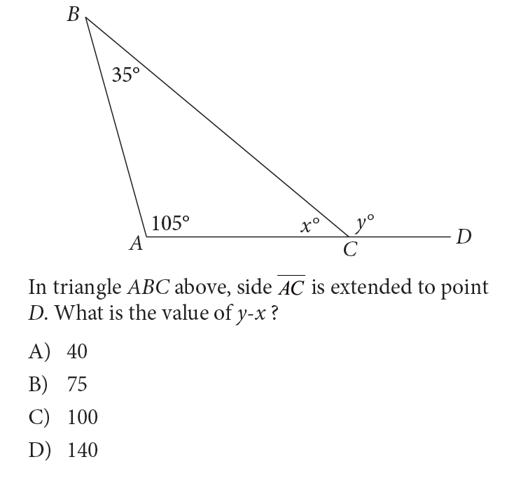
SAT BW NC Friday 02/01

