Slide 1
Bell work week 20 (week 18/19 winter break)
Week of 01/07-01/11

Slide 2
Table talk
Share one exciting thing you did during the break
Share one new year resolution

Slide 3
SAT NC Monday 01/07/2019
The number of radians in a 720-degree angle can be written as aπ, where a is a constant. What is the value of a ?

Slide 4
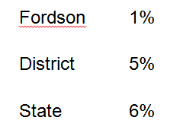
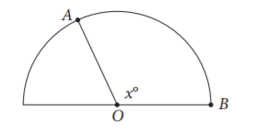
SAT NC Tuesday 01/08
Segments $\overline{OA}$ and $\overline{OB}$ are radii of the semicircle above. Arc has length 3π and OA=5. What is the value of x?

Slide 5
SAT NC Wednesday 01/09
Point A and B lie on a circle with radius 1, and arc has a length $\frac{π}{3}$. What fraction of the circumference of the circle is the length of arc
?

Slide 6
Tutoring
Today 1:15-2:00
Tomorrow: 1:15-2:45
Tuesday 01/15: 1:15-3:15
SAT calc sessions review tomorrow, SAT semester assessment Monday

Slide 7
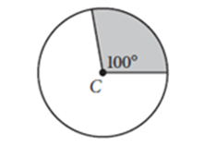
SAT Calc Thursday 01/10
Point C is the center of the circle above. What fraction of the area of the circle is the area of the shaded region?

Slide 8
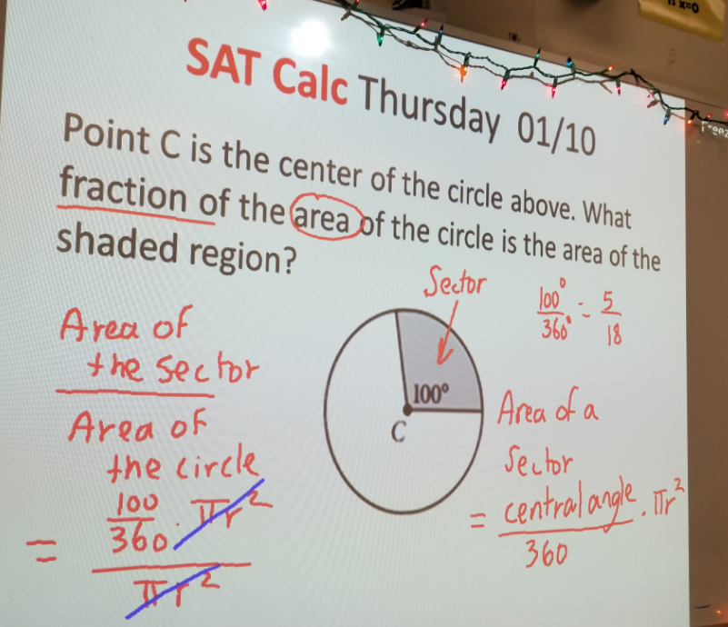

Slide 9
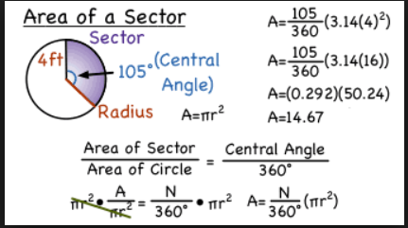

Slide 10
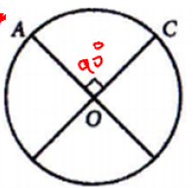
Friday 01/11
The circle above with center O has a circumference of 36.
What is the length of the minor arc AC?
9
12
18
36

