Slide 1
Chapter 4
Section 4.1

Slide 2
Trigonometric functions
Real world application: waves, electric current, telecommunication
Objective 1: convert between radian and degree

Slide 3
Convert from degree to radian p325#9-12

Slide 4
Convert from radian to degree P325:17-24

Slide 5
Arc Length Formula

Slide 6
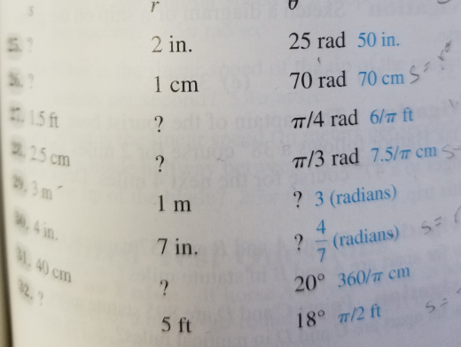
P325#25-32

Slide 8
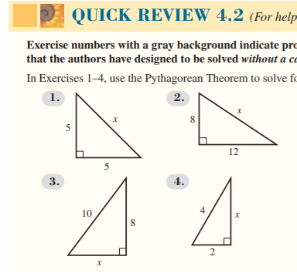
Pythagorean Theorem review
P334#1-4 Quick review pair work

Slide 10
Finding Trig Ratios

Slide 11
Homework p334-335

Slide 12
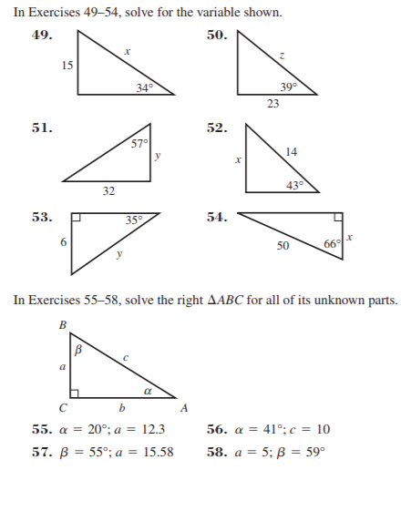

Slide 13
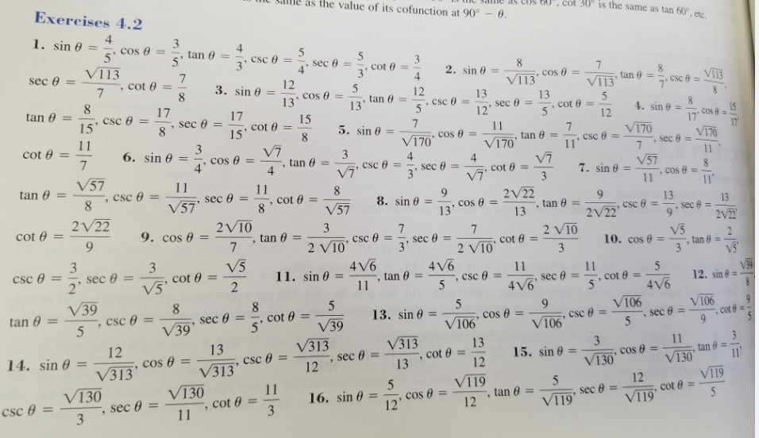

Slide 15
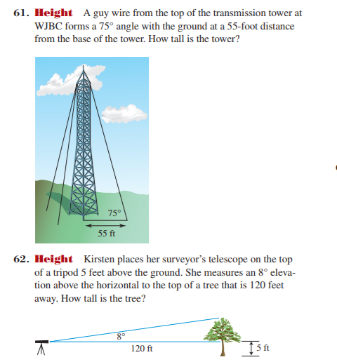
Answer 205.26 ft
Answer 21.86 ft

