Slide 1
Winter Break Khan Academy SAT assignment
2018-2019

Slide 2
Instructions
In Khan Academy, Click SUBJECTS -> SAT
Turn on "sharing with your coach" (see Powerpoint attached)
Link your Khan Academy and College Board accounts to import your PSAT/SAT results
Complete any diagnostic tests if Khan Academy asks you to
Click the PRACTICE tab then MATH.
You have to practice the full test to get full credit
You have to write down each question or print it. If you print it, you have to annotate it!
you get full credit for completing the whole test. At least 60 questions (25 no calculator, 35 calculator)
Questions have to be from all 4 areas and mixed up from subareas.
1 extra point for each additional question, maximum of 10.
To get full credit, you must show work and corrections should be made in colored pen.

Slide 3
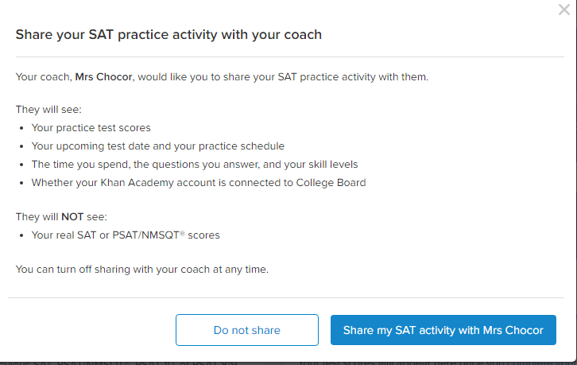
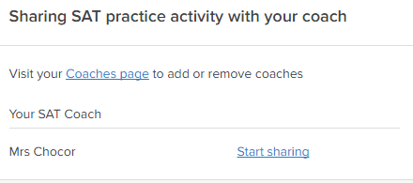

Slide 4
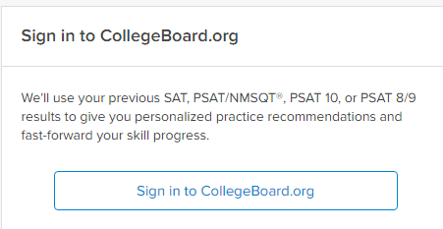

Slide 5
