Slide 1
Chapter 3
I can statements

Slide 2
Chapter 3 I can statements
I can identify whether a given function is exponential or not (from a graph, table or equation)
I can find the initial value, growth/decay factor, growth/decay rate from an exponential equation
I can write an exponential model given an initial value and r.
I can find b from r and r from b
Doubling/halving formula
I can use all log properties to switch to exponential forms, evaluate expressions and solve equations
I can use the compounded interest formula in a bank account context problem (3.6)

Slide 3
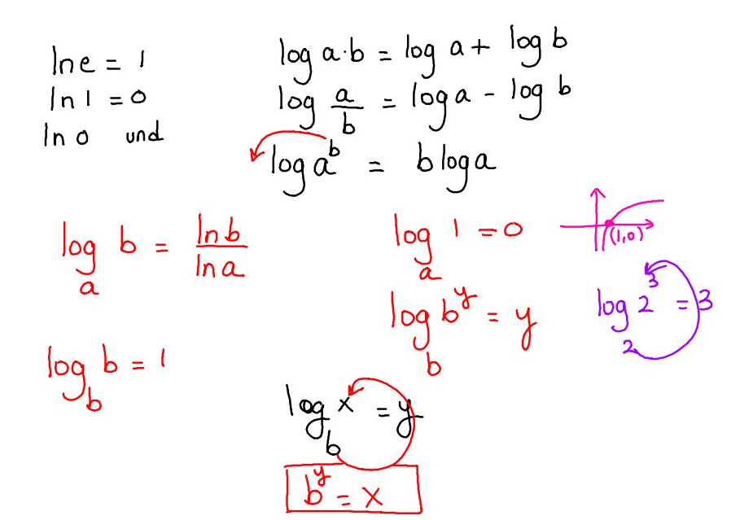
Summary of some rules

