Slide 1

Bellwork Thursday 03/01 Use your SLOT guided notes from yesterday
Factor
$x^{2}−100$
${4a}^{2}−25$
Distribute
3. ${(3v+7)}^{2}$
4. ${(m−12)}^{2}$

Slide 2
Bell work Thusday 10/25 SAT challenge Question
$${y=x}^{2}−a$$
In the equation above, a is a positive constant amd the graph of the equation in the xy-plane is a parabola. Which of the following is an equivalent form of the equation?
$y=\left(x−a\right)\left(x+a\right)$
$y=\left(x+\sqrt{a}\right)\left(x−\sqrt{a}\right)$
$y=(x+\frac{a}{2}$)($x−\frac{a}{2})$
$y={(x+a)}^{2}$

Slide 3
Which of the following expressions is equivalent to ${16x}^{4}−81?$
($4x^{3}−9)(4x+9)$
($2x−3)(2x+3)(4x^{2}−9)$
($2x−3)(2x+3)(4x^{2}+9)$
${(2x−3)}^{4}$

Slide 4
Which of the following is equivalent to ${(a+\frac{b}{2})}^{2}?$
$a^{2}+\frac{b^{2}}{2}$
$a^{2}+\frac{b^{2}}{4}$
$a^{2}+\frac{ab}{2}+\frac{b^{2}}{2}$
$a^{2}+\frac{ab}{2}+\frac{b^{2}}{2}$

Slide 5
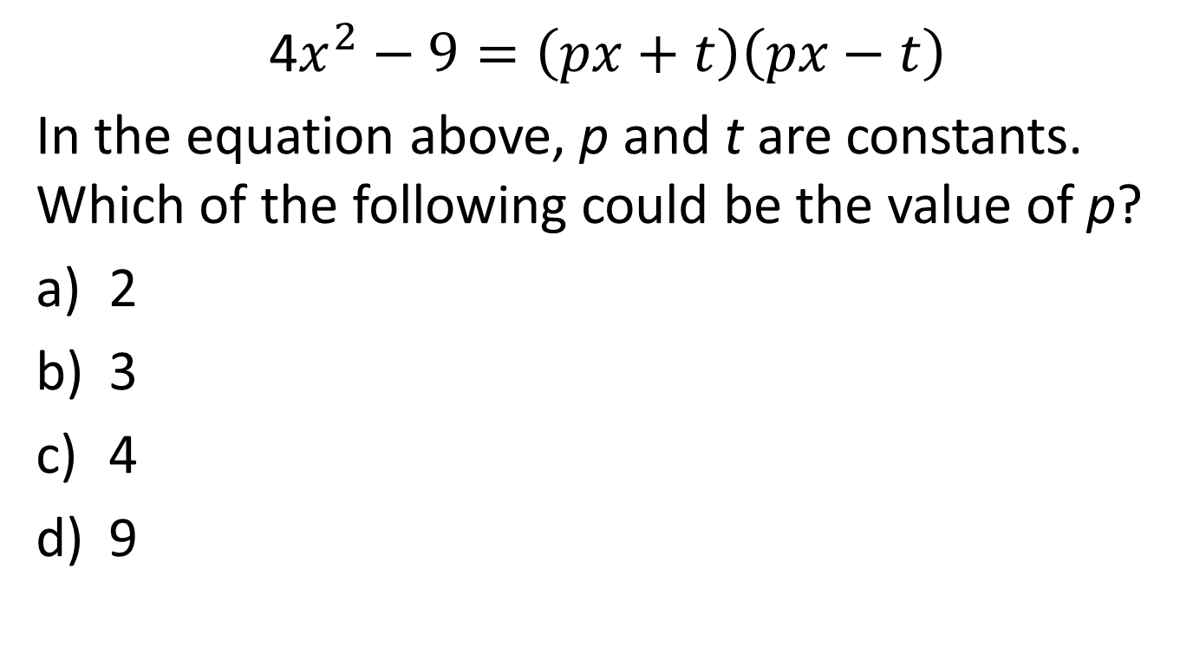
4$x^{2}−9=\left(px+t\right)\left(px−t\right)$
In the equation above, p and t are constants. Which of the following could be the value of p?
2
3
4
9

Slide 6
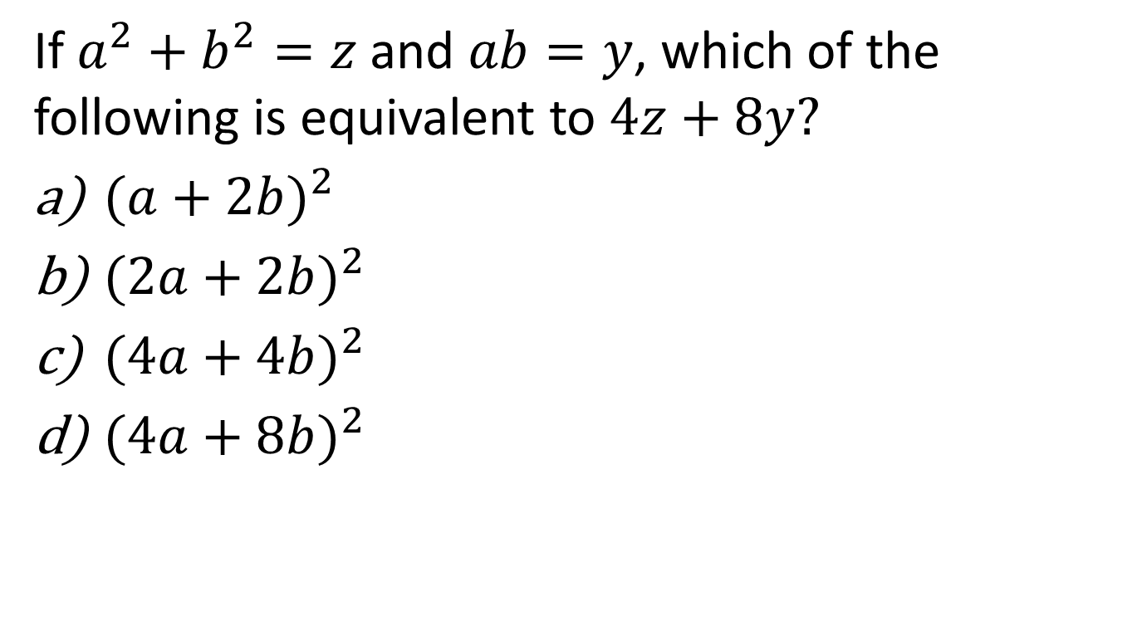
If $a^{2}+b^{2}=z$ and $ab=y$, which of the following is equivalent to $4z+8y?$
${(a+2b)}^{2}$
${(2a+2b)}^{2}$
${(4a+4b)}^{2}$
${(4a+8b)}^{2}$

Slide 7
$${9a}^{4}+12a^{2}b^{2}+4b^{4}$$
Which of the following is equivalent to the expression shown above?
${(3a^{2}+2b^{2})}^{2}$
${(3a+2b)}^{4}$
${(9a^{2}+4b^{2})}^{2}$
${(9a+4b)}^{4}$

