Slide 1
Section 2.6
Graphs of Rational Functions

Slide 2
Section 2.6 Graphs of Rational Functions
Objective: Graph a rational function without a calculator
Example 1 Graph the following function:
$$f\left(x\right)=\frac{x^{2}−9}{x^{2}+4x+3}$$
Steps:
Factor the Numerator N and Denominator Completely
Find the domain Restrictions D≠0, Equal D to 0 (If N has any restrictions √, log… take it into consideration)
Find the vertical asymptotes Equal the D to zero (Check for holes)
Find the horizontal Asymptotes Compare the degree of N and D follow the rules
Find the x intercept Equal the Numerator to 0 (Because a fraction equal to 0 if N=0)
Find the y intercept Plug 0 for x
Sketch the graph

Slide 3
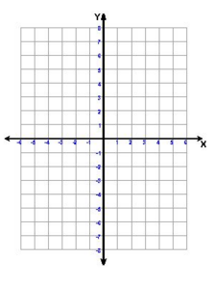

Slide 4
Example 2
$\frac{{4x}^{2}−16}{x^{2}−5x+6}$

Slide 6

Example 3
$f\left(x\right)=\frac{x}{x^{2}−4}$

Slide 8

Example 4
$f\left(x\right)=\frac{−3}{x−2}$

Slide 10

Example 5
$f\left(x\right)=5−\frac{3}{x−2}$

Slide 12
Homework
P226#31-36 Find VA, HA, x int, y int then match the graph. MUST SHOW WORK!

Slide 13
